Slide 1
Optical Instruments
Ray Optics
and Optical Instruments
Microscope and Telescope
01
Notes:
Source: 09-Ray Optics.pdf, Chapter 9, printed pp. 221–248. All content and original figure crops derive only from the supplied PDF.

Slide 2
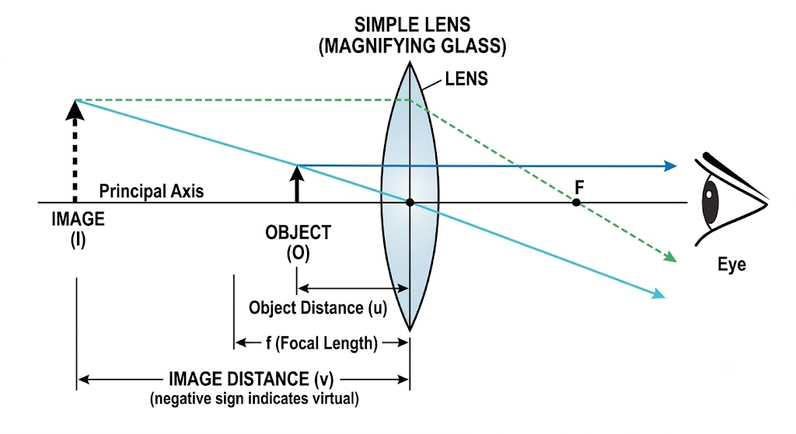

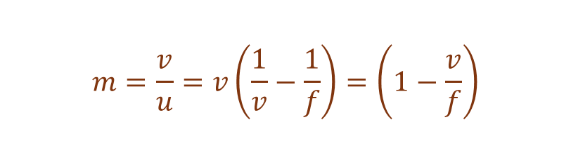
The simple microscope
Magnification
A converging lens of short focal length acts as a magnifier.
$$m=\frac{v}{u}=v\left(\frac{1}{v}−\frac{1}{f}\right)=\left(1−\frac{v}{f}\right)$$
Place the object at or within the focal length.
The virtual, erect image can lie at the near point or at infinity.
For Relaxed-eye viewing.
image should be formed at Least Distance of Distinct Vision .
V=-D
Thus
$$M=1+\frac{D}{f}$$
Notes:
Source: 09-Ray Optics.pdf, Chapter 9, printed pp. 240–242. All content and original figure crops derive only from the supplied PDF.
D ≈ 25 cm is the least distance of distinct vision. An image at infinity allows relaxed viewing.

Slide 3
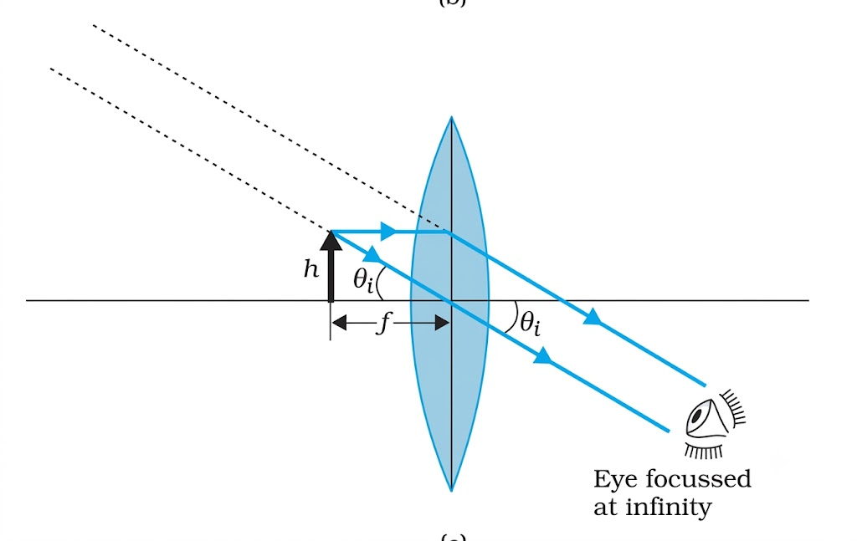


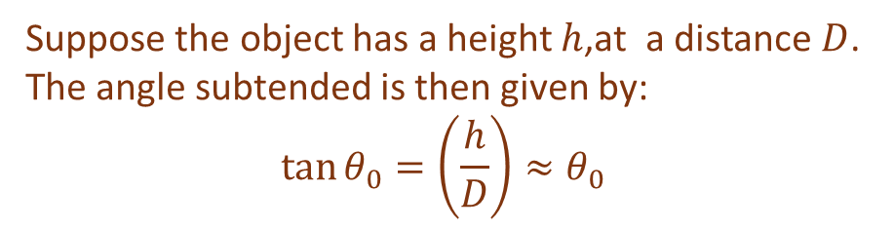
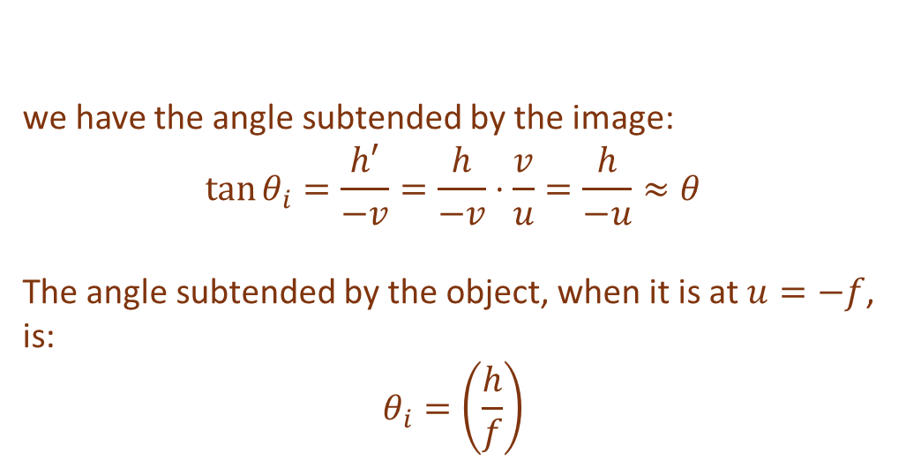
Angular magnification
we have the angle subtended by the image:
$${\tan{θ}}_{i}=\frac{h′}{−v}=\frac{h}{−v}⋅\frac{v}{u}=\frac{h}{−u}≈θ$$
The angle subtended by the object, when it is at $u=−f$, is:
$$θ_{i}=\left(\frac{h}{f}\right)$$
Suppose the object has a height $h$,at a distance $D$. The angle subtended is then given by:
$${\tan{θ}}_{0}=\left(\frac{h}{D}\right)≈θ_{0}$$
$$m=\left(\frac{θ_{i}}{θ_{0}}\right)=\frac{D}{f}$$
From the relations:
$$\frac{h′}{h}=m=\frac{v}{u}$$
M = D/f
Notes:
Source: 09-Ray Optics.pdf, Chapter 9, printed pp. 241–242. All content and original figure crops derive only from the supplied PDF.
The magnifier lets the object come closer than the normal near point.

Slide 4
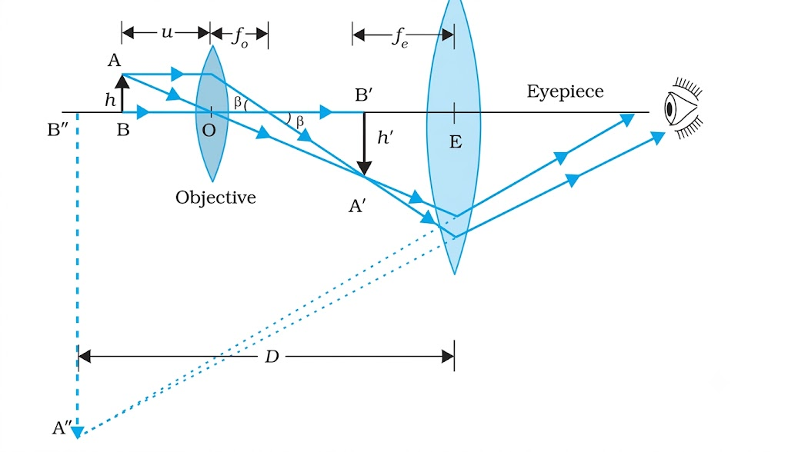
The compound microscope
Objective
Eyepiece
Final image
Forms a real, inverted and enlarged intermediate image.
Acts as a simple magnifier for the intermediate image.
Virtual and inverted relative to the original object.
Notes:
Source: 09-Ray Optics.pdf, Chapter 9, printed pp. 243–244. All content and original figure crops derive only from the supplied PDF.

Slide 5
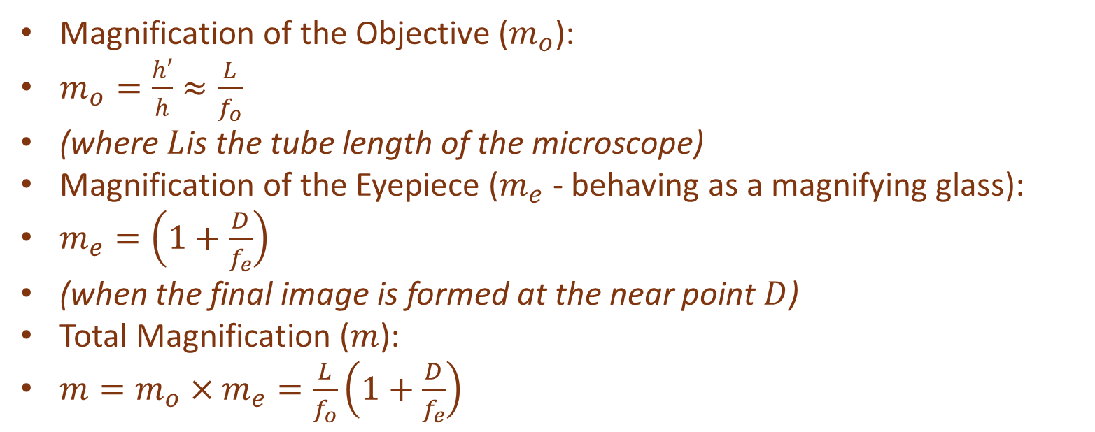
Compound microscope magnification
Magnification of the Objective ($m_{o}$):
$m_{o}=\frac{h′}{h}≈\frac{L}{f_{o}}$
(where $L$is the tube length of the microscope)
Magnification of the Eyepiece ($m_{e}$ - behaving as a magnifying glass):
$m_{e}=\left(1+\frac{D}{f_{e}}\right)$
(when the final image is formed at the near point $D$)
Total Magnification ($m$):
$m=m_{o}×m_{e}=\frac{L}{f_{o}}\left(1+\frac{D}{f_{e}}\right)$
Notes:
Source: 09-Ray Optics.pdf, Chapter 9, printed pp. 243–244. All content and original figure crops derive only from the supplied PDF.

Slide 6
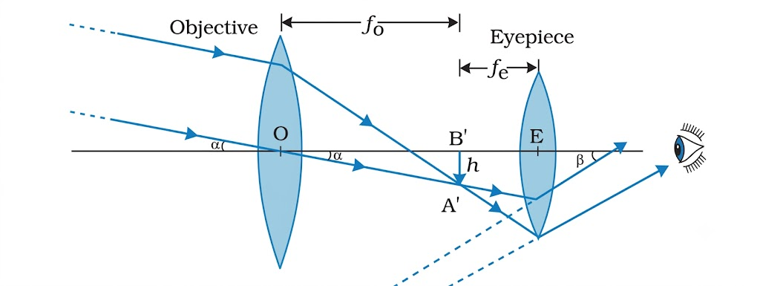
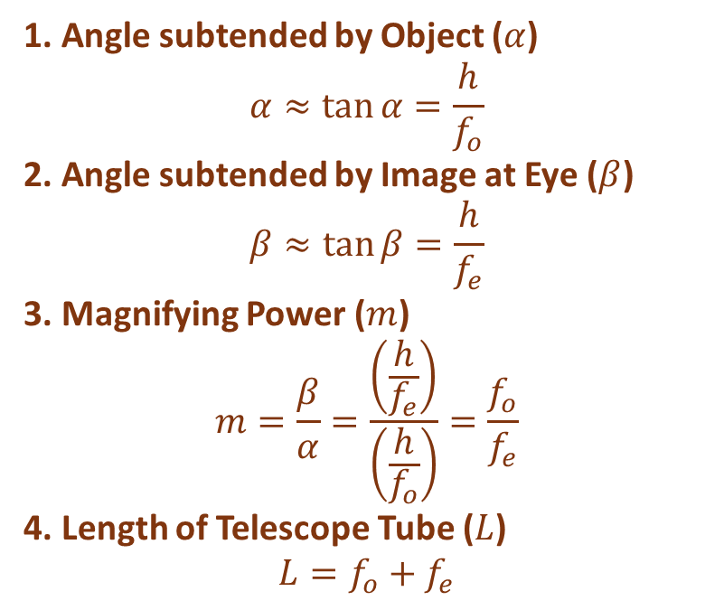
The refracting telescope
1. Angle subtended by Object ($α$)
$$α≈\tan{α}=\frac{h}{f_{o}}$$
2. Angle subtended by Image at Eye ($β$)
$$β≈\tan{β}=\frac{h}{f_{e}}$$
3. Magnifying Power ($m$)
$$m=\frac{β}{α}=\frac{\left(\frac{h}{f_{e}}\right)}{\left(\frac{h}{f_{o}}\right)}=\frac{f_{o}}{f_{e}}$$
4. Length of Telescope Tube ($L$)
$$L=f_{o}+f_{e}$$
The objective has a long focal length and large aperture.
It forms a real intermediate image of the distant object.
The eyepiece produces the final inverted image at infinity.
Notes:
Source: 09-Ray Optics.pdf, Chapter 9, printed pp. 244–245. All content and original figure crops derive only from the supplied PDF.
Magnification magnitude in normal adjustment. Example: fₒ = 100 cm and fₑ = 1 cm give M = 100.

Slide 7
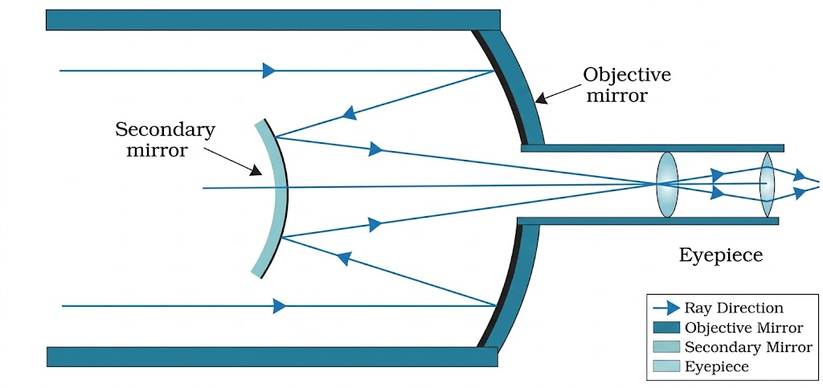
The reflecting telescope
A concave primary mirror replaces the large objective lens.
Mirrors avoid chromatic aberration and allow support across their back surface.
A Cassegrain arrangement uses a secondary mirror and a hole in the primary.
A large objective aperture improves light gathering and the ability to distinguish closely spaced objects.
Notes:
Source: 09-Ray Optics.pdf, Chapter 9, printed pp. 245–246. All content and original figure crops derive only from the supplied PDF.
A large objective aperture improves light gathering and the ability to distinguish closely spaced objects.

