Slide 1
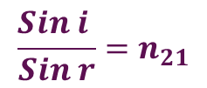
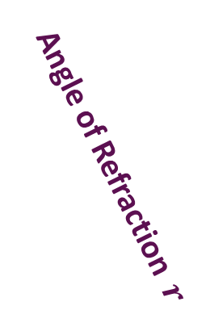
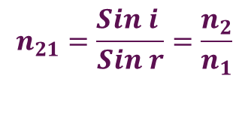
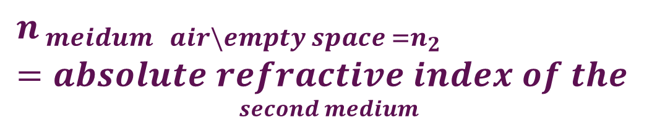

Refraction
Angle of incedence
$$\frac{Sin i }{Sin r}=n_{21}$$
Incident Ray
i
Point of incedence
Medium 1
Rarer
$$n_{21}=refractive index of$$
$$second medium w.r.t first$$
Plane of Separation
Medium 2
Denser
$$n_{ meidum air\backslash empty space =n_{2}}=absolute refractive index of the$$
$$second medium$$
Normal
Refracted Ray
$$n_{21}=\frac{Sin i }{Sin r}=\frac{n_{2}}{n_{1}}$$
Angle of Refraction $r$
Rarer to Denser Closer to Normal

Slide 2


















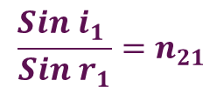

Prism
A
$$\frac{Sin i_{1} }{Sin r_{1}}=n_{21}$$
$$FromΔQRM$$
$$δ=i_{1}−r_{1}+i_{2}−r_{2}$$
$$=i_{1}+i_{2}−(r_{1}+r_{2})$$
$$FromΔQRN$$
N’
$$δ$$
M
N”
$$r_{1}+r_{2}+∠N=180$$
$$i_{2}−r_{2}$$
$$i_{1}$$
$$i_{1}−r_{1}$$
$$i_{2}$$
$$From Quadrilatera QNRA$$
Q
$$r_{1}$$
$$r_{2}$$
R
$$∠N+∠R+∠Q+∠A=360$$
S
$$∠N+90+90+∠A=360$$
P
N
$$∠N+∠A=180$$
B
C
$$r_{1}+r_{2}+∠N=∠N+∠A$$
$$r_{1}+r_{2}=∠A$$
$$δ=i_{1}+i_{2}−A$$

Slide 3





A
$$δ ↑$$
$$r_{2}$$
N”
$$δ$$
M
$$D$$
N”
$$i_{1}$$
$$i_{1}−r_{1}$$
$$i_{2}−r_{2}$$
$$i_{2}$$
Q
$$r_{1}$$
$$r_{2}$$
R
$$i →$$
S
P
N
$$Minimum Deviation D$$
B
C

Slide 4








A
$$δ ↑$$
$$r_{2}$$
N”
$$D$$
$$D$$
N”
$$i$$
$$i$$
Q
$$r$$
$$r$$
R
$$i →$$
S
P
$$At Minimum Deviation D$$
$$i_{1}=i_{2}=i$$
$$r_{1}=r_{2}=r$$
B
C

Slide 5



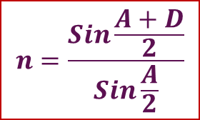





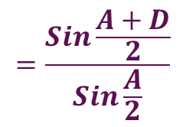
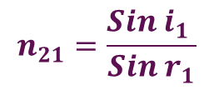
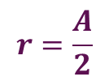


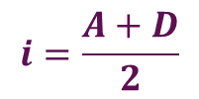









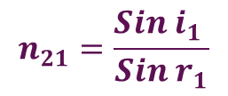
$$n_{21}=\frac{Sin i_{1} }{Sin r_{1}}$$
$$At Minimum Deviation D$$
$$i_{1}=i_{2}=i$$
$$FromΔQRM$$
$$r_{1}=r_{2}=r$$
$$r=\frac{A}{2}$$
$$δ=i_{1}−r_{1}+i_{2}−r_{2}$$
$$=i_{1}+i_{2}−(r_{1}+r_{2})$$
$$r_{1}+r_{2}=∠A$$
$$2r=∠A$$
$$FromΔQRN$$
$$r_{1}+r_{2}+∠N=180$$
$$δ=i_{1}+i_{2}−A$$
$$D=2i−A$$
$$From Quadrilateral QNRA$$
$$A+D=2i$$
$$i=\frac{A+D}{2}$$
$$∠N+∠R+∠Q+∠A=360$$
$$∠N+90+90+∠A=360$$
$$n_{21}=\frac{Sin i_{1} }{Sin r_{1}}$$
$$=\frac{Sin\frac{A+D}{2}}{Sin\frac{A}{2}}$$
$$∠N+∠A=180$$
$$r_{1}+r_{2}+∠N=∠N+∠A$$
$$r_{1}+r_{2}=∠A$$
$$n=\frac{Sin\frac{A+D}{2}}{Sin\frac{A}{2}}$$
$$δ=i_{1}+i_{2}−A$$

Slide 6
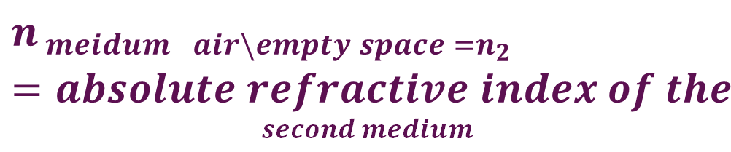
Refraction
Angle of incedence
$$\frac{Sin i }{Sin r}=n_{21}$$
Incident Ray
i
Point of incedence
Medium 1
Rarer
$$n_{21}=refractive index of$$
$$second medium w.r.t first$$
Plane of Separation
Medium 2
Denser
$$n_{ meidum air\backslash empty space =n_{2}}=absolute refractive index of the$$
$$second medium$$
Normal
Refracted Ray
$$n_{21}=\frac{Sin i }{Sin r}=\frac{n_{2}}{n_{1}}$$
Angle of Refraction $r$
Rarer to Denser Closer to Normal

Slide 7
Spherical Refracting Surfaces
Radius of Curvature R
Radius of Curvature R
C
P
C
P
Center of Curvature
Center of Curvature C
Convex
Concave

Slide 8











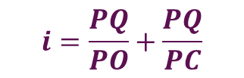
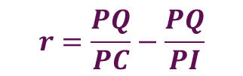


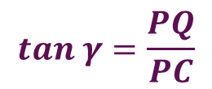
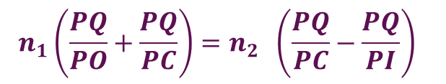




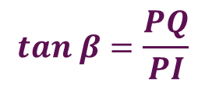



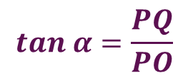

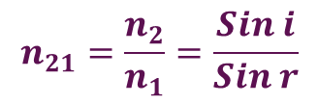


Refraction At a spherical Surface
$$tan α=\frac{PQ}{PO}$$
$$tan β=\frac{PQ}{PI}$$
$$tan γ=\frac{PQ}{PC}$$
= $α$
=$β$
=$γ$
$$From ΔOQC$$
Q
$$i=\frac{PQ}{PO}+\frac{PQ}{PC}$$
$$i$$
$$i=α+γ$$
$$From ΔQCI$$
$$γ=r+β$$
$$r$$
$$r=γ−β$$
$$α$$
$$γ$$
$$β$$
$$r=\frac{PQ}{PC}−\frac{PQ}{PI}$$
O
P
C
I
$$n_{21}=\frac{n_{2}}{n_{1}}=\frac{Sin i}{Sin r}$$
$$n_{1}Sin i=n_{2}Sin r$$
$$Snell^{′}s Law$$
$$n_{2}$$
$$n_{1}$$
$$n_{1} i=n_{2} r$$
$$\left(\frac{n_{1}}{PO}+\frac{n_{1}}{PC}\right)=\left(\frac{n_{2}}{PC}−\frac{n_{2}}{PI}\right)$$
$$n_{1}\left(\frac{PQ}{PO}+\frac{PQ}{PC}\right)=n_{2} \left(\frac{PQ}{PC}−\frac{PQ}{PI}\right)$$
$$\frac{n_{1}}{PO}+\frac{n_{2}}{PI}=\frac{n_{2}}{PC}−\frac{n_{1}}{PC}$$
$$\left(\frac{n_{1}}{PO}+\frac{n_{1}}{PC}\right)=\left(\frac{n_{2}}{PC}−\frac{n_{2}}{PI}\right)$$
$$\frac{n_{1}}{PO}+\frac{n_{2}}{PI}=\frac{n_{2}−n_{1}}{PC}$$
$$\left(\frac{n_{1}}{PO}+\frac{n_{1}}{PC}\right)=\left(\frac{n_{2}}{PC}−\frac{n_{2}}{PI}\right)$$

Slide 9














$$\frac{n_{1}}{PO}+\frac{n_{2}}{PI}=\frac{n_{2}−n_{1}}{PC}$$
Q
$$\frac{n_{1}}{−u}+\frac{n_{2}}{v}=\frac{n_{2}−n_{1}}{r}$$
$$i$$
$$r$$
$$α$$
$$γ$$
$$β$$
O
P
C
I
$$\frac{n_{1}}{−u}+\frac{n_{2}}{v}=\frac{n_{2}−n_{1}}{r}$$
$$u$$
$$v$$
$$n_{1}$$
$$r$$
$$n_{2}$$
$$−\frac{n_{1}}{u}+\frac{n_{2}}{v}=\frac{n_{2}−n_{1}}{r}$$
$$−\frac{\begin{aligned}Ref index of \\ Object Medium\end{aligned}}{Object Distance}+\frac{\begin{aligned}Ref index of \\ Image Medium\end{aligned}}{Image Distance}=\frac{\begin{aligned}Ref index of \\ Image Medium\end{aligned}−\begin{aligned}Ref index of \\ Object Medium\end{aligned}}{radius ofcurvature ofimagemedium}$$

Slide 10
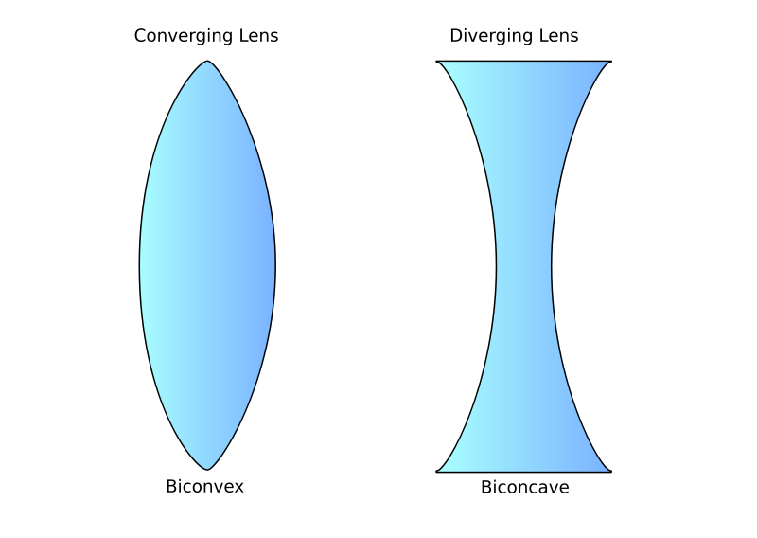
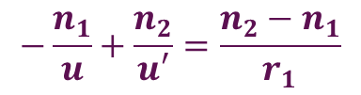



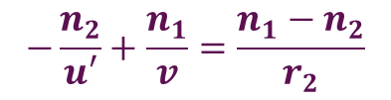
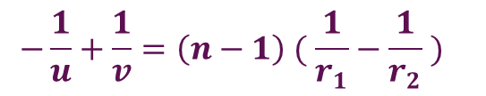
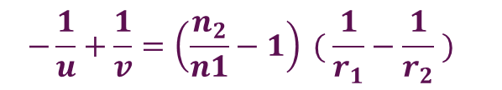



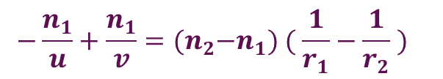


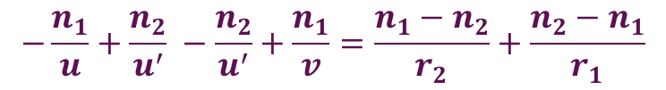
Lens maker’s formula
$$−\frac{\begin{aligned}Ref index of \\ Object Medium\end{aligned}}{Object Distance}+ \frac{\begin{aligned}Ref index of \\ Image Medium\end{aligned}}{Image Distance} = \frac{\begin{aligned}Ref index of \\ Image Medium\end{aligned}−\begin{aligned}Ref index of \\ Object Medium\end{aligned}}{radius ofcurvature ofimagemedium}$$
$$for the first refracting surface$$
$$−\frac{n_{1}}{u}+\frac{n_{2}}{u′}=\frac{n_{2}−n_{1}}{r_{1}}$$
$$for the Second refracting surface$$
P
$$−\frac{n_{2}}{u′}+\frac{n_{1}}{v}=\frac{n_{1}−n_{2}}{r_{2}}$$
O
I
I’
$$adding above two$$
$$u$$
$$u′$$
$$n_{2}$$
$$−\frac{n_{1}}{u}+\frac{n_{2}}{u^{′}} −\frac{n_{2}}{u^{′}}+\frac{n_{1}}{v}=\frac{n_{1}−n_{2}}{r_{2}}+\frac{n_{2}−n_{1}}{r_{1}}$$
$$n_{1}$$
$$n_{1}$$
$$v$$
$$−\frac{n_{1}}{u}+\frac{n_{1}}{v}={(n}_{2}−n_{1}) ( \frac{1}{r_{1}}−\frac{1}{r_{2}} )$$
$$−\frac{1}{u}+\frac{1}{v}=\left(n−1\right) ( \frac{1}{r_{1}}−\frac{1}{r_{2}} )$$
$$−\frac{1}{u}+\frac{1}{v}=\left(\frac{n_{2}}{n1}−1\right) ( \frac{1}{r_{1}}−\frac{1}{r_{2}} )$$

Slide 11
Different Lenses

Slide 12
Focus

Slide 13
Principal Focus
C
F
F
C
f
f

Slide 14
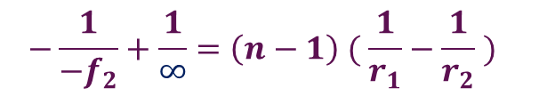

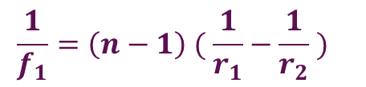

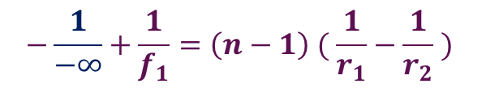
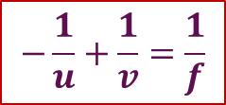
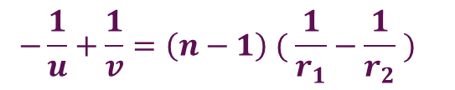


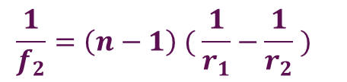
Thin Lens equation
$$−\frac{1}{u}+\frac{1}{v}=\left(n−1\right) ( \frac{1}{r_{1}}−\frac{1}{r_{2}} )$$
C
F
F
v=f
u=f
$$v=∞$$
$$u=∞$$
$$−\frac{1}{−f_{2}}+\frac{1}{∞}=\left(n−1\right) ( \frac{1}{r_{1}}−\frac{1}{r_{2}} )$$
$$−\frac{1}{−∞}+\frac{1}{f_{1}}=\left(n−1\right) ( \frac{1}{r_{1}}−\frac{1}{r_{2}} )$$
$$\frac{1}{f_{1}}=\left(n−1\right) ( \frac{1}{r_{1}}−\frac{1}{r_{2}} )$$
$$\frac{1}{f_{2}}=\left(n−1\right) ( \frac{1}{r_{1}}−\frac{1}{r_{2}} )$$
$\frac{1}{f_{1}}=$ $\frac{1}{f_{2}}=$ $\frac{1}{f}$
$$−\frac{1}{u}+\frac{1}{v}=\frac{1}{f}$$
$\frac{1}{f}=$ $powerof lens$

Slide 15


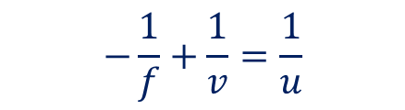


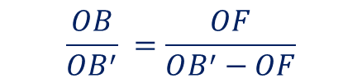
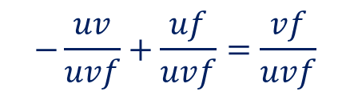



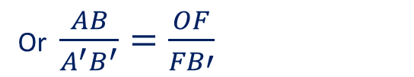

Thin Lens equation
ΔABO and ΔA’B’O are similar
A
D
$$\frac{AB}{A^{′}B^{′}}=\frac{OB}{OB^{′}}$$
B’
B
O
F
ΔODF and ΔA’B’F are similar
A’
$$\frac{OD}{A^{′}B^{′}}=\frac{OF}{FB′}$$
Or $\frac{AB}{A^{′}B^{′}}=\frac{OF}{FB′}$
$$f$$
$$u$$
$$v$$
$$\frac{OB}{OB^{′}} =\frac{OF}{FB′}$$
$$\frac{OB}{OB^{′}} =\frac{OF}{OB^{′}−OF}$$
Or
$$−\frac{uv}{uvf}+\frac{uf}{uvf}=\frac{vf}{uvf}$$
$$\frac{−u}{v} =\frac{f}{v−f}$$
$$−\frac{1}{f}+\frac{1}{v}=\frac{1}{u}$$
$$−u\left(v−f\right)=vf$$
$$−\frac{1}{u}+\frac{1}{v}=\frac{1}{f}$$
$$−uv+uf=vf$$

Slide 16





Magnification
A
D
ΔABO and ΔA’B’O are similar
B’
$$\frac{AB}{A^{′}B^{′}}=\frac{OB}{OB^{′}}$$
B
O
F
$$\frac{A′B′}{AB}=\frac{OB′}{OB}$$
A’
$$f$$
$$Magnification m=−\frac{v}{u}$$
$$u$$
$$v$$

Slide 17

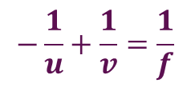

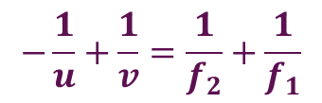
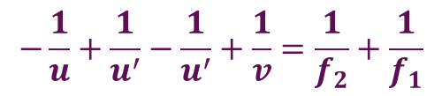
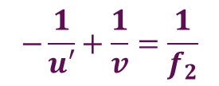
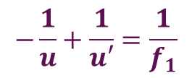
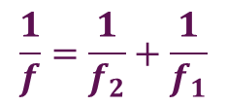
Combination of lenses
$$−\frac{1}{u}+\frac{1}{v}=\frac{1}{f}$$
$$for the first lens$$
$$−\frac{1}{u}+\frac{1}{u′}=\frac{1}{f_{1}}$$
$$for the second lens$$
$$−\frac{1}{u′}+\frac{1}{v}=\frac{1}{f_{2}}$$
P
O
I
I’
$$−\frac{1}{u}+\frac{1}{u^{′}}−\frac{1}{u^{′}}+\frac{1}{v}=\frac{1}{f_{2}}+\frac{1}{f_{1}}$$
$$u$$
$$u′$$
$$−\frac{1}{u}+\frac{1}{v}=\frac{1}{f_{2}}+\frac{1}{f_{1}}$$
$$v$$
$$\frac{1}{f}=\frac{1}{f_{2}}+\frac{1}{f_{1}}$$

