Slide 1
Electromagnetic Waves
The capacitor asks a paradoxical question
How can current be continuous when charge cannot cross the dielectric?
conduction current
conduction current
changing electric field
Reference: NCERT Physics XII, Ch. 8 • Displacement Current & EM Waves
02

Slide 2
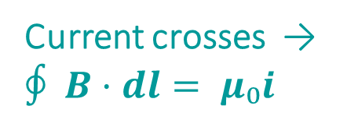

THE AMPÈRE’S LAW PUZZLE
Why does one loop give two answers?
One loop around a charging capacitor
Surface S₁ crosses the wire
Surface S₂ crosses the gap
`
S₂
$$∮ B·dl = 0$$
through gap
Current crosses → $∮ B·dl= μ₀i$
i(t)
No charge crosses the gap.
Yet the same loop must give the same magnetic field.
C
S₁
cuts wire
Maxwell’s fix: a changing electric field acts like a current.
Reference: NCERT Physics XII, Ch. 8 • Displacement Current & EM Waves
03

Slide 3





DERIVATION
Electric flux supplies the missing current
1
Field between plates
$E =\frac{Q}{ε_{0}A}$
Maxwell’s missing term
$$Φ = EA =\frac{Q}{ε_{0}}$$
2
Electric flux
$$i_{d}=ε_{0}\frac{dΦ_{E}}{dt}$$
$$\frac{dΦ_{E}}{dt} = (\frac{1}{ε_{0}})·\frac{dQ}{dt}$$
3
Differentiate
Recognise current
For an ideal charging capacitor:
4
$$\frac{dQ}{dt} = i_{d}$$
iᵈ = iᶜ = i
A changing electric flux has the same magnetic effect as a conduction current. The current due to this change is called displacement current
Reference: NCERT Physics XII, Ch. 8 • Displacement Current & EM Waves
04

Slide 4
AMPÈRE–MAXWELL LAW
Maxwell restores one continuous current
$$∮ B·dl = μ₀ ( i_{c} +ε_{0}\frac{dΦ_{E}}{dt} )$$
total current i = iᶜ + iᵈ
Conduction current iᶜ
Displacement current iᵈ
Actual charge carriers cross a surface.
Examples: current in a wire, ion flow in an electrolyte.
Electric flux through a surface changes with time.
No charge must cross the dielectric gap.
Both terms source the same magnetic field.
Reference: NCERT Physics XII, Ch. 8 • Displacement Current & EM Waves
05

Slide 5
FROM CAPACITOR FIELDS TO RADIATION
Changing fields can sustain each other
Accelerated charge
changing E
changing B
propagating wave
oscillates
Faraday: changing B creates E
Maxwell: changing E creates B
The fields regenerate each other and carry energy away from the source.
Reference: NCERT Physics XII, Ch. 8 • Displacement Current & EM Waves
08

Slide 6
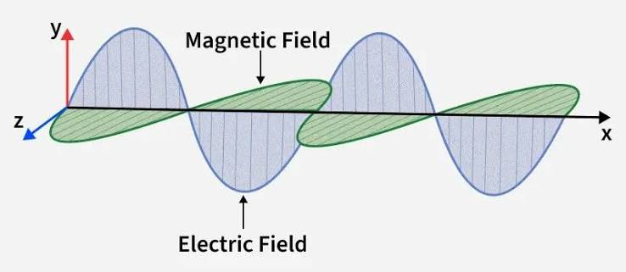
NATURE OF ELECTROMAGNETIC WAVES
Every EM wave carries a perpendicular field triad
Geometry
E ⟂ B ⟂ k
Speed in vacuum
c = 1/√(μ₀ε₀) = 3 × 10⁸ m s⁻¹
Wave relation
νλ = c
Field amplitudes
E₀/B₀ = c
No material medium is required.
Reference: NCERT Physics XII, Ch. 8 • Displacement Current & EM Waves
09

Slide 7
ELECTROMAGNETIC SPECTRUM
One spectrum, many Waves
wavelength increases
frequency • photon energy increase
Radio
Micro-
wave
Infrared
Visible
Ultra-
violet
X-ray
Gamma
> 0.1 m
0.1 m
1 mm
700 nm
400 nm
1 nm
1 pm
700 nm
VISIBLE LIGHT
400 nm
Boundaries are approximate; adjacent regions overlap.
All bands travel at c in vacuum.
Reference: NCERT Physics XII, Ch. 8 • Displacement Current & EM Waves
10

Slide 8
DETAILED ELECTROMAGNETIC SPECTRUM • PART I
Long waves power communication, heating and sight
Band | Wavelength | Frequency | Produced by | Detected by | Typical uses / interaction
Radio | > 0.1 m | < 3 GHz | Accelerating electrons in aerials | Receiver aerials | Broadcasting, communication; penetrates atmosphere
Microwave | 0.1 m – 1 mm | 3 – 300 GHz | Klystrons, magnetrons, Gunn devices | Point-contact / microwave diodes | Radar, satellite links, ovens; excites molecular rotation
Infrared | 1 mm – 700 nm | 3×10¹¹ – 4.3×10¹⁴ Hz | Hot bodies; vibrating atoms and molecules | Thermopiles, bolometers, IR sensors | Thermal imaging, remote controls; heating
Visible | 700 – 400 nm | 4.3×10¹⁴ – 7.5×10¹⁴ Hz | Atomic electron transitions | Eye, photocells, photographic sensors | Vision, illumination, photography, optical links
Pattern: longer wavelengths interact strongly with circuits, molecules and bulk matter.
Reference: NCERT Physics XII, Ch. 8 • Displacement Current & EM Waves
11

Slide 9
DETAILED ELECTROMAGNETIC SPECTRUM • PART II
Short waves reveal finer detail—and demand more care
Band | Wavelength | Frequency | Produced by | Detected by | Typical uses / caution
Ultraviolet | 400 – 1 nm | 7.5×10¹⁴ – 3×10¹⁷ Hz | Very hot bodies; electron transitions | Photocells, photographic sensors | Sterilisation, fluorescence, LASIK; excess exposure damages tissue
X-rays | 1 nm – 1 pm | 3×10¹⁷ – 3×10²⁰ Hz | Fast electrons striking targets; inner-shell transitions | Film, Geiger tubes, ionisation chambers | Medical/material imaging; ionising—limit exposure
Gamma | < 1 pm | > 3×10²⁰ Hz | Nuclear transitions; radioactive decay | Radiation detectors | Cancer therapy, sterilisation; deeply penetrating and ionising
As wavelength falls, photon energy rises: E = hν
Use shielding, distance and exposure time appropriately.
Reference: NCERT Physics XII, Ch. 8 • Displacement Current & EM Waves
12

