Slide 1

Reflection in a Plane Surface
Angle of incidence
Angle of Reflection
Laws of reflection
Incident ray, Reflected ray and Normal; all lay in the same plane
Incident angle = Reflected angle
Incident Ray
Reflected Ray
i
$$i=r$$
Plane of Reflection
Point of incidence
Normal

Slide 2
Parts of a Spherical Mirror
Aperture
Aperture
Radius of Curvature R
Radius of Curvature R
P
Pole
Pole
P
P
Principal Axis
Center of Curvature C
Center of Curvature C
Concave
Convex

Slide 3
Rays and Focus
Pole
Focus
P
P
Focus
Concave
Convex

Slide 4
Principal Focus
Pole
P
P
Principal Focus
Principal Focus
Concave
Convex

Slide 5
Sign Convention
Pole
C
F
P
F
C
Principal Focus
Principal Focus
POSITIVE
Concave
Convex
NEGATIVE
POSITIVE
NEGATIVE

Slide 6






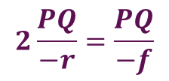

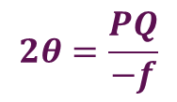

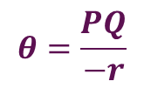
Radius–Focal Length Relation
$$f$$
$$angle=\frac{arc}{radius}$$
Q
$$θ$$
$$2θ=\frac{PQ}{−f}$$
$$θ$$
$$θ=\frac{PQ}{−r}$$
C
F
$$2θ$$
P
$$θ$$
$$2\frac{PQ}{−r}=\frac{PQ}{−f}$$
$$r$$
$$r=2f$$

Slide 7
Image Formation
B
I
o
R
F
P
M

Slide 8
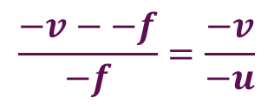
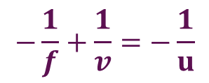
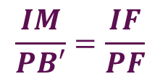
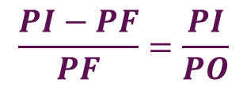
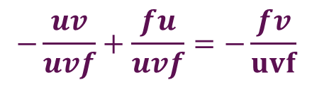



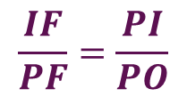

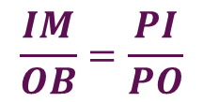



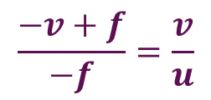
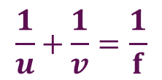
Mirror Formula
$$u$$
$$v$$
From $ΔPB^{′}F and ΔIMF$
B’
B
$$f$$
$$\frac{IM}{PB′}=\frac{IF}{PF}$$
I
F
From $ΔOBP and ΔIMP$
o
R
P
$$\frac{IM}{OB}=\frac{PI}{PO}$$
M
$$\frac{IF}{PF}=\frac{PI}{PO}$$
$$u\left(−v+f\right)=−fv$$
$$\frac{PI−PF}{PF}=\frac{PI}{PO}$$
$$−uv+uf=−fv$$
$$−\frac{uv}{uvf}+\frac{fu}{uvf}=−\frac{fv}{uvf}$$
$$\frac{1}{u}+\frac{1}{v}=\frac{1}{f}$$
$$\frac{−v−−f}{−f}=\frac{−v}{−u}$$
$$\frac{−v+f}{−f}=\frac{v}{u}$$
$$−\frac{1}{f}+\frac{1}{v}=−\frac{1}{u}$$

