Slide 1
Alternating emf: Alternating emf is that emf which continuously changes in magnitude and periodically reverses its direction.
E = E₀ sin ωt
Alternating Current: Alternating current is that current which continuously changes in magnitude and periodically reverses its direction.
I = I₀ sin ωt
E = E₀ sin ωt
E ,I
E₀
I₀
0
Symbol of AC Source
π/2
π
3π/2
2π
5π/2
3π
7π/2
θ = ωt
4π
T/4 T/2 3T/4 T 5T/4 3T/2 7T/4 2T
t
E, I – Instantaneous value of emf and current E₀, I₀ – Peak or maximum value or amplitude of emf and current
ω – Angular frequency t – Instantaneous timeωt – Phase

Slide 2

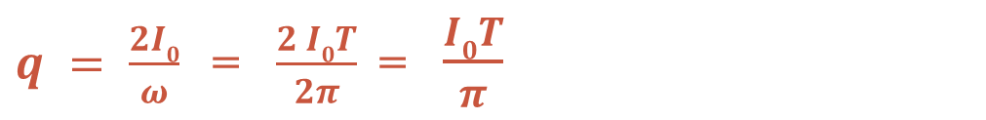
Average or Mean Value of Alternating Current:
Average or Mean value of alternating current over half cycle is that steady current which will send the same amount of charge in a circuit in the time of half cycle as is sent by the given alternating current in the same circuit in the same time.
dq = I dt = I₀ sin ωt dt
$$q = \int_{0}^{T}{I0 sin⁡ωt dt}$$
$q = \frac{2I0}{ω}$= $\frac{2 I0T}{2π}$= $\frac{I0T}{π}$
Mean Value of AC, I_{m} = I_{av} = $q/(T /2)$
I_{m} = I_{av} = 2 I₀ / π = 0.637 I₀ = 63.7 % I₀
Average or Mean Value of Alternating emf:
E_{m} = E_{av} = 2 E₀ / π = 0.637 E₀ = 63.7 % E₀
Note: Average or Mean value of alternating current or emf is zero over a cycle as the + ve and – ve values get cancelled.

Slide 3
Root Mean Square or Virtual or Effective Value of Alternating Current:
Root Mean Square (rms) value of alternating current is that steady current which would produce the same heat in a given resistance in a given time as is produced by the given alternating current in the same resistance in the same time.
Le dH be the heat produced in the resistance R in dt seconds when AC flowed through it, then
T
dH = I²R dt = I₀² R sin² ωt dt
H = ∫ I₀² R sin² ωt dt
0
H = I₀² RT / 2
(After integration)
If I_{v} be the virtual value of AC, then
H = I_{dc} ² RT
I_{dc} = I_{rms} = I_{eff} = I₀ / √2 = 0.707 I₀ = 70.7 % I₀
Root Mean Square or Virtual or Effective Value of Alternating emf:
E_{dc} = E_{rms} = E_{eff} = E₀ / √2 = 0.707 E₀ = 70.7 % E₀

Slide 4



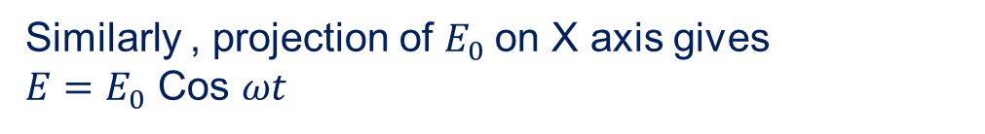


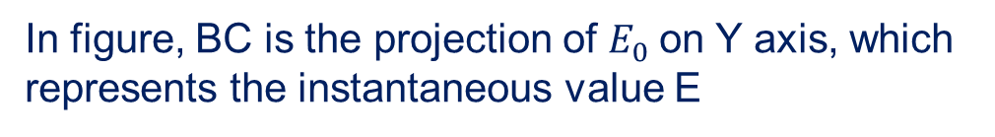

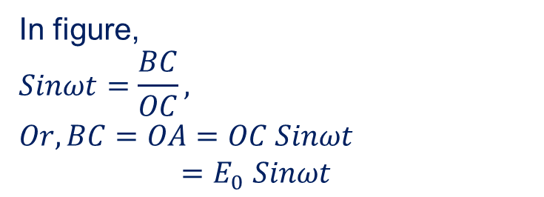


Phasor
A phasor (short for phase vector) is a rotating vector that represents a sinusoidal wave
(like an alternating voltage or current). At any instant it projection of either of the axes gives the instantaneous value
$$Y$$
In figure,
$$Sinωt=\frac{BC}{OC},$$
$$Or, BC=OA=OC Sinωt$$
$=E_{0}$ $Sinωt$
$$C$$
$$A$$
$$E_{0}$$
$$ωt$$
In figure, BC is the projection of $E_{0}$on Y axis, which represents the instantaneous value E
$$X$$
$$o$$
$$B$$
Similarly , projection of $E_{0}$on X axis gives
$E=E_{0}$ Cos $ωt$

Slide 5
AC Circuit with a Pure Resistor:
E = E₀ sin ωt
R
I = E / R
= (E₀ / R) sin ωt
I = I₀ sin ωt
(where I₀ = E₀ / R and R = E₀ / I₀)
E = E₀ sin ωt
Emf and current are in same phase.
E = E₀ sin ωt
y
E ,I
I = I₀ sin ωt
E₀
E₀
I₀
I₀
0
π/2
π
3π/2
2π
5π/2
3π
7π/2
θ = ωt
4π
T/4 T/2 3T/4 T 5T/4 3T/2 7T/4 2T
t
0
ωt
x
Phasor Diagram.

Slide 6


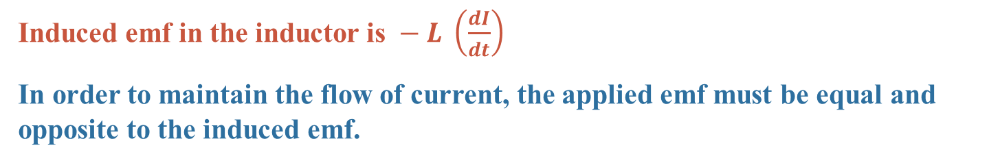

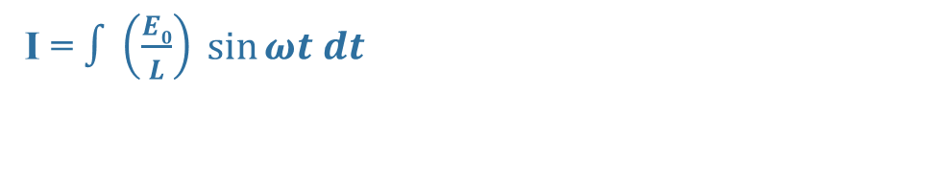

AC Circuit with a Pure Inductor:
E = E₀ sin ωt
L
Induced emf in the inductor is $− L \left(\frac{dI}{dt}\right)$
In order to maintain the flow of current, the applied emf must be equal and opposite to the induced emf.
E = E₀ sin ωt
$$E = L \left(\frac{dI}{dt}\right)$$
or, $E0 sin⁡ωt = L \left(\frac{dI}{dt}\right)$
$$or, dI = \left(\frac{E0}{L}\right)sin⁡ωt dt$$
I = $∫\left(\frac{E0}{L}\right) sin⁡ωt dt$
$= \left(\frac{E0}{ωL}\right)( − cos⁡ωt$)
$$= I0 sin⁡(ωt − π / 2)$$
(where I₀ = E₀ / ωL and X_{L} = ωL = E₀ / I₀) X_{L} is Inductive Reactance. Its SI unit is ohm.
y
E₀
E = E₀ sin ωt
E ,I
I = I₀ sin (ωt - π / 2)
E₀
I₀
ωt
0
0
π/2
π
3π/2
2π
5π/2
3π
7π/2
θ = ωt
x
4π
π/2
T/4 T/2 3T/4 T 5T/4 3T/2 7T/4 2T
t
I₀
Current lags behind emf by π/2 rad.

Slide 7
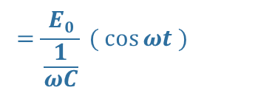

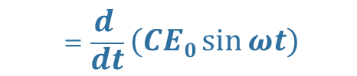
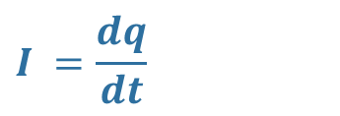


AC Circuit with a Capacitor:
$$q = CE = CE0 sin⁡ωt$$
C
$$E = E0 sin⁡ωt$$
$$=\frac{d }{dt}(CE0\sin{ωt)}$$
$$I =\frac{dq}{dt}$$
$$=\frac{E0}{\frac{1}{ωC}} ( cos⁡ωt )$$
E = E₀ sin ωt
$$I = I0 sin⁡(ωt + π / 2)$$
(where $I0 =\frac{E0}{\frac{1}{ωC}}$and $XC =\frac{1}{ωC}=\frac{E}{I0} ,$X_{C} is Capacitive Reactance. Its SI unit is ohm.
y
E₀
E = E₀ sin ωt
E ,I
I = I₀ sin (ωt + π / 2)
I₀
E₀
I₀
π/2
ωt
0
0
π/2
π
3π/2
2π
5π/2
3π
7π/2
θ = ωt
x
4π
T/4 T/2 3T/4 T 5T/4 3T/2 7T/4 2T
t
Current leads the emf by π/2 radians.

Slide 8
Variation of X_{L} with Frequency:
X_{L}
I₀ = E₀ / ωL and X_{L} = ωL
X_{L} is Inductive Reactance and ω = 2π f
X_{L} = 2π f L i.e. X_{L} α f
0
f
Variation of X_{C} with Frequency:
X_{C}
I₀ = E₀ / (1/ωC) and X_{C} = 1 / ωC
X_{C} is Capacitive Reactance and ω = 2π f
X_{C} = 1 / 2π f C i.e. X_{C} α 1 / f
0
f
TIPS:
Inductance (L) can not decrease Direct Current. It can only decrease Alternating Current.
Capacitance (C) allows AC to flow through it but blocks DC.

Slide 9

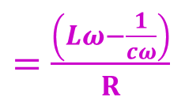

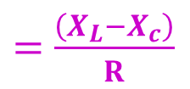
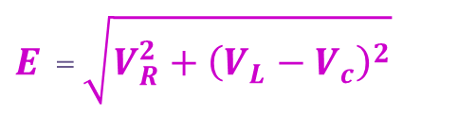
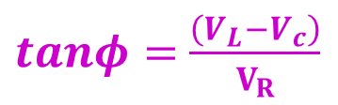

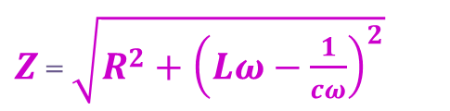

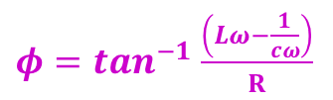
L
R
AC Circuit with L, C, R in Series Combination:
C
V_{L}
V_{R}
The applied emf appears as Voltage drops V_{R}, V_{L} and V_{C} across R, L and C respectively.
V_{C}
E = E₀ sin ωt
In R, current and voltage are in phase.
In L, current lags behind voltage by π/2
In C, current leads the voltage by π/2
V_{L}
V_{L}
- V_{C}
π/2
π/2
0
I
V_{R}
π/2
I
V_{R}
$E$ = $\sqrt{V_{R}^{2}+{\left(V_{L}−V_{c}\right)}^{2}}$
V_{C}
V_{C}
$tanφ=$ $\frac{\left(V_{L}−V_{c}\right)}{V_{R}}$
$=$ $\frac{\left(X_{L}−X_{c}\right)}{R}$
$IZ$ = $\sqrt{{\left(IR\right)}^{2}+{\left(IX_{L}−IX_{C}\right)}^{2}}$
E
$=$ $\frac{\left(Lω−\frac{1}{cω}\right)}{R}$
V_{L} - V_{C}
$IZ$ = $I\sqrt{R^{2}+{\left(X_{L}−X_{C}\right)}^{2}}$
Φ
$Z$ = $\sqrt{R^{2}+{\left(X_{L}−X_{C}\right)}^{2}}$
I
V_{R}
$φ=\tan^{−1}$ $\frac{\left(Lω−\frac{1}{cω}\right)}{R}$
E = $\sqrt{\left[VR2 + \left(VL – VC\right)2\right]}$
$Z$ = $\sqrt{R^{2}+{\left(Lω−\frac{1}{cω}\right)}^{2}}$
* Z is called impedance

Slide 10
How phase changes across three LCR cases
X_{L} – X_{C}
ω L – 1/ωC
tan Φ =
tan Φ =
R
R
Special Cases:
Case I: When X_{L} > X_{C} i.e. ω L > 1/ωC,
tan Φ = +ve or Φ is +ve
The current lags behind the emf by phase angle Φ and the LCR circuit is inductance - dominated circuit.
Case II: When X_{L} < X_{C} i.e. ω L < 1/ωC,
tan Φ = -ve or Φ is -ve
The current leads the emf by phase angle Φ and the LCR circuit is capacitance - dominated circuit.
Case III: When X_{L} = X_{C} i.e. ω L = 1/ωC,
tan Φ = 0 or Φ is 0°
The current and the emf are in same phase. The impedance does not depend on the frequency of the applied emf. LCR circuit behaves like a purely resistive circuit.

Slide 11
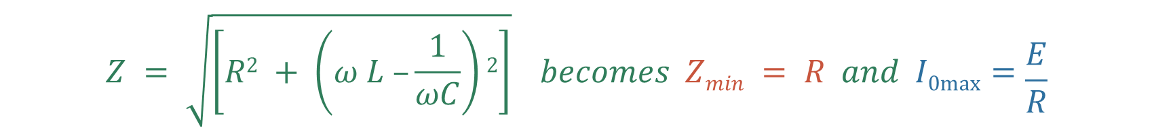
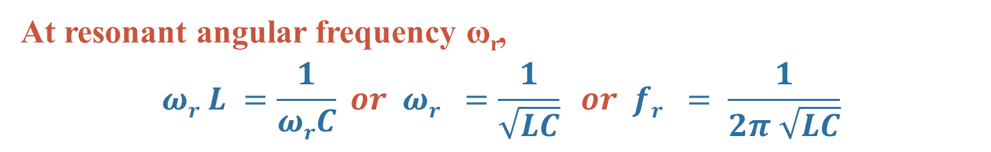
Resonance in AC Circuit with L, C, R:
When X_{L} = X_{C} i.e. ω L = 1/ωC, tan Φ = 0 or Φ is 0°
$$Z = \sqrt{\left[R2 + \left(ω L –\frac{1}{ωC}\right)2\right]} becomes Zmin = R and I0max⁡=\frac{E}{R}$$
i.e. The impedance offered by the circuit is minimum and the current is maximum. This condition is called resonant condition of LCR circuit and the frequency is called resonant frequency.
At resonant angular frequency ω_{r},
$$ωr L =\frac{1}{ωrC} or ωr =\frac{1}{\sqrt{LC}} or fr = \frac{1}{2π \sqrt{LC}}$$

Slide 12
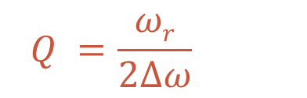
Resonant Curve & Q - Factor:
In figure, three plots with $ω$ Vs $I_{o}$ of three different LCR circuits are given
R₁ < R₂ < R₃
Band width = 2 ∆ ω
Quality factor (Q – factor) is defined as the ratio of resonant frequency to band width.
I₀
I_{0max}
$$Q =\frac{ωr}{2∆ω}$$
I_{0max} / √2
R₁
R₂
It can also be defined as the ratio of potential drop across either the inductance or the capacitance to the potential drop across the resistance.
R₃
Q = V_{L} / V_{R}
0
or Q = V_{C} / V_{R}
ω_{r}
ω
ω_{r} - ∆ ω
ω_{r} + ∆ ω
or Q = ω_{r} L / R
or Q = 1 / ω_{r}CR

Slide 13
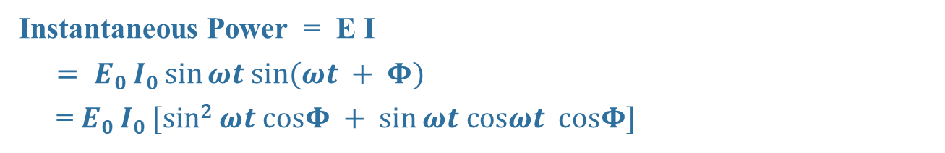


Power in AC Circuit with L, C, R:
E = E₀ sin ωt
I = I₀ sin (ωt + Φ) (where Φ is the phase angle between emf and current)
Instantaneous Power = E I
$= E0 I0 sin⁡ωt sin⁡(ωt + Φ)$
= $E0 I0 [sin2 ωt cosΦ + sin⁡ωt cosωt cosΦ]$
If the instantaneous power is assumed to be constant for an infinitesimally small time dt, then the work done is
dW = E₀ I₀ [sin² ωt cosΦ + sin ωt cosωt cosΦ]
$$W = \int_{0}^{T}{E0 I0 [sin2 ωt cosΦ + sin⁡ωt cosωt cosΦ] dt}$$
Work done over a complete cycle is
W = E₀I₀ cos Φ x T / 2
$$Pav = \left(\frac{E0I0}{2}\right) cos⁡Φ$$
Average Power over a cycle is P_{av} = W / T
$$Pav = \left(\frac{E0}{\sqrt{2}}\right)\left(\frac{I0}{\sqrt{2}}\right) cos⁡Φ$$
(where cos Φ = R / Z
= R /√ [R² + (ω L – 1/ωC)²] is called Power Factor)
P_{av} = E_{v} I_{v} cos Φ

Slide 14
P_{av} = E_{v} I_{v} cos Φ
Power in AC Circuit with C:
Power in AC Circuit with R:
In C, current leads emf by π/2.
Φ = + π/2
P_{av} = E_{v} I_{v} cos (π/2) = E_{v} I_{v} (0) = 0
In R, current and emf are in phase.
Φ = 0°
P_{av} = E_{v} I_{v} cos Φ = E_{v} I_{v} cos 0° = E_{v} I_{v}
Wattless Current or Idle Current:
Power in AC Circuit with L:
E_{v}
In L, current lags behind emf by π/2.
Φ = - π/2
P_{av} = E_{v} I_{v} cos (-π/2) = E_{v} I_{v} (0) = 0
I_{v} cos Φ
I_{v}
Φ
90°
I_{v} sin Φ
The component I_{v} cos Φ generates power with E_{v}.
However, the component I_{v} sin Φ does not contribute to power along E_{v} and hence power generated is zero. This component of current is called wattless or idle current.
P = E_{v} I_{v} sin Φ cos 90° = 0

Slide 15
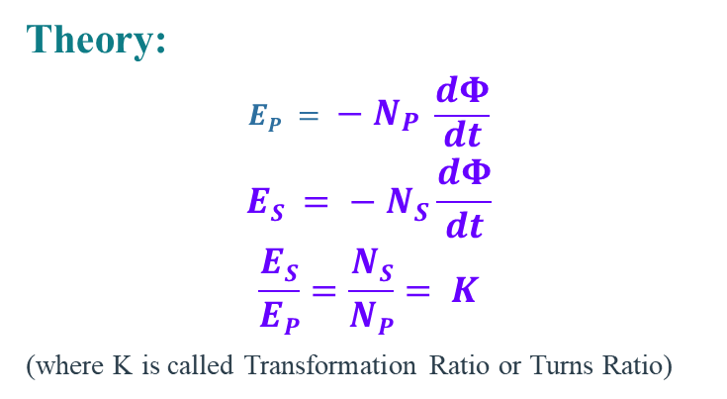
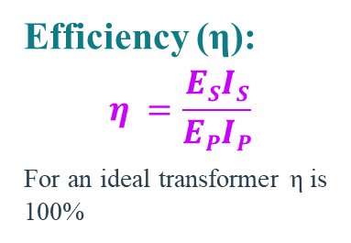
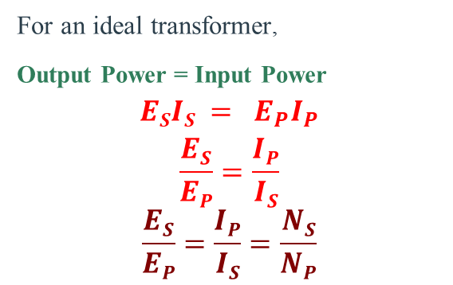
Transformer:
Transformer is a device which converts lower alternating voltage at higher current into higher alternating voltage at lower current.
Principle:
Transformer is based on Mutual Induction.
It is the phenomenon of inducing emf in the secondary coil due to change in current in the primary coil and hence the change in magnetic flux in the secondary coil.
P
S
Load
Theory:
$$EP = − N_{P} \frac{dΦ}{dt}$$
$$ES = − N_{S}\frac{dΦ}{dt}$$
$$\frac{ES}{EP}=\frac{NS}{NP}= K$$
(where K is called Transformation Ratio or Turns Ratio)
For an ideal transformer,
Output Power = Input Power
$$ESIS = E_{P}I_{P}$$
$$\frac{ES}{EP}=\frac{IP}{IS}$$
$$\frac{ES}{EP}=\frac{IP}{IS}=\frac{NS}{NP}$$
Efficiency (η):
$$η =\frac{ESIS}{EPIP}$$
For an ideal transformer η is 100%

Slide 16
Step - up Transformer:
Step - down Transformer:
P
S
Load
P
S
Load
N_{S} > N_{P} i.e. K > 1
E_{S} > E_{P} & I_{S} < I_{P}
N_{S} < N_{P} i.e. K < 1
E_{S} < E_{P} & I_{S} > I_{P}
Energy Losses in a Transformer:
Copper Loss: Heat is produced due to the resistance of the copper windings of Primary and Secondary coils when current flows through them.
This can be avoided by using thick wires for winding.
Flux Loss: In actual transformer coupling between Primary and Secondary coil is not perfect. So, a certain amount of magnetic flux is wasted.
Linking can be maximized by winding the coils over one another.

Slide 17
Iron Losses:
a) Eddy Currents Losses:
When a changing magnetic flux is linked with the iron core, eddy currents are set up which in turn produce heat and energy is wasted. Eddy currents are reduced by using laminated core instead of a solid iron block because in laminated core the eddy currents are confined with in the lamination and they do not get added up to produce larger current. In other words their paths are broken instead of continuous ones.
Solid Core
Laminated Core
b) Hysteresis Loss:
When alternating current is passed, the iron core is magnetized and demagnetized repeatedly over the cycles and some energy is being lost in the process. This can be minimized by using suitable material with thin hysteresis loop.
Losses due to vibration of core: Some electrical energy is lost in the form of mechanical energy due to vibration of the core and humming noise due to magnetostriction effect.

