Slide 1
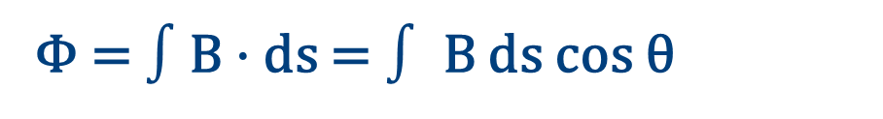
ELECTROMAGNETIC INDUCTION
Magnetic flux measures field through a surface
Magnetic flux counts the magnetic field passing normally through a chosen surface.
1
VECTOR DEFINITION
n
dΦ = B · ds = B ds cos θ
θ
B
Φ = $∫$B · ds = $∫$ B ds cos θ
θ is the angle between the field B and the surface normal
2
UNIFORM FIELD THROUGH A PLANE AREA
The projected area A cos θ determines how much field crosses the surface.
Φ = B A cos θ
Maximum at θ = 0° • zero at θ = 90°

Slide 2
ELECTROMAGNETIC INDUCTION
Four variables control magnetic flux
Φ = B A cos θ
1
2
3
4
FIELD STRENGTH
COIL AREA
ORIENTATION
COMBINATION
Change B
Change A
Change θ
Change more than one
Flux is a scalar quantity.
Flux density is the magnetic field B.
SI unit: weber (Wb) = tesla·metre²
CGS unit: maxwell; 1 Mx = 10⁻⁸ Wb
For a normal surface, flux per unit area equals B.

Slide 3
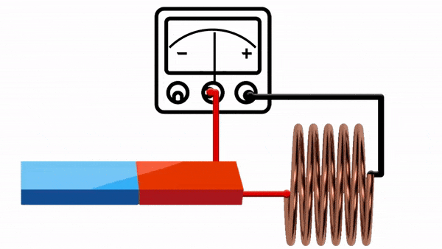
ELECTROMAGNETIC INDUCTION
Faraday’s first experiment: motion induces current
Move the magnet relative to the coil → flux changes → the galvanometer deflects. Stop the motion → the deflection disappears.

Slide 4
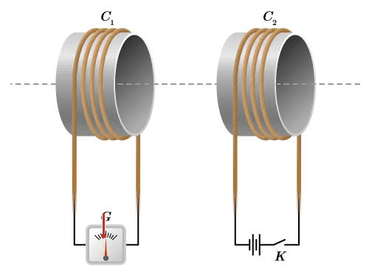
ELECTROMAGNETIC INDUCTION
Faraday’s first experiment: motion induces current
Move the magnet relative to the coil → flux changes → the galvanometer deflects. Stop the motion → the deflection disappears.

Slide 5



ELECTROMAGNETIC INDUCTION
Faraday’s laws of electromagnetic induction
1
FIRST LAW
COMPACT FORM
When ever the magnetic flux linked with the coil changes , an induced emf is developed. It lasts as long as the change occurs
$$\text{ε}=\frac{dϕ}{dt}$$
$$\text{ε}=N\frac{dϕ}{dt}$$
2
SSECOND LAW
Induced emf is directly proportional to the rate of change in flux
N is the number of turns.
$$\text{ε}∝\frac{dϕ}{dt}$$
No changing flux, no induced emf.

Slide 6

ELECTROMAGNETIC INDUCTION
Lenz’s law
“The induced current acts to oppose the change of flux that produced it.”
Lenz’s law fixes the direction of induction
ΔΦ
ε
I
opposing
the change in flux
Now, Faraday’s law becomes
$$\text{ε}=−N\frac{dϕ}{dt}$$
This opposition is the electromagnetic expression of energy conservation.

Slide 7
ELECTROMAGNETIC INDUCTION
Three routes produce an induced emf
Every route changes one term in Φ = B A cos θ
B
A
θ
CHANGE THE FIELD
CHANGE THE AREA
CHANGE THE ANGLE
Move a magnet or vary current in a nearby coil.
Move a conductor into or out of the field.
Rotate the coil relative to the field.
Faraday’s experiments changed B; generators commonly change θ.

Slide 8


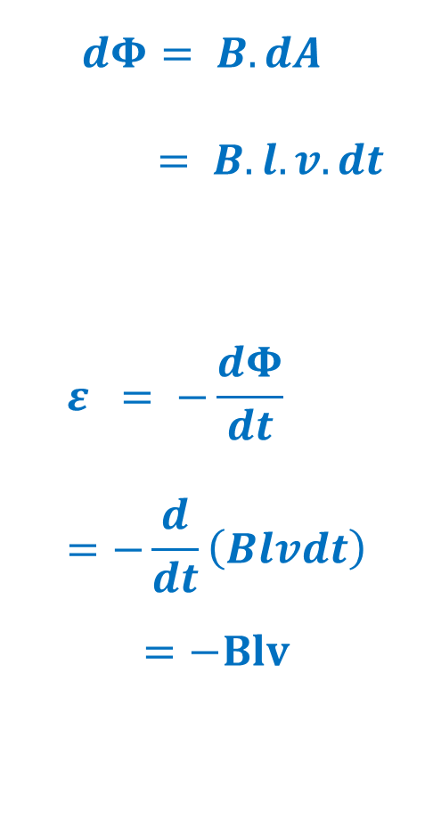

ELECTROMAGNETIC INDUCTION
Motional emf
$$dΦ= B.dA$$
$= B.l.v.dt$
$$ε = −\frac{dΦ}{dt} =−\frac{d}{dt}\left(Blvdt\right)$$
$$=−Blv$$
CONDUCTOR MOVING IN B
B
P’
P
Q’
Q
$$v$$
$$l$$
S’
v.dt
R’
S
R
$$ε=−Blv$$

Slide 9
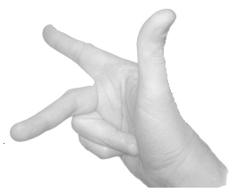
ELECTROMAGNETIC INDUCTION
Fleming’s rule predicts current direction
Stretch the right-hand thumb, forefinger and middle finger mutually perpendicular.
Magnetic Field (B)
Force (F)
1
FOREFINGER
magnetic field B
ElectricCurrent (I)
2
THUMB
motion / force
3
MIDDLE FINGER
induced current I
B ⟂ motion ⟂ I

Slide 10
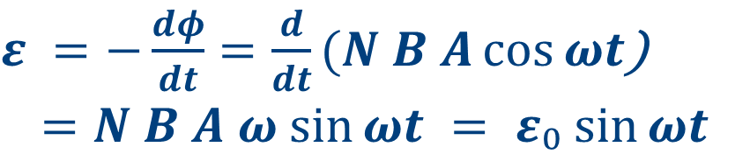
ELECTROMAGNETIC INDUCTION
Rotating the coil makes flux vary periodically
1
INSTANTANEOUS FLUX
$$Φ =N\vec{B}.\vec{A}= N B A cos⁡θ$$
For uniform B and a coil of area A
S
2
CONSTANT ANGULAR SPEED
$$θ = ωt$$
P
θ
B
Take θ = 0 when the coil normal is aligned with B
n
3
INDUCED EMF
$ε =−\frac{dφ}{dt}=\frac{d}{dt}(N B A\cos{ωt}$)
$$=N B A ω sin⁡ωt = ε₀ sin⁡ωt$$
R
Q
ε₀ = N B A ω is the peak emf

Slide 11
ELECTROMAGNETIC INDUCTION
Rotation generates alternating emf
PERIODIC IN MAGNITUDE AND DIRECTION
ε = ε₀ sin ωt
π/2
π
3π/2
2π
5π/2
3π
7π/2
4π
A rotating coil produces an emf that reverses every half-cycle. The resulting current is alternating current.
t
Sine and cosine forms describe the same waveform with a phase shift.
π/2
π
3π/2
2π
5π/2
3π
7π/2
4π
This is the operating principle of generators.
t

Slide 12
An A.C. generator turns motion into electricity
ELECTROMAGNETIC INDUCTION
ENERGY CONVERSION
S
mechanical rotation
→ alternating electrical output
N
1
Rotate the armature in a magnetic field.
2
Flux through the coil changes continuously.
3
Slip rings deliver the alternating emf to the load.
A.C. dynamo • alternator

Slide 13
ELECTROMAGNETIC INDUCTION
Eddy currents are loops induced inside conductors
A changing magnetic flux drives circulating currents through the body of a solid conductor.
B
APPLICATIONS
Induction furnaces — localized heating
Speedometers and energy meters — measurement
Dead-beat galvanometers — damping
The induced loops oppose the changing flux that creates them.
Train brakes — oppose wheel rotation
Diathermy — localized tissue heating

Slide 14

ELECTROMAGNETIC INDUCTION
Self-induction opposes changes in coil current
A changing current changes the coil’s own flux, inducing an emf in that same coil.
ELECTRICAL INERTIA
1
FLUX LINKAGE
$$Φ = L I$$
L
L is the self-inductance of the coil
resists rapid
current change
2
BACK EMF
$$ε =−\frac{dφ}{dt}=\frac{d}{dt}\left(LI\right)=−L \frac{dI}{dt}$$
The induced emf opposes growth or decay of current
Unit: henry (H)
Practical Unit: milli henry (mH)

Slide 15

ELECTROMAGNETIC INDUCTION
A solenoid’s inductance
1
FIELD INSIDE THE SOLENOID
B = μ₀ n I = μ₀(N/ℓ)I
$$n = N/ℓ$$
2
TOTAL FLUX LINKAGE
Φ = N B A = μ₀N²IA/ℓ
$$Also ,Φ = L I$$
l
Every turn links the common area comparing two
3
SELF-INDUCTANCE
L = μ₀N²A/ℓ = μ₀n²Aℓ
More turns and area increase L; greater length reduces it

Slide 16

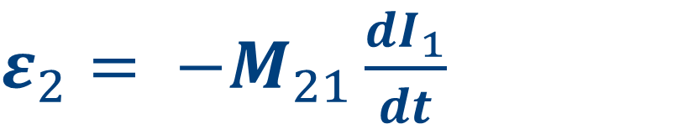
ELECTROMAGNETIC INDUCTION
Mutual induction couples two coils
A changing current in the primary changes the flux linked with the secondary, inducing an emf there.
$$Φ₂₁ = M₂₁ I₁$$
1
FLUX LINKAGE
PRIMARY
SECONDARY
Unit: henry (H)
M₂₁ Mutual inductance of the coil
2
INDUCED EMF
$ε_{2}= −M_{21}\frac{dI_{1}}{dt}$
The direction follows Lenz’s law

Slide 17
Mutual inductance of coaxial solenoids
Two long solenoids • same length ℓ • common cross-sectional area A
COAXIAL GEOMETRY
1
FIELD CREATED BY THE PRIMARY
B₁ = μ₀ n₁ I₁ = μ₀(N₁/ℓ)I₁
B₁
n₁ = N₁/ℓ is the primary turn density
2
FLUX LINKED BY THE SECONDARY
A
Φ₂₁ = N₂B₁A = μ₀N₁N₂I₁A/ℓ
One turn: φ₂₁ = B₁A • N₂ turns: Φ₂₁ = N₂φ₂₁
I₁
I₂
3
IDENTIFY MUTUAL INDUCTANCE
ℓ
Φ₂₁ = M₂₁I₁
PRIMARY N₁
SECONDARY N₂
The current I₁ cancels from the final expression
The shared area A links the field from the primary to every turn of the secondary.
M = M₁₂ = M₂₁ = μ₀N₁N₂A/ℓ
Reciprocity: either coil pair gives the same mutual inductance.

Slide 18
ELECTROMAGNETIC INDUCTION
Geometry and material set coupling strength (Out of Syllabus)
1
MAGNETIC CORE
M = μ₀ μᵣ N₁N₂A/ℓ
COMBINING INDUCTORS
A core with relative permeability μᵣ increases coupling
Series
UNEQUAL COIL RADII
L = L₁ + L₂
2
M = μ₀ μᵣ N₁N₂πr₁²/ℓ
For r₁ < r₂, the smaller common area limits linkage
Parallel
3
COEFFICIENT OF COUPLING
k = M / √(L₁L₂)
1/L = 1/L₁ + 1/L₂
Typically 0 ≤ k < 1; placement controls how much flux is shared
Relative placement matters as much as coil geometry.

