Slide 1
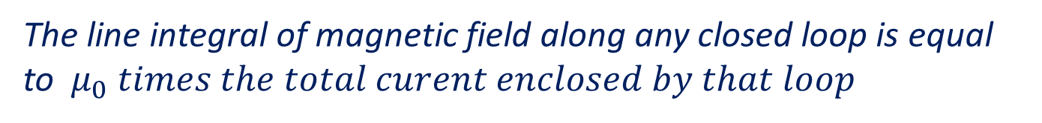


Ampere’s Circuital theorem
The line integral of magnetic field along any closed loop is equal to $μ_{0} times the total curent enclosed by that loop$
$$\oint{B.dl=μ_{0}I_{enc}}$$
$$I$$

Slide 2
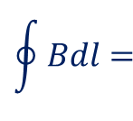
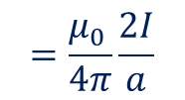


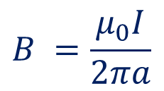

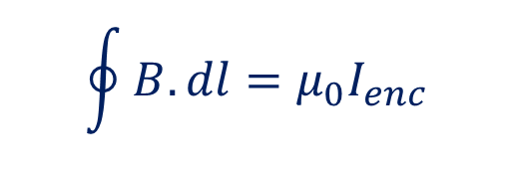




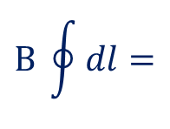
Ampere’s Circuital theorem- Applications
Infinitely long straight line conductor
$$\oint{B.dl=μ_{0}I_{enc}}$$
$$I$$
$$\oint{B.dl=}$$
$$B \oint{dl=}$$
$$\oint{Bdl=}$$
$$B 2πa$$
$$P$$
$$a$$
$$B.2πa=μ_{0}I$$
$$dl$$
$$B =\frac{μ_{0}I}{2πa}$$
$$=\frac{μ_{0 }}{4π}\frac{2I}{a}$$

Slide 3
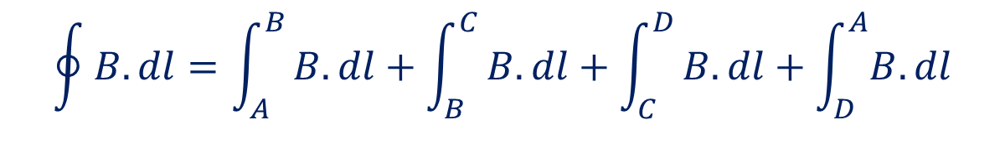











Infinitely long solenoid
$$P$$
$$A$$
$$B$$
$$\oint{B.dl=μ_{0}I_{enc}}$$
$$D$$
$$C$$
$$\oint{B.dl=\int_{A}^{B}{B.dl+\int_{B}^{C}{B.dl+\int_{C}^{D}{B.dl+\int_{D}^{A}{B.dl}}}}}$$
$$=Bl$$
$$Bl=μ_{0}NI$$
$$n=\frac{N}{l}$$
$$Bl=μ_{0}nl I$$
$$B=μ_{0}n I$$

Slide 4
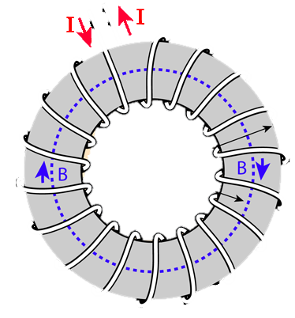




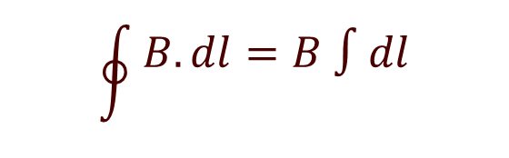


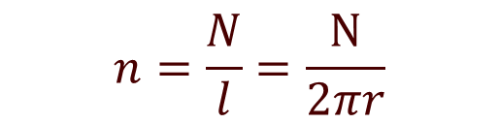
Toroid
$$\oint{B.dl=μ_{0}I_{enc}}$$
$$\oint{\begin{aligned}B.dl=B ∫dl \\ \end{aligned}}$$
$$=B2πr$$
$$r$$
$$B2πr =μ_{0}NI$$
$$n=\frac{N}{l}=\frac{N}{2πr}$$
$$B2πr =μ_{0}n2πrI$$
$$B=μ_{0}n I$$

Slide 5

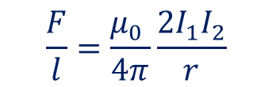





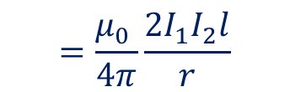
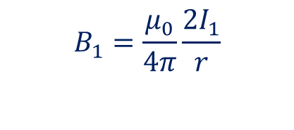
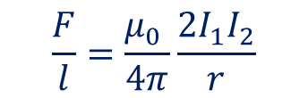
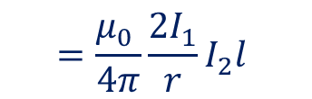


Forces between two parallel infinitely long current-carrying conductors:
Field due to 1 on 2:
$$B_{1}=\frac{μ_{0}}{4π}\frac{2I_{1}}{r}$$
$$I_{1}$$
$$I_{2}$$
The force acting on $I_{2}$due to this field ,
$F=BIl Sinθ$,
$$θ={90}^{0}$$
$$Sinθ=1$$
$$r$$
$$=\frac{μ_{0} }{4π}\frac{2I_{1}}{r}I_{2}l$$
$$=\frac{μ_{0} }{4π}\frac{2I_{1}I_{2}l}{r}$$
The force acting on $I_{2}$ per unit length
$$\frac{F}{l}=\frac{μ_{0} }{4π}\frac{2I_{1}I_{2}}{r}$$
$$\frac{F}{l}=\frac{μ_{0} }{4π}\frac{2I_{1}I_{2}}{r}$$
Similarly ,the force acting on $I_{1}$due to $I_{2} can be written as$ ,

Slide 6

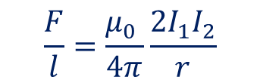


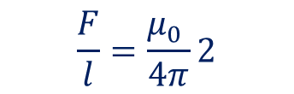
Definition of ampere :
We have
$$\frac{F}{l}=\frac{μ_{0} }{4π}\frac{2I_{1}I_{2}}{r}$$
If $I_{1}=I_{2}=1 A and r=1m$
$$\frac{F}{l}=\frac{μ_{0} }{4π}2$$
$$=\frac{μ_{0} }{2π}$$
$$=2×{10}^{−7} N/m$$
Ampere is that current, when flowed through a pair of infinitely long straight wire separated by 1 m exerts a force of $2×{10}^{−7} N/m$ per unit length of each.

Slide 7








Torque on a Rectangular loop in a magnetic filed
Let θ be the angle between the plane of the loop and the direction of the magnetic field. The axis of the coil is perpendicular to the magnetic field.
F_{SP}
b
S
Force on side SP
θ
F_{RS}
I
$$F_{sp}=BIb Sinθ$$
Acting upward
P
Force on side QR
x
B
$$F_{QR}=BIb Sinθ$$
Acting downward
l
They cancel each other.
F_{PQ}
R
$$F_{PQ}=BIl Sinθ$$
$$=BIl Sin90$$
$$=BIl$$
Acting perpendicular to the coil, out ward
I
θ
Acting perpendicular to the coil, in ward
Q
$$F_{SR}=BIl Sinθ$$
$$=BIl Sin90$$
$$=BIl$$
F_{QR}
These two forces results in a torque on the loop

Slide 8



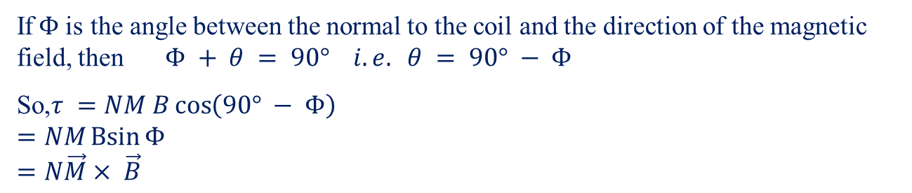


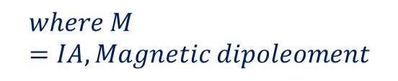




Torque on a Rectangular loop in a magnetic filed contd.
$$F_{PQ}=BIl$$
$$F_{SR}=BIl$$
S
b
x
$$Torque=Force×⊥distance$$
θ
B
$$=BIl×PN$$
θ
Φ
P
N
$$=BIl×b Cos θ$$
n
$$=BIACos θ$$
F_{PQ}
I
$$If the loop has N turns, total torque$$
$$τ=NIABCos θ$$
$$where M=IA, Magnetic dipoleoment$$
$$=NMBCos θ$$
I
R
B
Φ
Q
n
If$Φ$is the angle between the normal to the coil and the direction of the magnetic field, then$Φ + θ = 90° i.e. θ = 90° − Φ$
So,$τ =NM B\cos\left(90° − Φ\right)$
$$=NM\operatorname{Bsin}{Φ}$$
$$=N\vec{M}× \vec{B}$$

Slide 9

Moving Coil Galvanometer:
Torque experienced by the coil is
ז = N I A B sin Φ
Restoring torque in the coil is
ז = k α (where k is restoring torque per unit angular twist, α is the angular twist in the wire)
At equilibrium,
N I A B sin Φ = k α
T
PBW
E
M
F_{RS}
P
S
N
x
S
$I=\frac{k}{NAB Sinφ}α$
B
Q
R
F_{PQ}
The factor sin Φ can be eliminated by choosing Radial Magnetic Field.
LS
Hair Spring
LS
TS

Slide 10
Conversion of Galvanometer to Ammeter:
Galvanometer can be converted into ammeter by shunting it with a very small resistance.
Potential difference across the galvanometer and shunt resistance are equal.
I
I_{g}
G
S
I_{s} = I - I_{g}
I_{g} G
(I – I_{g} ) S = I_{g} G
or
S =
I – I_{g}
Conversion of Galvanometer to Voltmeter:
Galvanometer can be converted into voltmeter by connecting it with a very high resistance.
Potential difference across the given load resistance is the sum of p.d across galvanometer and p.d. across the high resistance.
I_{g}
G
R
V
V
V = I_{g} (G + R)
or R =
- G
I_{g}

