Slide 1
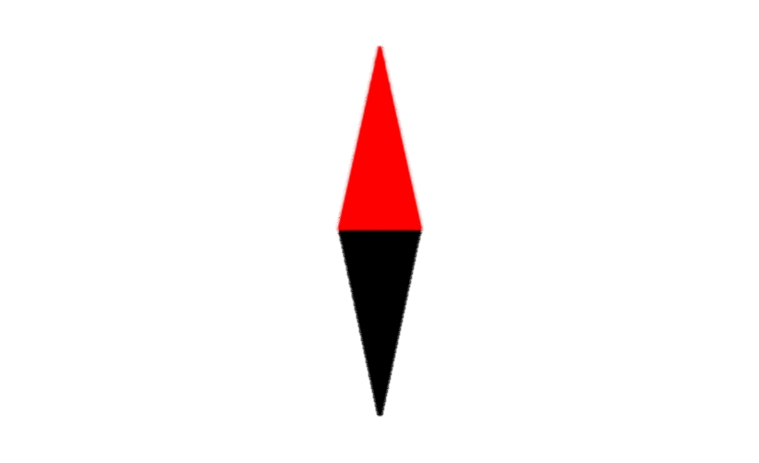
Magnetic Field
Oersted Experiment

Slide 2
Magnetic Field
Oersted Experiment
A magnetic field in generated around a wire when it carries a current
Magnetic Field Intensity (B)
A Vector quantity
Measured in Tesla
We will revisit the properties of filed later.

Slide 3

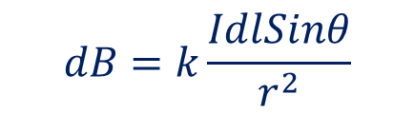



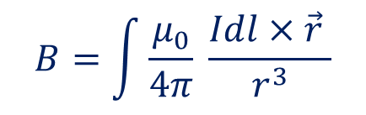

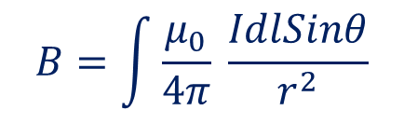

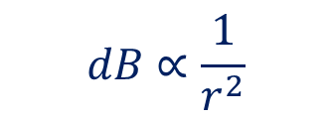





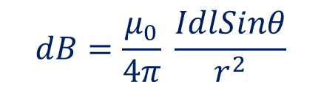
Biot-Savart Law
$$dB$$
$$dB∝I$$
$$dB∝\frac{1}{r^{2}}$$
$$dB∝dl$$
$$dB∝sinθ$$
$$P$$
$$dB∝\frac{IdlSinθ}{r^{2}}$$
$$dB=k\frac{IdlSinθ}{r^{2}}$$
$$θ$$
$$r$$
$$dB=\frac{μ_{0}}{4π} \frac{IdlSinθ}{r^{2}}$$
$$μ_{0}=4π×{10}^{−7}NA^{−2}$$
$$dl$$
$$I$$
$$B=\int{\frac{μ_{0}}{4π} \frac{IdlSinθ}{r^{2}}}$$
$$B=\int{\frac{μ_{0}}{4π} \frac{Idl×\vec{r} }{r^{3}}}$$

Slide 4
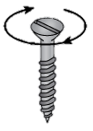
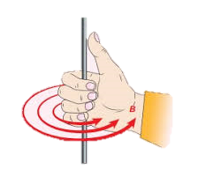
Right Handed Corkscrew Rule
If a right handed cork screw is assumed to be held along the conductor, and the screw is rotated such that it moves in the direction of the current, direction of magnetic field is same as that of the rotation of the screw.
Maxwell's Right Hand Grip Rule
I
Assume that the current carrying conductor is held in the right hand so that the fingers wrap around the conductor and the thumb is stretched If the thumb is along the direction of current, wrapped fingers will show the direction of circular magnetic field lines.
Field

Slide 5





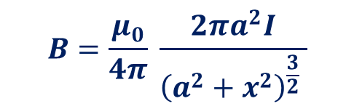

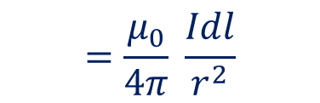





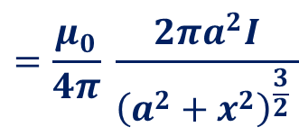












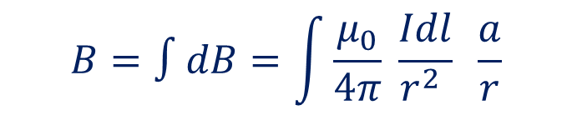
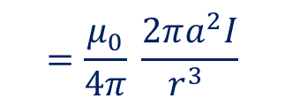





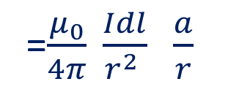
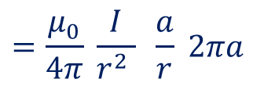
Biot-Savart Law –Applications
Magnetic Field at a point on the axial line of a Circular coil
$$C$$
$$dB=\frac{μ_{0}}{4π} \frac{IdlSinθ}{r^{2}}$$
$$=\frac{μ_{0}}{4π} \frac{Idl}{r^{2}}$$
$$dl$$
$$Y$$
$$r$$
$$r$$
$$A$$
$$Effectiv filed ,dB=\frac{μ_{0}}{4π} \frac{Idl}{r^{2}}sinφ$$
$$φ$$
$$a$$
$$dB$$
$$a$$
$$φ$$
=$\frac{μ_{0}}{4π} \frac{Idl}{r^{2} } \frac{a}{r}$
$$φ$$
$$o$$
$$X$$
$$x$$
$$x$$
$$P$$
$$a$$
$$i$$
$$B=∫dB=\int{\frac{μ_{0}}{4π} \frac{Idl}{r^{2} } \frac{a}{r}}$$
$$=\frac{μ_{0}}{4π} \frac{I}{r^{2} } \frac{a}{r}\int{dl}$$
$$Y′$$
$$B$$
$$dB′$$
$$=\frac{μ_{0}}{4π} \frac{I}{r^{2} } \frac{a}{r} 2πa$$
$$=\frac{μ_{0}}{4π} \frac{2πa^{2}I}{r^{3} }$$
$$dl′$$
$$sinφ=\frac{a}{r}$$
$$=\frac{μ_{0}}{4π} \frac{2πa^{2}I}{{\left(a^{2}+x^{2}\right)}^{\frac{3}{2}} }$$
$$B=\frac{μ_{0}}{4π} \frac{2πa^{2}I}{{\left(a^{2}+x^{2}\right)}^{\frac{3}{2}} }$$
$$r=\sqrt{a^{2}+x^{2}}$$

Slide 6
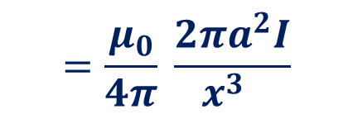
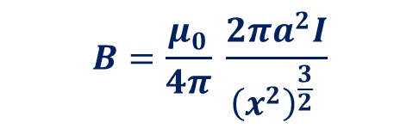

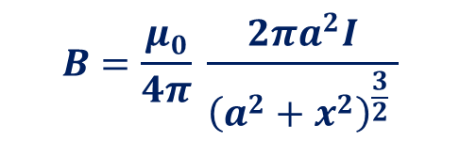

Biot-Savart Law –Applications
Magnetic Field at a point on the axial line of a Circular coil
$$C$$
$$dl$$
$$B=\frac{μ_{0}}{4π} \frac{2πa^{2}I}{{\left(a^{2}+x^{2}\right)}^{\frac{3}{2}} }$$
$$a$$
$$If p is at far away, x≫a$$
$$B=\frac{μ_{0}}{4π} \frac{2πa^{2}I}{{\left(x^{2}\right)}^{\frac{3}{2}} }$$
$$=\frac{μ_{0}}{4π} \frac{2πa^{2}I}{x^{3} }$$
$$o$$
$$i$$
$$P$$
$$a$$
$$=\frac{μ_{0}}{4π} \frac{2AI}{x^{3} }$$
$$dl′$$

Slide 7

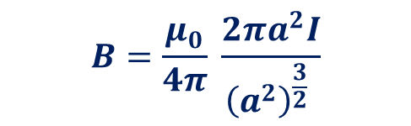

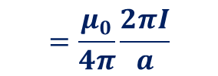
Biot-Savart Law –Applications
Magnetic Field at a point on the axial line of a Circular coil
$$C$$
$$dl$$
$$B=\frac{μ_{0}}{4π} \frac{2πa^{2}I}{{\left(a^{2}+x^{2}\right)}^{\frac{3}{2}} }$$
$$a$$
$$If p is at far away, x≫a$$
$$B=\frac{μ_{0}}{4π} \frac{2πa^{2}I}{{\left(x^{2}\right)}^{\frac{3}{2}} }$$
$$=\frac{μ_{0}}{4π} \frac{2πa^{2}I}{x^{3} }$$
$$o$$
$$P$$
$$i$$
$$a$$
$$=\frac{μ_{0}}{4π} \frac{2AI}{x^{3} }$$
$$dl′$$
$$If p is at the center, x=0$$
$$B=\frac{μ_{0}}{4π} \frac{2πa^{2}I}{{\left(a^{2}\right)}^{\frac{3}{2}} }$$
$$=\frac{μ_{0}}{4π}\frac{2πI}{a}$$

