Slide 1
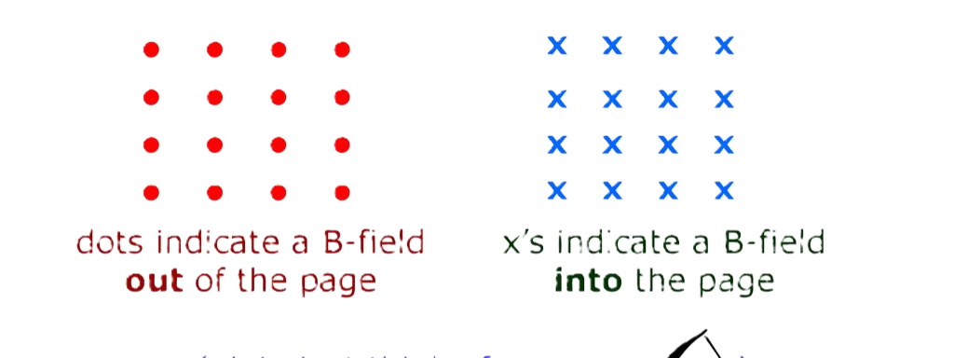
Magnetic Field
We know static charges creates an electric field around it.
Similarly Moving charge creates a magnetic field around it.
A Magnetic field is
1. A vector quantity
2. It is produced by a current.
3. similar electric field.
A magnetic field is represented as

Slide 2
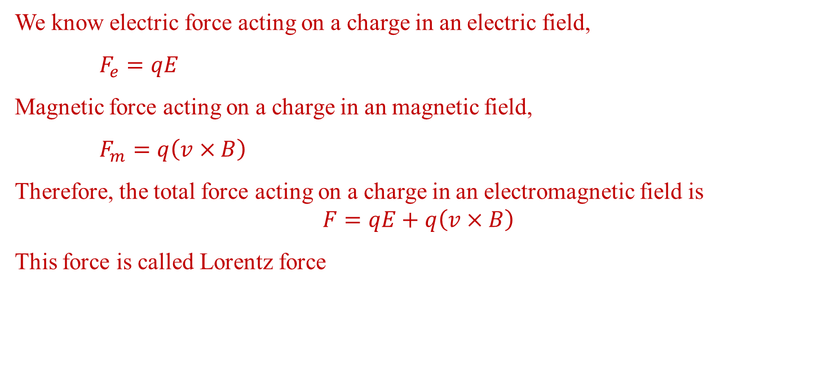
Force on charge in electromagnetic field
We know electric force acting on a charge in an electric field,
$F_{e}=qE$
Magnetic force acting on a charge in an magnetic field,
$F_{m}=q\left(v×B\right)$
Therefore, the total force acting on a charge in an electromagnetic field is
$$F=qE+q\left(v×B\right)$$
This force is called Lorentz force

Slide 3
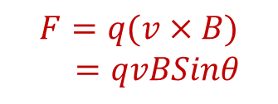
Magnetic Lorentz Force
The force acting on a charge in a magnetic field is called Magnetic Lorentz force
$$F=q(v×B)$$
$=qvBSinθ$
F depends on
1. Magnitude of Charge
2. Velocity of the charge
3. Angle between the motion of charge and Field
Note: F is zero if,
Charge is at rest
Enter in the field parallel to it

Slide 4
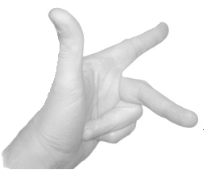
Force (F)
Magnetic Field (B)
Fleming’s Left Hand Rule:
ElectricCurrent (I)
If the central finger, fore finger and thumb of left hand are stretched mutually perpendicular to each other and the central finger points to current, fore finger points to magnetic field, then thumb points in the direction of motion (force) on the current carrying conductor

Slide 5

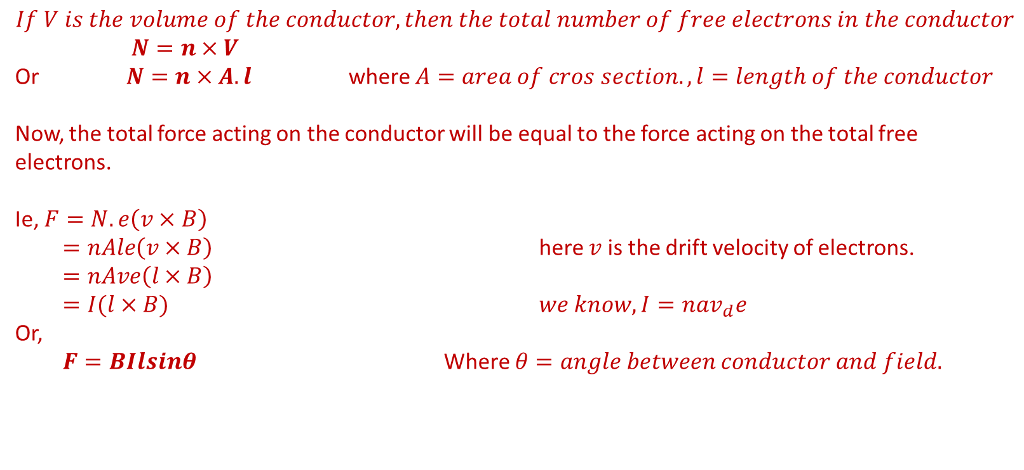
Force on a current-carrying conductor in a uniform Magnetic Field:
$$Force on electron in a magnetic field$$
$$F=e(v×B)$$
$$let n be the number density of free electrons in side the conductor$$
$$If V is the volume of the conductor, then the total number of free electrons in the conductor$$
$$N=n×V$$
Or $N=n×A.l$ where $A=area of cros section., l=length of the conductor$
Now, the total force acting on the conductor will be equal to the force acting on the total free electrons.
Ie, $F=N.e\left(v×B\right)$
$=nAle\left(v×B\right)$ here $v$ is the drift velocity of electrons.
$=nAve\left(l×B\right)$
$=I(l×B)$ $we know, I=nav_{d}e$
Or,
$F=BIlsinθ$ Where $θ=angle between conductor and field.$

Slide 6

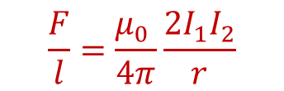





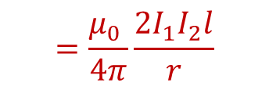
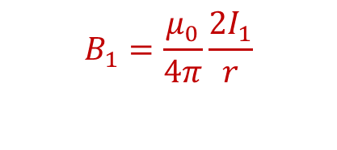
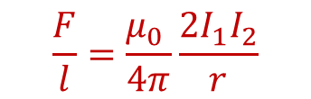
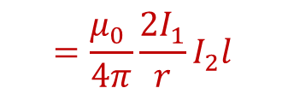


Forces between two parallel infinitely long current-carrying conductors:
Field due to 1 on 2:
$$B_{1}=\frac{μ_{0}}{4π}\frac{2I_{1}}{r}$$
The force acting on $I_{2}$due to this field ,
$$I_{1}$$
$$I_{2}$$
$F=BIl Sinθ$,
$$θ={90}^{0}$$
$$Sinθ=1$$
$$=\frac{μ_{0} }{4π}\frac{2I_{1}}{r}I_{2}l$$
$$=\frac{μ_{0} }{4π}\frac{2I_{1}I_{2}l}{r}$$
$$r$$
The force acting on $I_{2}$ per unit length
$$\frac{F}{l}=\frac{μ_{0} }{4π}\frac{2I_{1}I_{2}}{r}$$
$$\frac{F}{l}=\frac{μ_{0} }{4π}\frac{2I_{1}I_{2}}{r}$$
Similarly ,the force acting on $I_{1}$due to $I_{2} can be written as$ ,

Slide 7

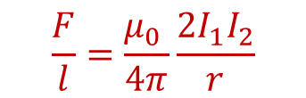


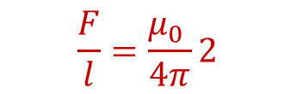
Definition of ampere :
We have
$$\frac{F}{l}=\frac{μ_{0} }{4π}\frac{2I_{1}I_{2}}{r}$$
If $I_{1}=I_{2}=1 A and r=1m$
$$\frac{F}{l}=\frac{μ_{0} }{4π}2$$
$$=\frac{μ_{0} }{2π}$$
$$=2×{10}^{−7} N/m$$
Ampere is that current, when flowed through a pair of infinitely long straight wire separated by 1 m exerts a force of $2×{10}^{−7} N/m$ per unit length of each.

Slide 8


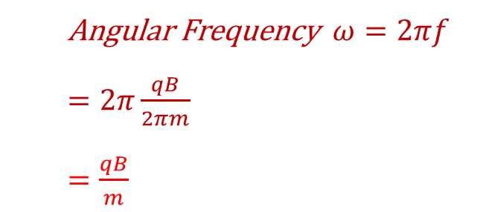


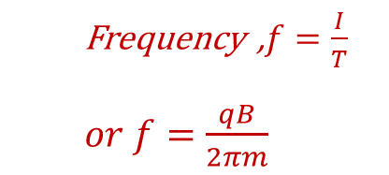

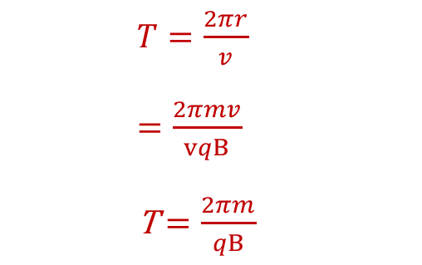



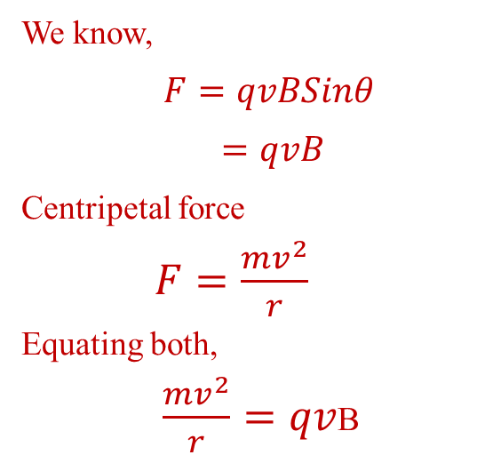
Motion of a charged particle in a Magnetic Field.(Perpendicular to field
Imagine Magnetic field Perpendicular to the plane of the paper. ( Here we assume it is into the paper
Let's imagine a charged particle entering perpendicular to the field
$$V$$
The velocity vector is shown in figure
$$F$$
Lorentz's force acting on the particle will be perpendicular to both
And as result it will turn in to a circular trajectory.
We know,
$F=qvBSinθ$
$=qvB$
Centripetal force
$F=\frac{mv^{2}}{r}$
Equating both,
$\frac{mv^{2}}{r}=qv$B
Time period of circular motion
$$F$$
$$V$$
$T=\frac{2πr}{v}$
$=\frac{2πmv}{vqB}$
T $=\frac{2πm}{qB}$
$$F$$
$$V$$
Angular Frequency $ω=2πf$
$=2π\frac{qB}{2πm}$
$=\frac{qB}{m}$
Frequency ,$f=\frac{I}{T}$
$or f=\frac{qB}{2πm}$
$r=\frac{mv}{qB}$

Slide 9
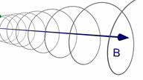
Motion of a charged particle in a Magnetic Field at an arbitrary angle

