Slide 1


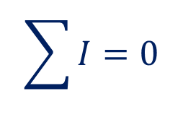







Kirchhoff’s Rules
First Rule/Junction rule
$$I_{2}$$
$$I_{1}$$
$$\sum{I}=0$$
$$I_{5}$$
$$I_{1}+I_{2}−I_{3}+I_{4}+I_{5}=0$$
$$I_{3}$$
$$I_{4}$$
$$Positive$$
$$Junction$$
$$Negative$$

Slide 2
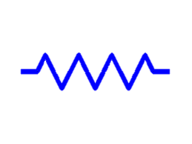





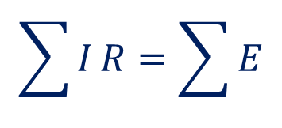







Kirchhoff’s Rules
$$I_{2}$$
$$E_{1}$$
Second Rule/Loop rule
$$I_{1}$$
$$R_{2}$$
$$R_{1}$$
$$\sum{I}R=\sum{E}$$
$$R_{3}$$
$$I_{5}$$
$$R_{5}$$
$$I_{3}$$
$${−I}_{1}R_{1}+I_{2}R_{2}+I_{3}R_{3}+I_{4}R_{4}−I_{5}R_{5}=E_{1}−E_{2}$$
$$R_{4}$$
$$I_{4}$$
$$E_{2}$$

Slide 3




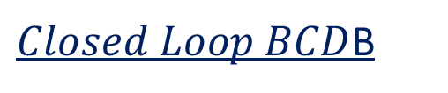


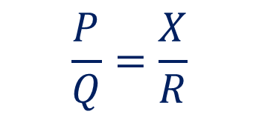





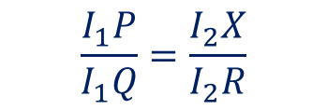



Wheatstone Bridge
C
$$Closed Loop ACDA$$
$Closed Loop BCD$B
P
Q
$$−I_{1}P+I_{G}G+I_{2}X=0$$
$$−\left(I_{1}+I_{G}\right)Q−I_{G}G+(I_{2}−I_{G})R=0$$
$$I_{1}+I_{G}$$
$$I_{G}$$
$$When Balanced$$
$$I_{1}$$
A
$$→$$
B
$$−I_{1}P+I_{2}X=0$$
$$−I_{1}Q+I_{2}R=0$$
$$I_{2}$$
G
$$I_{1}P=I_{2}X$$
$$I_{1}Q=I_{2}R$$
I
X
R
$$\frac{I_{1}P}{I_{1}Q}=\frac{I_{2}X}{I_{2}R}$$
$$I_{2}−I_{G}$$
I
D
$$\frac{P}{Q}=\frac{X}{R}$$
E
E

Slide 4

Wheatstone Bridge- different style rearrangements
C
P
Q
A
$$→$$
B
G
X
R
I
D
E
E
Notes:
p

Slide 5

Wheatstone Bridge- different style rearrangements
C
P
Q
A
$$→$$
B
G
X
R
I
D
E

Slide 6

Wheatstone Bridge- different style rearrangements
C
P
Q
$$→$$
G
A
B
X
R
D
E

