Slide 1
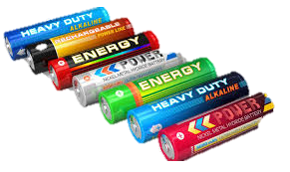
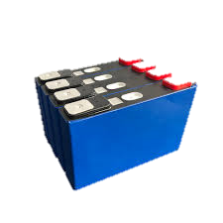

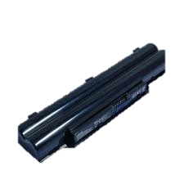
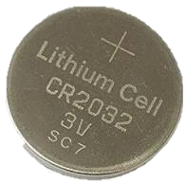
Source of EMFs

Slide 2
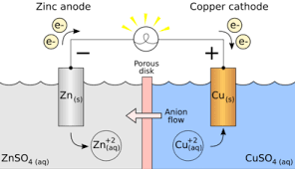

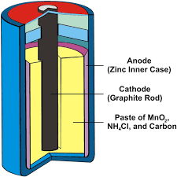
Internal Resistance of a cell
Distance Between Electrodes
Area of Cross section of Electrodes
Nature of Electrolites

Slide 3
Internal Resistance of a cell
The resistance offered by the internal components like, electrolyte, electrode etc of a cell.
Factors affecting the Internal resistance of a cell.
Nature of electrolyte
Distance of separation of electrodes
Area of cross- section of electrodes
External Load

Slide 4
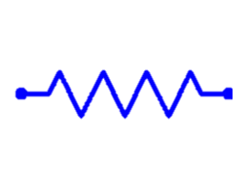
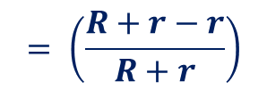
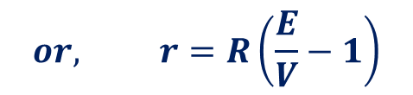


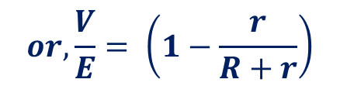
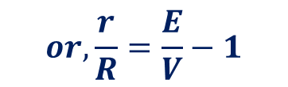


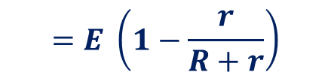

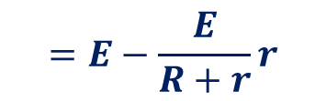
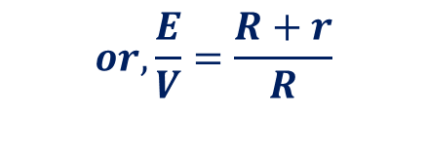

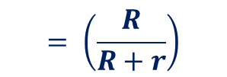

EMF, Internal Resistance and Terminal Potential Difference
$$R$$
$$Current I=\frac{Voltage}{Resistance}$$
$$=\frac{E}{R+r}$$
$$I$$
$$=E−\frac{E}{R+r}r$$
$$=E \left(1−\frac{r}{R+r}\right)$$
$$V=E−Ir$$
$$or, \frac{V}{E}= \left(1−\frac{r}{R+r}\right)$$
$$= \left(\frac{R+r−r}{R+r}\right)$$
$$= \left(\frac{R}{R+r}\right)$$
$$or,\frac{E}{V}=\frac{R+r}{R}$$
$$E,r$$
$$= 1+\frac{r}{R}$$
V
$$or,\frac{r}{R}=\frac{E}{V}−1$$
$$or, r=R\left(\frac{E}{V}−1\right)$$

Slide 5












Grouping of cells –Series
$$R$$
$$I$$
$$V=V_{1}+V_{2}+V_{3}+…$$
$$V=E−Ir$$
$$V=E_{1}−Ir_{1}+E_{2}−Ir_{2}+…+E_{n}−Ir_{n}$$
$$=E_{1}+E_{2}+E_{3}+ …−I(r_{1}+r_{2}+…+r_{n})$$
$$V=E_{eq}−I(r_{eq})$$
$$E_{eq}−V=I(r_{eq})$$
$$E_{1},r_{1}$$
$$E_{2},r_{2}$$
$$E_{n},r_{n}$$
$$I=(V−E_{eq})/ r_{eq}$$
$${E_{eq}=E}_{1}+E_{2}+E_{3}+E_{n}$$
$$r_{eq}=r_{1}+r_{2}+…+r_{n}$$

Slide 6

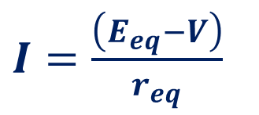
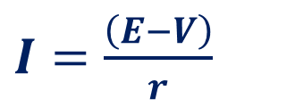


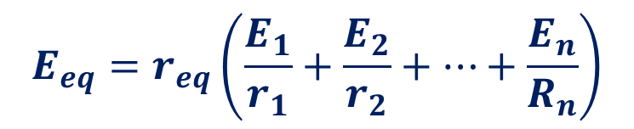


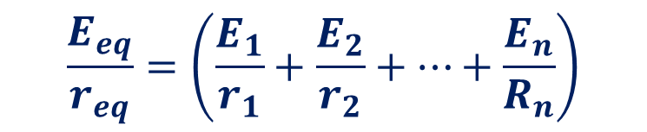



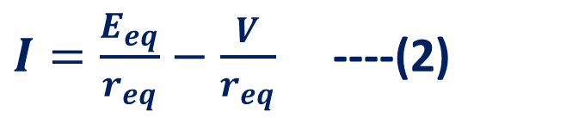
Grouping of cells -Parallel
$I=\frac{\left(E−V\right)}{r}$
$$R$$
$$I$$
$$I=I_{1}+I_{2}+I_{3}+…$$
$$I=\frac{\left(E_{1}−V\right)}{r_{1}}+\frac{\left(E_{2}−V\right)}{r_{2}}+…+\frac{\left(E_{n}−V\right)}{r_{n}}$$
$${I_{1},E}_{1},r_{1}$$
$I=\left(\frac{E_{1}}{r_{1}}+\frac{E_{2}}{r_{2}}+…+\frac{E_{n}}{R_{n}}\right)−V\left( \frac{1}{r_{1}}+\frac{1}{r_{2}}+…+\frac{1}{r_{n}}\right)$ ----(1)
$${I_{2},E}_{2},r_{2}$$
$I=\frac{\left(E_{eq}−V\right)}{r_{eq}}$
$I=\frac{E_{eq}}{r_{eq}}−\frac{V}{r_{eq}}$ ----(2)
$${I_{n},E}_{n},r_{n}$$
$$\frac{E_{eq}}{r_{eq}}=\left(\frac{E_{1}}{r_{1}}+\frac{E_{2}}{r_{2}}+…+\frac{E_{n}}{R_{n}}\right)$$
$$E_{eq}=r_{eq}\left(\frac{E_{1}}{r_{1}}+\frac{E_{2}}{r_{2}}+…+\frac{E_{n}}{R_{n}}\right)$$
$$r_{eq}=\left( \frac{1}{r_{1}}+\frac{1}{r_{2}}+…+\frac{1}{r_{n}}\right)$$

