Slide 1
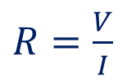


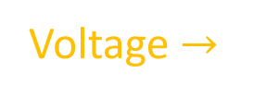




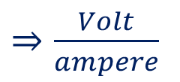
Ohm’s Law- Molecular View
V
A
Current $→$
Voltage $prportional$to Current
Voltage $→$
If temperature is a constant.
$$V∝I$$
$$V=IR$$
$$R=Resistance of the conductor$$
$R=\frac{V}{I}$
$⇒\frac{Volt}{ampere}$
$⇒ohm (Ω)$

Slide 2
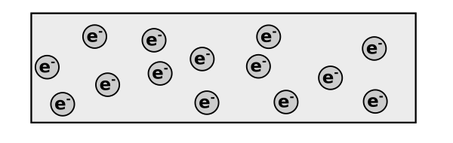


Ohm’s Law- Molecular View
$$Relaxation time τ$$
$$Average velcoity of electrons \overline{u}$$
$$=u_{1}+u_{2}+u_{3}+…=0$$

Slide 3
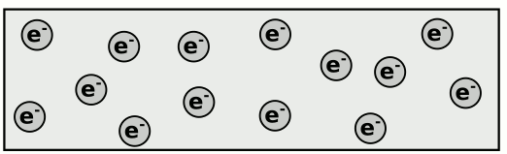

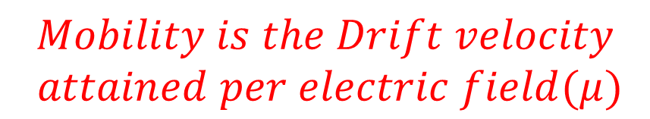
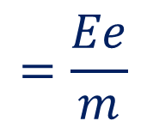
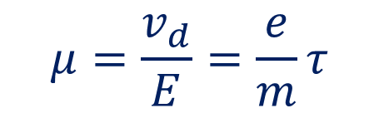
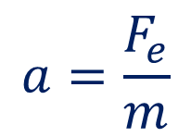

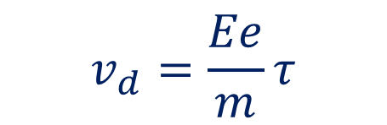

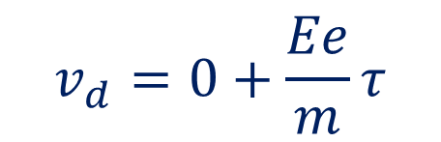
Ohm’s Law- Molecular View
$$Average velcoity of electrons \overline{u}$$
$$=u_{1}+u_{2}+u_{3}+…=0$$
$$a=\frac{F_{e}}{m}$$
$$=\frac{Ee}{m}$$
$$Mobility is the Drift velocity$$
$$attained per electric field(μ)$$
$$F_{e}=Ee$$
$$v=u+at$$
$$μ=\frac{v_{d}}{E}=\frac{e}{m}τ$$
$$v_{d}=0+\frac{Ee}{m}τ$$
$$v_{d}=\frac{Ee}{m}τ$$
$$v_{d}is called drift velocity$$

Slide 4
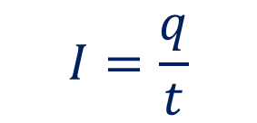
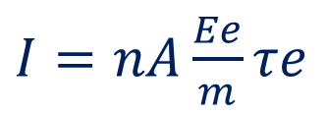
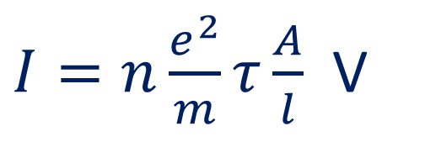
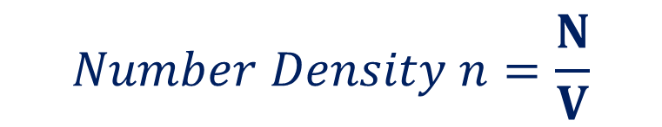


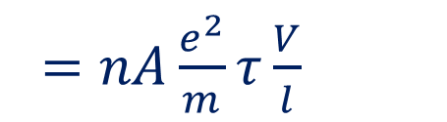

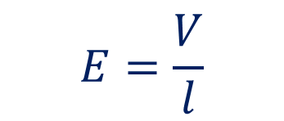


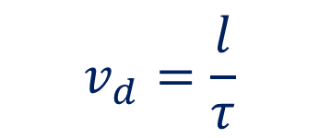

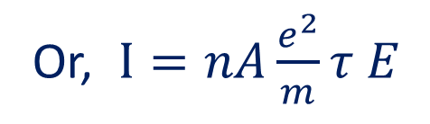



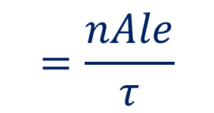
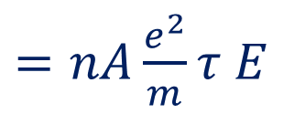
$$v_{d}=\frac{Ee}{m}τ$$
$$v_{d}=\frac{l}{τ}$$
$$Number Density n=\frac{N}{V}$$
$$A$$
$$l$$
$$Volume=A l$$
$$E=\frac{V}{l}$$
$$q=Ne$$
$$=n.Ve$$
$$=n.Ale$$
Or, $I=nA\frac{e^{2}}{m}τ E$
$$I=\frac{q}{t}$$
$$=\frac{nAle}{τ}$$
$=nAv_{d}e$
$=nA\frac{e^{2}}{m}τ\frac{V}{l}$
$I=nAv_{d}e$
$I=n\frac{e^{2}}{m}τ\frac{A}{l}$ V
$I=nA\frac{Ee}{m}τe$
$=nA\frac{e^{2}}{m}τ E$

Slide 5

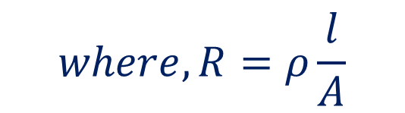
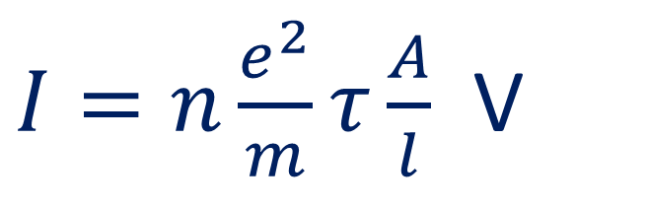


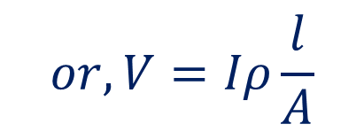
$I=n\frac{e^{2}}{m}τ\frac{A}{l}$ V
$$A$$
$$l$$
$$V=I\frac{m}{ne^{2}τ}\frac{l}{A}$$
$$or,V=Iρ\frac{l}{A}$$
$$where,ρ=\frac{m}{ne^{2}τ}$$
$$where,R=ρ\frac{l}{A}$$
$$or, V=IR$$

Slide 6
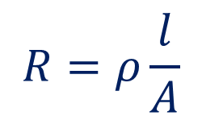
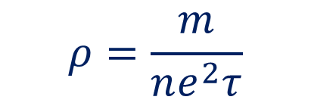
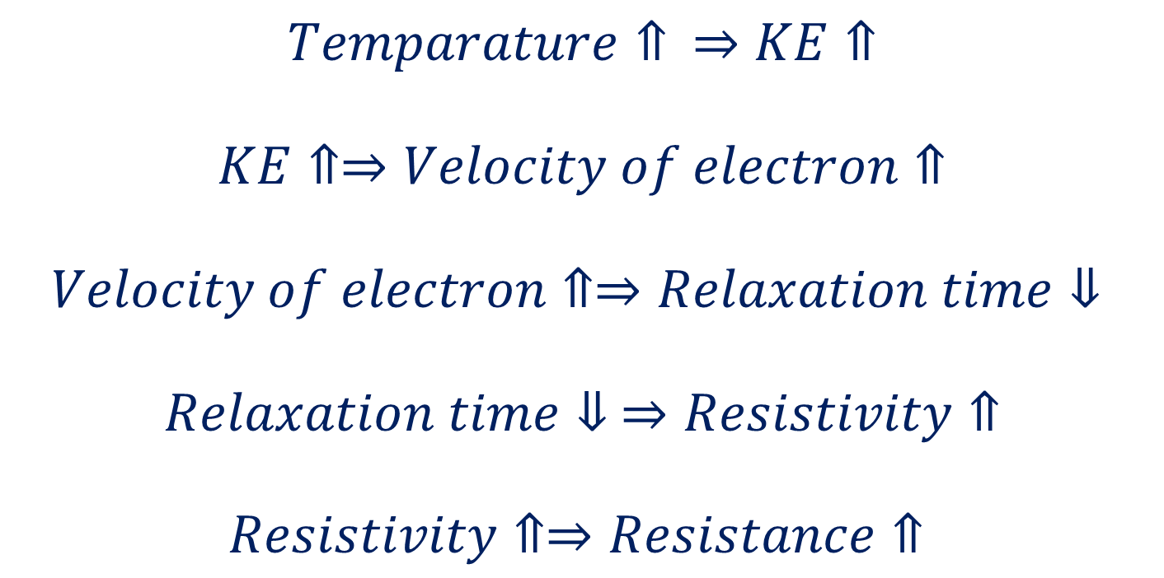
Resistivity- Molecular View
$$R=ρ\frac{l}{A}$$
$$ρ=\frac{m}{ne^{2}τ}$$
$$Temparature⇑ ⇒KE⇑$$
$$KE⇑⇒Velocity of electron⇑$$
$$Velocity of electron⇑⇒Relaxation time⇓$$
$$Relaxation time⇓ ⇒Resistivity⇑$$
$$Resistivity⇑⇒Resistance⇑$$

Slide 7

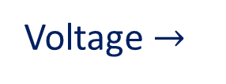
Temperature Dependence of Resistance and Resistivity
Current $→$
Voltage $→$

Slide 8

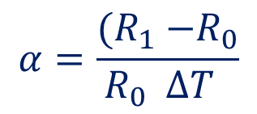
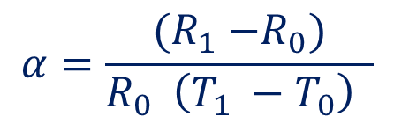

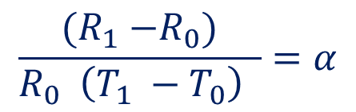



Temperature Dependence of Resistance and Resistivity
$$ρ_{T}=ρ_{0}\left[1+α(T−T_{0})\right]$$
$$ρ_{T} is the resistivity at temperature T$$
$$ρ_{0} is the resistivity at temperature T_{0}$$
$$R_{T}=R_{0}\left[1+α(T−T_{0})\right]$$
$$R_{T} is the resistance at temperature T$$
$$R_{0} is the resistance at temperature T_{0}$$
$$R_{1} =R_{0}\left[1+α(T_{1}−T_{0})\right]$$
$=R_{0}$ $+αR_{0}(T_{1}−T_{0})$
$$α=\frac{{(R}_{1} −R_{0})}{R_{0} \left(T_{1} −T_{0}\right) }$$
$$R_{1} −R_{0}=αR_{0}(T_{1}−T_{0})$$
$$\frac{{(R}_{1} −R_{0})}{R_{0} \left(T_{1} −T_{0}\right) }=α$$
$$α=\frac{{(R}_{1} −R_{0}}{R_{0} ΔT }$$

Slide 9
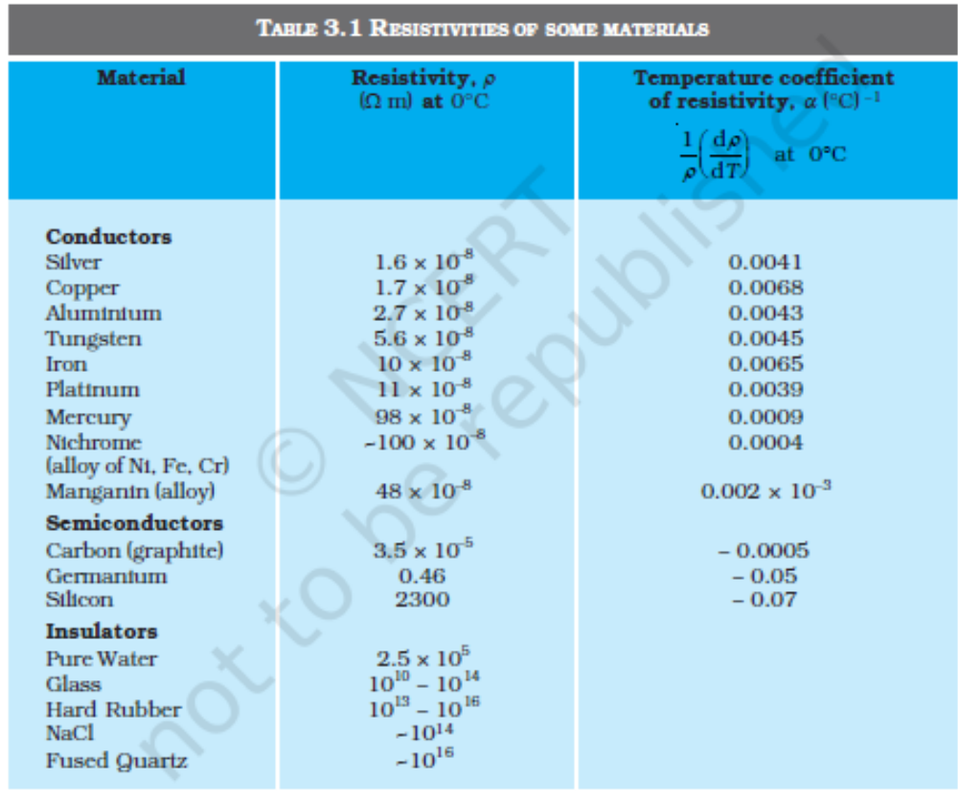
$$Table of electrical propertirs$$

Slide 10
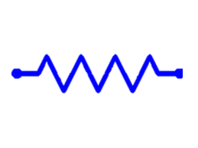















$$Resistance in Series$$
$$R_{1}$$
$$R_{2}$$
$$R_{3}$$
$$V=V_{1}+V_{2}+V_{3}$$
$$V_{1}$$
$$V_{2}$$
$$V_{3}$$
$$V=IR_{1}+IR_{2}+IR_{3}$$
$$I$$
$$V=IR$$
$$IR=IR_{1}+IR_{2}+IR_{3}$$
$$V$$
$$R=R_{1}+R_{2}+R_{3}$$
$R=R_{1}+R_{2}+R_{3}$+…
$$R=\sum_{i=1}^{n}{R_{i}}$$

Slide 11















$$Resistance in Parallel$$
$$R_{1}$$
$$I_{1}$$
$$R_{2}$$
$$I=I_{1}+I_{2}+I_{3}$$
$$I_{2}$$
$$R_{3}$$
$$I=\frac{V}{R_{1}}+\frac{V}{R_{2}}+\frac{V}{R_{3}}$$
I$=\frac{V}{R}$
$$I_{3}$$
$$\frac{V}{R}=\frac{V}{R_{1}}+\frac{V}{R_{2}}+\frac{V}{R_{3}}$$
$$I$$
$$V$$
$$\frac{1}{R}=\frac{1}{R_{1}}+\frac{1}{R_{2}}+\frac{1}{R_{3}}$$
$\frac{1}{R}=\frac{1}{R_{1}}+\frac{1}{R_{2}}+\frac{1}{R_{3}}$ +…
$$\frac{1}{R}=\sum_{i=1}^{n}{\frac{1}{R_{i}} }$$

Slide 12




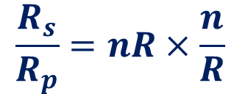

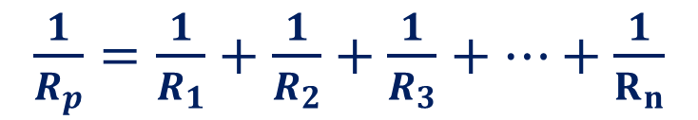
$$A problem$$
‘n’ equal resistors are connected in series and then in parallel. Find the ratio of equivalent resistances
$$R_{S}=R_{1}+R_{2}+R_{3}+…+R_{n}$$
$$=nR$$
$\frac{1}{R_{p}}=\frac{1}{R_{1}}+\frac{1}{R_{2}}+\frac{1}{R_{3}}+…+\frac{1}{R_{n}}$
$$=\frac{n}{R}$$
$$\frac{R_{s}}{R_{p}}=nR×\frac{n}{R}$$
$$=n^{2}$$

Slide 13



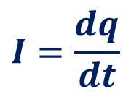


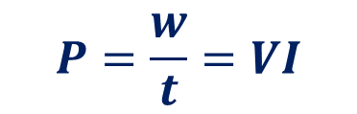







$$Electrical Energy and Power$$
$$R$$
$$dq$$
$$I$$
$$dw=Vdq$$
$$V$$
$$I=\frac{dq}{dt}$$
$$w=∫Vdq$$
$$dq=Idt$$
$$w=∫VIdt$$
$$=VI∫dt$$
$$=VIt$$
$$P=\frac{w}{t}=VI$$
$$=I^{2}R$$

