Slide 1






Electric Current : The Flow of charges
Pressure difference ${P=P}_{1}−P_{2}$
$$P_{2}$$
Charge flowing through a conductor requires
$$V_{2}$$
Potential difference ${V=V}_{1}−V_{2}$
$$P_{1}$$
A fluid Flowing through a Pipe
$$V_{1}$$

Slide 2

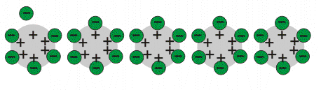




Electric Current : The Flow of charges
$$−$$
$$+$$
Conventional current
$$−$$
$$+$$

Slide 3







Electric Current Intensity (I) : The Rate of Flow of charges
Electric Current Intensity $I=\frac{q}{t}$
$$Unit ⇒\frac{Coulomb}{Second}$$
=$ampere$
Electric Current Intensity $I=\underset{t →0 }{Lim}{\frac{q}{t}}$
$$=\frac{dq}{dt}$$
$$−$$
$$+$$

Slide 4
Ohm’s Law

Slide 5
Ohm’s Law

Slide 6
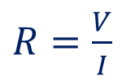







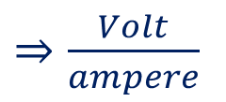
Ohm’s Law
V
A
Current $→$
Voltage $∝$to Current
Voltage $→$
If temperature is a constant.
V $∝$I
$$V=IR$$
$$R=Resistance of the conductor$$
$R=\frac{V}{I}$
$⇒\frac{Volt}{ampere}$
$⇒ohm (Ω)$

Slide 7

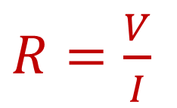

Ohm’s Law
$R=\frac{V}{I}$
$$V=IR$$
Resistance is the property of given conductor
If
Its length changes
Its area of cross section changes
Temperature changes
Constitution changes
Then resistance changes.

Slide 8


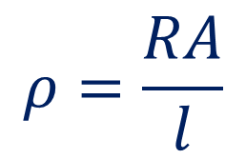
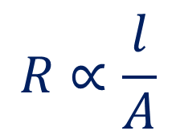

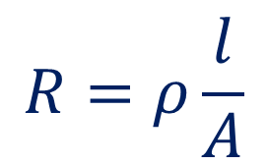
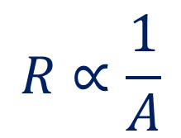
Resistivity
$$R∝\frac{1}{A}$$
$$R∝\frac{l}{A}$$
$$R∝l$$
$$R=ρ\frac{l}{A}$$
$$ρ=\frac{RA}{l}$$
$$Unit⇒\frac{Ωm^{2}}{m}$$
$$=Ω m$$

Slide 9

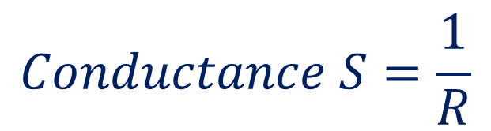

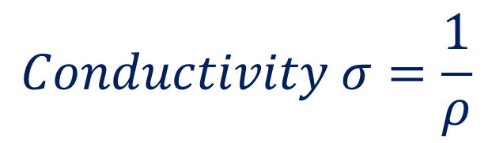
Conductance and Conductivity
$$Conductance S=\frac{1}{R}$$
$$Unit⇒Ω^{−1} \left(mho\right)$$
$$Conductivity σ=\frac{1}{ρ}$$
$$Unit⇒Ω^{−1}m^{−1} \left(mho m^{−1}\right)$$

Slide 10
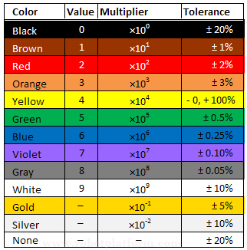

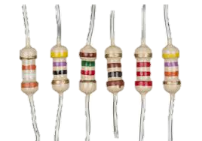
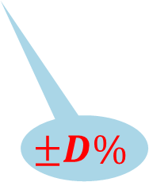


Carbon Resistors-Not in syllabus
A
B
$$×10^{C}$$
$$±D\%$$
$$16×10^{2} ±5\%$$
B B R O Y Great Britain Very Good
Wife
0 1 2 3 4 5 6 7 8 9

