Slide 1
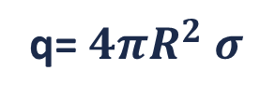
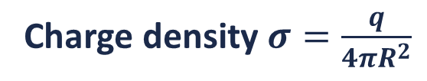
Electric Field due to a spherical shell
Inside
Outside
R
Charge density $σ=\frac{q}{4πR^{2}}$
q= $4πR^{2} σ$

Slide 2



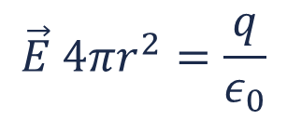
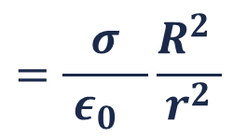
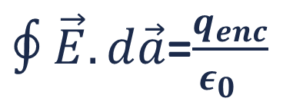

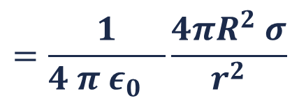

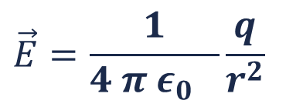

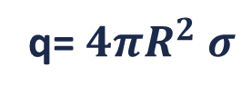

Electric Field outside a spherical shell
$$\vec{E}$$
P
$∮\vec{E}.d\vec{a}$=$\frac{q_{enc}}{ε_{0} }$
$$d\vec{a}.$$
r
$$∮\vec{E}.d\vec{a}$$
$$=\vec{E}∫d\vec{a}$$
$$=\vec{E} 4πr^{2}$$
R
Charge density $σ=\frac{q}{4πR^{2}}$
$$q_{enc}=q$$
q= $4πR^{2} σ$
$$\vec{E} 4πr^{2}=\frac{q}{ε_{0}}$$
$$\vec{E}=\frac{1}{4 π ε_{0} }\frac{q}{r^{2}}$$
$$=\frac{1}{4 π ε_{0} }\frac{4πR^{2} σ}{r^{2}}$$
$$=\frac{σ}{ ε_{0} }\frac{R^{2} }{r^{2}}$$
E→
R→

Slide 3

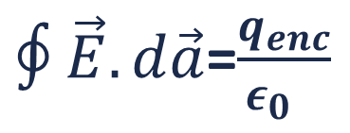
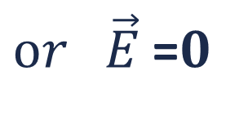
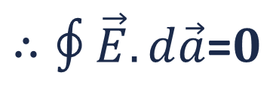
Electric Field inside a spherical shell
$∮\vec{E}.d\vec{a}$=$\frac{q_{enc}}{ε_{0} }$
P
r
$$q_{enc}=0$$
R
$∴∮\vec{E}.d\vec{a}$=$0$
$or \vec{E}$=$0$
Electrostatic shielding
Electrostatic field inside a metal cavity is zero.
We will comeback to this later…

Slide 4
Variation of Electric Field due to a spherical shell with the distance from the centre
→
E
R
r > R
r < R
r < R
r > R

Slide 5
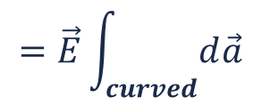
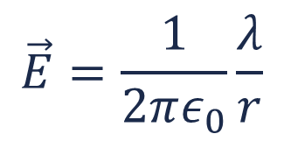

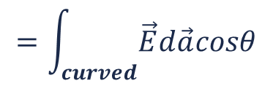


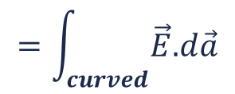

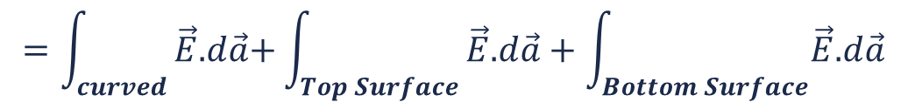
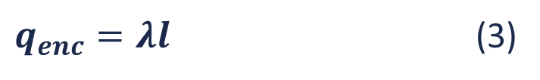


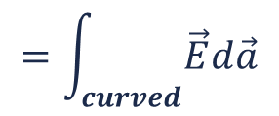
Electric Field due to an infinitely long line charge
+
+
++++++++++++++++++
$We have Gauss ′theorem,∮\vec{E}.d\vec{a}$=$\frac{q_{enc}}{ε_{0} }$ (1)
$$=\int_{curved}{\vec{E}\text{.}d\vec{a}\text{+}\int_{Top Surface}{\vec{E}\text{.}d\vec{a}+\int_{Bottom Surface}{\vec{E}\text{.}d\vec{a} }}}$$
$$∮\vec{E}.d\vec{a}$$
$$=\int_{curved}{\vec{E}\text{.}d\vec{a}}$$
$$=\int_{curved}{\vec{E}d\vec{a}cosθ}$$
$$=\int_{curved}{\vec{E}d\vec{a}}$$
$$=\vec{E}\int_{curved}{d\vec{a}}$$
P
$=\vec{E}2πr l$ (2)
r
$$l$$
$q_{enc}=λl$ (3)
Applying in Gauss 'theorem
$$\vec{E}=\frac{1}{2πε_{0}}\frac{λ}{r}$$
$$\vec{\text{E}}.2πr l$$
$$=λl/ε_{0}$$
Note: For illustrative purposes, the electric field lines in the figure are not drawn with uniform spacing, although the actual electric field lines are uniform

Slide 6
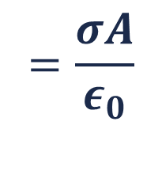


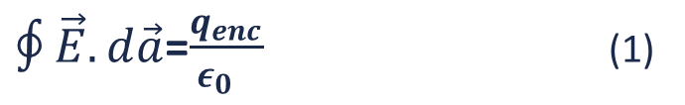
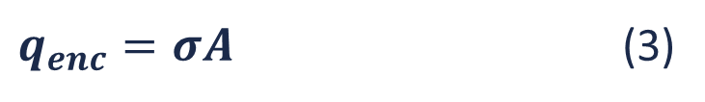

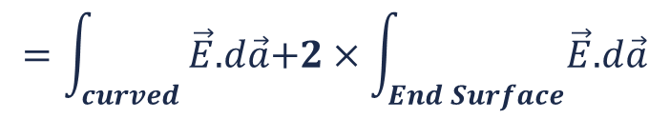
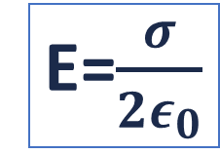
Electric Field due to an infinite plane sheet of charge
σ
+ + + + + + + + + + + + + + + + + +
+ + + + + + +
+ + +
$∮\vec{E}.d\vec{a}$=$\frac{q_{enc}}{ε_{0} }$ (1)
$$=\int_{curved}{\vec{E}\text{.}d\vec{a}\text{+}2×\int_{End Surface}{\vec{E}\text{.}d\vec{a}}}$$
$=\text{2}×\vec{E}A$ (2)
$$∮\vec{E}.d\vec{a}$$
r
P
$q_{enc}=σA$ (3)
A
$$=\frac{σA}{ε_{0}}$$
$$\text{2}×\vec{E}\text{.}A$$
E=$\frac{σ}{{2ε}_{0}}$
Note: For illustrative purposes, the electric field lines and charge distribution in the figure are not drawn with uniform spacing, although the actual case they are uniform

Slide 7
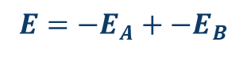
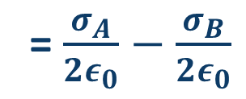
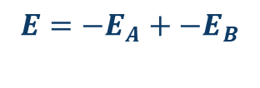



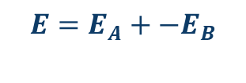
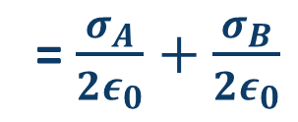

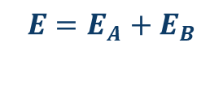
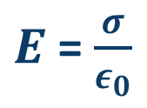




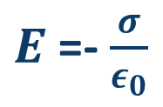


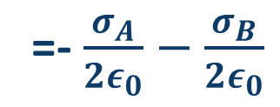
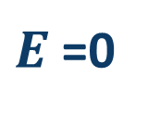

Pair of sheets- same kind(Positive)
$$σ_{A}$$
$$σ_{B}$$
+ + + + + + + + + + + + + + + + + +
+ + + + + + +
+ + +
+ + + + + + + + + + + + + + + + + +
+ + + + + + +
+ + +
$$E=−E_{A}+−E_{B}$$
=- $\frac{σ_{A}}{{2ε}_{0}}−\frac{σ_{B}}{{2ε}_{0}}$
$$E_{B}$$
$$E_{B}$$
$$E_{B}$$
$$E_{A}$$
$$E_{A}$$
$$E_{A}$$
$$E=E_{A}+E_{B}$$
$$E=E_{A}+−E_{B}$$
= $\frac{σ_{A}}{{2ε}_{0}}+\frac{σ_{B}}{{2ε}_{0}}$
$${if σ}_{A}=σ_{B}$$
= $\frac{σ_{A}}{{2ε}_{0}}−\frac{σ_{B}}{{2ε}_{0}}$
$E$=- $\frac{σ}{ε_{0}}$
$E$= $\frac{σ}{ε_{0}}$
$${if σ}_{A}=σ_{B}$$
$${if σ}_{A}=σ_{B}$$
$E$=0
Note: For illustrative purposes, the electric field lines and charge distribution in the figure are not drawn with uniform spacing, although the actual case they are uniform
$$E=−E_{A}+−E_{B}$$

Slide 8
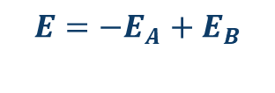
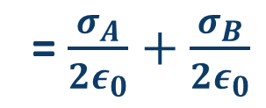
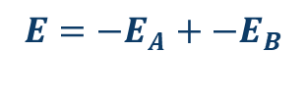



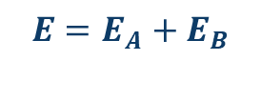
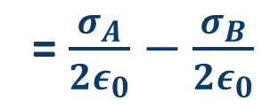

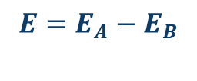
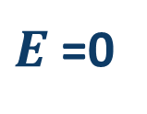







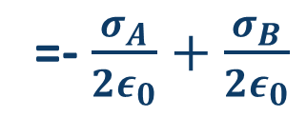
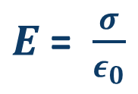

Pair of sheets-opposite kind
$$σ_{A}$$
$$σ_{B}$$
+ + + + + + + + + + + + + + + + + +
+ + + + + + +
+ + +
- - - - - - - - - - - - - - - - - -
- - - - - - -
- - -
$$E=−E_{A}+E_{B}$$
=- $\frac{σ_{A}}{{2ε}_{0}}+\frac{σ_{B}}{{2ε}_{0}}$
$$E_{B}$$
$$E_{B}$$
$$E_{B}$$
$$E_{A}$$
$$E_{A}$$
$$E_{A}$$
$$E=E_{A}+E_{B}$$
= $\frac{σ_{A}}{{2ε}_{0}}+\frac{σ_{B}}{{2ε}_{0}}$
$$E=E_{A}−E_{B}$$
$${if σ}_{A}=σ_{B}$$
= $\frac{σ_{A}}{{2ε}_{0}}−\frac{σ_{B}}{{2ε}_{0}}$
$${if σ}_{A}=σ_{B}$$
$E$= $\frac{σ}{ε_{0}}$
$E$=0
$${if σ}_{A}=σ_{B}$$
$E$=0
Note: For illustrative purposes, the electric field lines and charge distribution in the figure are not drawn with uniform spacing, although the actual case they are uniform
$$E=−E_{A}+−E_{B}$$

