Slide 1

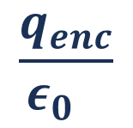
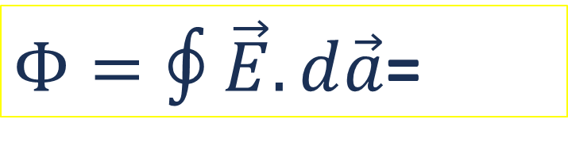
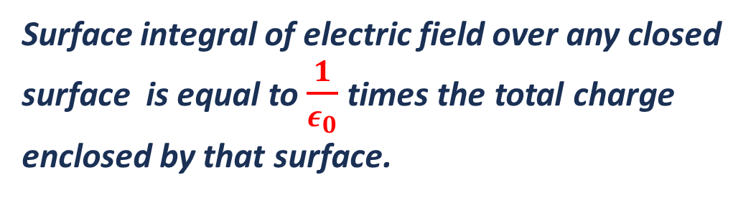

Gauss’ theorem of Electrostatics
Surface integral of electric field over any closed surface is equal to $\frac{1}{ε_{0}}$times the total charge enclosed by that surface.
q
$Φ=∮\vec{E}.d\vec{a}$=
$$\frac{q_{enc}}{ε_{0} }$$
r
$$d\vec{a}.$$
$$\vec{E}.$$
NB: Surface integral of electric field over any closed surface is the flux over the surface
Notes:
Good evening, everyone. Today we are going to explore one of the most powerful theorems in electrostatics — Gauss' Theorem. In simple terms, this theorem tells us that the total electric flux passing through any closed surface is directly proportional to the net charge enclosed inside that surface. The proportionality constant is 1 over epsilon-naught, the permittivity of free space. Notice the key phrase here — "any closed surface." It does not matter what shape the surface is — a sphere, a cube, or an irregular blob — as long as it is closed, the theorem holds. This idea is incredibly useful because it lets us calculate electric fields for symmetric charge distributions without doing complicated integrals. Keep in mind that Gauss' theorem is actually one of Maxwell's four fundamental equations of electromagnetism, so what we learn today forms the foundation for much deeper physics.

Slide 2







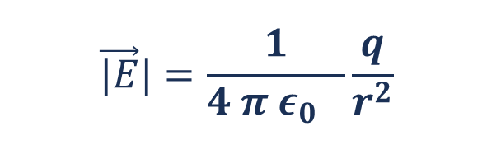
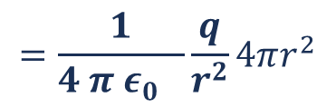
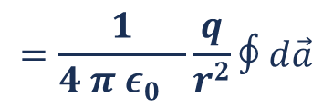
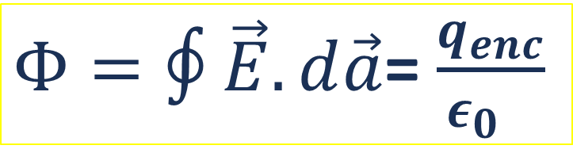
Gauss’ theorem of Electrostatics- Proof
$$\vec{|E}|=\frac{1}{4 π ε_{0} }\frac{q}{r^{2}}$$
Magnitude of electric filed
At any point is same due to symmetry
q
Now, let’s find the flux
r
$$dφ=\vec{E}.d\vec{a}$$
$$d\vec{a}.$$
$$∴φ=$$
$$∮\vec{E}.d\vec{a}$$
$$=∮\vec{E}.d\vec{a} cosθ$$
=$∮\vec{E}d\vec{a}$
P
$$\vec{E}.$$
$$=\frac{1}{4 π ε_{0} }\frac{q}{r^{2}}∮d\vec{a}$$
$$=\frac{1}{4 π ε_{0} }\frac{q}{r^{2}}4πr^{2}$$
=$\frac{q}{ε_{0} }$
$Φ=∮\vec{E}.d\vec{a}$= $\frac{q_{enc}}{ε_{0} }$
Notes:
Now let us prove Gauss' theorem step by step. We start from what we already know — Coulomb's law. Consider a point charge q placed at the origin, and imagine a spherical Gaussian surface of radius r centered on it. From Coulomb's law, the electric field at any point on this sphere has magnitude E equals 1 over 4 pi epsilon-naught times q over r squared. Because of the spherical symmetry, E points radially outward and is the same at every point on the surface. So the flux integral becomes straightforward — E dot dA simply equals E times dA, since E and the area vector are parallel everywhere on the sphere. Integrating over the entire spherical surface, we get E times 4 pi r squared. Substituting the expression for E, the r squared terms cancel beautifully, and we are left with q over epsilon-naught. This is exactly what Gauss' theorem states. The elegant part is that this result extends to any closed surface, not just spheres, because the inverse-square dependence of the electric field ensures the flux depends only on the enclosed charge, regardless of the surface geometry.

Slide 3




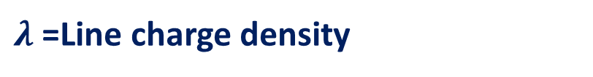
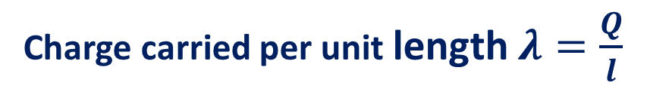

Charge distributions
-Linear charge distribution
q
q
q
q
q
q
q
q
$$dl$$
q
q
q
q
q
q
q
q
q
q
q
Charge carried by length $l→Q$
Charge carried per unit length $λ=\frac{Q}{l}$
$λ$=Line charge density
Charge carried in small length d$l→dQ$
$$dQ=λdl$$
$$q=∫dQ=∫λdl$$
Notes:
Let us now shift our focus to how charges are distributed in real physical systems. In practice, we rarely deal with isolated point charges — instead, charge is spread over wires, surfaces, and volumes. We begin with the simplest case: linear charge distribution. Think of a long, thin charged wire. Here, the charge is spread along a one-dimensional line. We define a quantity called linear charge density, denoted by lambda, which tells us how much charge exists per unit length. Its unit is coulombs per meter. If we want to find the charge on a tiny segment of length dl, we simply write dq equals lambda times dl. To get the total charge over a finite length, we integrate lambda over that length. This concept comes up frequently — for instance, when applying Gauss' law to find the electric field around an infinitely long charged wire, lambda is exactly the quantity we need. You will also encounter it in problems involving charged rings and semicircular arcs.

Slide 4





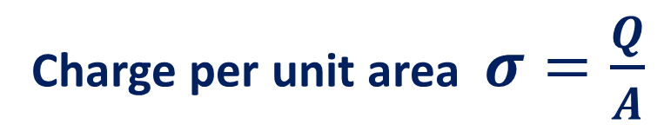
Charge distributions
-Surface charge distribution
Charge distributed in area A$→Q$
Charge per unit area $σ=\frac{Q}{A}$
dA
$σ$=Surface charge density
Charge carried in small area dA$→dQ$
$$dQ=σdA$$
$$Q= ∫dQ=∫σdA$$
Notes:
Moving up one dimension, we now consider surface charge distribution. This is what happens when charge is spread over a two-dimensional surface — imagine a charged metallic plate or the surface of a conductor. Here we define the surface charge density, denoted by sigma, which represents charge per unit area. Its unit is coulombs per square meter. For a small patch of area dA on the surface, the charge on that patch is dQ equals sigma times dA. To find the total charge on the entire surface, we integrate sigma over the full area A. This concept is absolutely central to several important applications. For example, in a parallel plate capacitor, the charge resides on the surfaces of the plates, and sigma directly determines the electric field between them. Similarly, on the surface of a conductor in electrostatic equilibrium, all excess charge sits on the outer surface, and sigma tells us how that charge is distributed. Remember — sigma can vary from point to point on the surface unless the distribution is uniform.

Slide 5
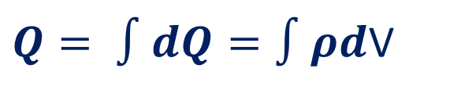
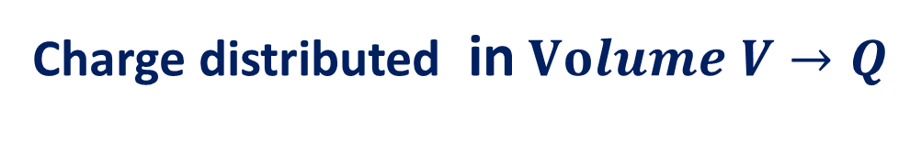

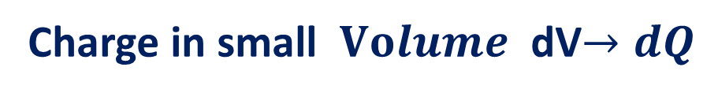

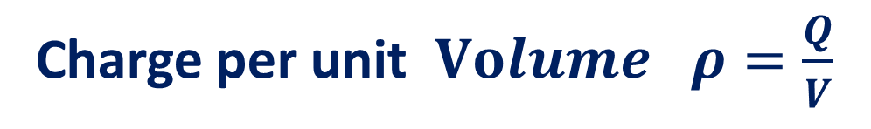
Charge distributions
-Volume charge distribution
Charge distributed in $Volume V→Q$
Charge per unit $Volume$ $ρ=\frac{Q}{V}$
$ρ$= $Volume$ charge density
dV
Charge in small $Volume$ dV$→dQ$
$$dQ=ρdV$$
$Q= ∫dQ=∫ρd$V
Notes:
Finally, we come to the most general case — volume charge distribution. This applies when charge is spread throughout a three-dimensional region of space. A classic example is a uniformly charged solid sphere or a charged cloud. We define the volume charge density, denoted by rho, as the charge per unit volume, measured in coulombs per cubic meter. For a tiny volume element dV, the charge contained in it is dQ equals rho times dV. The total charge in the entire volume V is obtained by integrating rho over that volume. This is the most general form of charge distribution because any physical charge arrangement — whether on a line, surface, or throughout a volume — can ultimately be described using volume charge density. When we apply Gauss' law to problems like finding the electric field inside a uniformly charged sphere, it is rho that tells us how much charge is enclosed within our Gaussian surface. To summarize our discussion today: lambda, sigma, and rho give us a systematic way to describe charge spread over one, two, and three dimensions respectively, and each connects directly to how we apply Gauss' theorem in practice.

