Slide 1
Electric Charge & Field Concept
+Q
Notes:
ELECTRIC CHARGE, FIELD LINES & ELECTRIC FLUX
Unified Lesson Plan | Grade 9-12 Physics | ~50 min
LESSON OVERVIEW
Topic: Electric charge, electric field lines, and electric flux.
LESSON FLOW (approximate)
Slides 1-2 (5 min) — Hook & introduction to field lines from a point charge
Slide 3 (5 min) — Formal definition of electric field lines (Faraday)
Slides 4-5 (14 min) — Field patterns for charge pairs + properties of field lines
Slide 6 (5 min) — Introduction to electric flux and its importance
Slide 7 (5 min) — Area vectors and effective area concept
Slides 8-9 (10 min) — Calculating flux: perpendicular and angled cases
Slide 10 (5 min) — Summary with rain analogy + all three formulas
Slide 11 (5 min) — General case (integration) + exit ticket & homework
WARM-UP / HOOK (5 min)
Rub a balloon on hair or wool, hold it near small paper bits.
Ask: What invisible force is at work here?
Let students share observations to activate prior knowledge about static electricity.
Introduce today's goal: we will learn to visualise and measure the invisible force fields around charges.

Slide 2
+Q
Electric Field Lines from a Point Charge
Notes:
ELECTRIC CHARGE, FIELD LINES & ELECTRIC FLUX
Unified Lesson Plan | Grade 9-12 Physics | ~50 min
SECTION 1 — FIELD LINES FROM A POINT CHARGE [Slide 2 of 11] (continued from hook)
SAY / DO
Point to the +Q diagram. Explain that field lines radiate outward from a positive charge in all directions.
Emphasise: the density of lines shows field strength — closer to the charge means stronger field.
Arrows show the direction a tiny positive test charge would move if placed in the field.
THINK-PAIR-SHARE (1 min)
Ask: Imagine placing a tiny positive test charge near +Q. Which way does it move? Does it accelerate more when close or far from +Q?
Students discuss in pairs, then share out.
MISCONCEPTION ALERT
Students often believe field lines are real physical things. Stress that they are a visualisation tool — an imaginary map of the field.
QUICK CHECK
If we replaced +Q with -Q, which way would the arrows point? (Inward, toward the negative charge.)

Slide 3
What Are Electric Field Lines?
Imaginary curves drawn in a region of space to indicate the direction and relative strength of the electric field at various points. It is the path followed by a positive test charge placed in a field, if it is free to move.
Introduced by Michael Faraday to visualize electric fields
Notes:
ELECTRIC CHARGE, FIELD LINES & ELECTRIC FLUX
Unified Lesson Plan | Grade 9-12 Physics | ~50 min
SECTION 2 — DEFINING ELECTRIC FIELD LINES [Slide 3 of 11] (5 min)
SAY / DO
Read the definition aloud: imaginary curves showing the direction and relative strength of the electric field.
Highlight that a free positive test charge placed in the field would follow these curves.
Credit Michael Faraday for inventing the concept to make the invisible visible.
GUIDED NOTE-TAKING
Have students write the definition in their own words in notebooks.
Prompt: Why do scientists build models like field lines rather than relying only on equations?
(Models help us visualise, predict, and communicate.)
DIFFERENTIATION
For struggling learners: compare field lines to wind-direction arrows on a weather map — you cannot see the wind, but the arrows show where it blows and how strong it is.

Slide 4
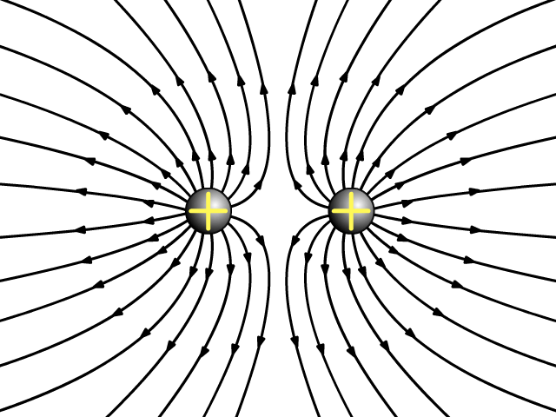
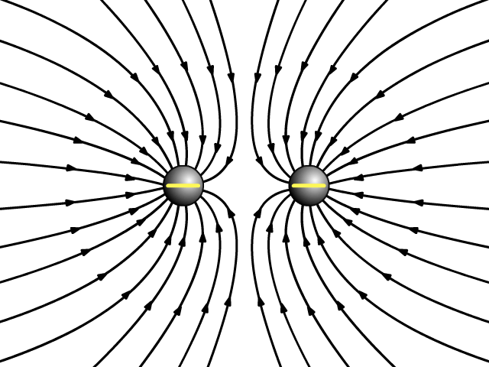
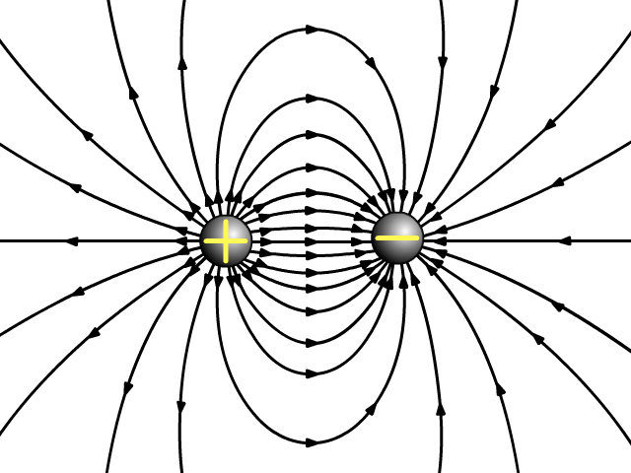
Electric Field Patterns
Like Charges (+ +)
Like Charges (- -)
Unlike Charges (+ -)
Notes:
ELECTRIC CHARGE, FIELD LINES & ELECTRIC FLUX
Unified Lesson Plan | Grade 9-12 Physics | ~50 min
SECTION 3A — FIELD PATTERNS BETWEEN CHARGE PAIRS [Slide 4 of 11] (7 min)
SAY / DO
Walk through the three diagrams:
Like charges (+ +): lines curve away from each other; a neutral point exists between them.
Like charges (- -): same repelling pattern, arrows reversed (pointing inward at each charge).
Unlike charges (+ -): lines flow from positive to negative in smooth arcs — a dipole pattern.
ACTIVITY — SKETCH & COMPARE (5 min)
Split class into 3 groups. Group 1 draws + +, Group 2 draws - -, Group 3 draws + -.
Each group presents and explains. Compare sketches with the slide diagrams.
DISCUSSION PROMPT
What do you notice about the space directly between two like charges? Why are there no field lines through that point?
(The fields cancel — net E = 0 at the midpoint for equal like charges.)
REAL-WORLD CONNECTION
The + - dipole pattern underlies radio antennas, polar molecules like water, and many biological processes.

Slide 5
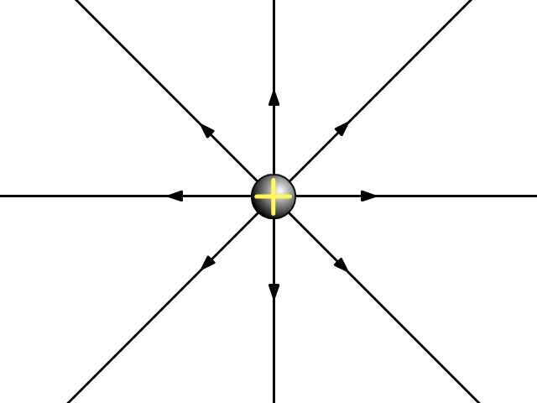
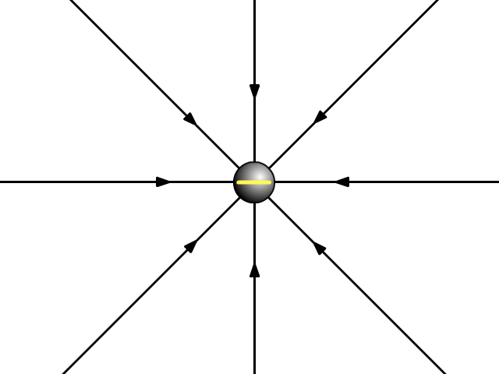
Properties of Electric Field Lines
Originate from positive charges (+)
Terminate at negative charges (-)
Always continuous and smooth curves
Perpendicular to the charged surface at origin and termination
The tangent at any point indicates the direction of the electric field
Two field lines can never intersect each other
Greater density of lines indicates stronger field intensity
Notes:
ELECTRIC CHARGE, FIELD LINES & ELECTRIC FLUX
Unified Lesson Plan | Grade 9-12 Physics | ~50 min
SECTION 3B — PROPERTIES OF ELECTRIC FIELD LINES [Slide 5 of 11] (7 min)
SAY / DO — walk through each property on the slide:
1. Originate from positive charges, terminate at negative charges.
2. Continuous, smooth curves — no sharp corners.
3. Perpendicular to the charged surface at start and end.
4. Tangent at any point = direction of the E field there.
5. Two field lines NEVER cross (E can only have one direction at a point).
6. Denser lines = stronger field.
ACTIVITY — MYTH OR FACT? (3 min)
Read each statement; students hold up True / False cards:
- Field lines can form closed loops. [FALSE in electrostatics]
- If two lines crossed, the field would have two directions at one point. [TRUE — that is why crossing is impossible]
- Closely spaced lines mean a weak field. [FALSE — closely spaced = strong]
COMMON MISCONCEPTION
Students may think lines can cross when two sources are present. Reinforce: two directions at one point is physically impossible.
TRANSITION
We have mastered field lines. Next question: how much field passes through a surface? This idea is called electric flux.

Slide 6
Electric Flux
How much of an electric field passes through a surface?
Why It Matters
Electric flux is the foundation of Gauss’s Law — one of
Maxwell’s equations that governs all of electromagnetism.
It helps us calculate electric fields for symmetric charge
distributions without complex integration.
Notes:
ELECTRIC CHARGE, FIELD LINES & ELECTRIC FLUX
Unified Lesson Plan | Grade 9-12 Physics | ~50 min
SECTION 4 — INTRODUCING ELECTRIC FLUX [Slide 6 of 11] (5 min)
SAY / DO
Define flux: a measure of how much electric field passes through a surface.
Explain why it matters: flux is the foundation of Gauss's Law — one of Maxwell's four master equations of electromagnetism.
Gauss's Law lets us find E fields for symmetric charge distributions without complex integration.
ANALOGY — HULA HOOP IN THE RAIN
Imagine holding a hula hoop in a rainstorm. How much rain passes through depends on how you angle it.
Electric flux works the same way — it measures how much electric field flows through a given surface.
ENGAGEMENT
Ask students to hold a notebook flat, then tilt it.
If this notebook were in an electric field, which position lets more field lines through?
This sets up the angle dependence we explore next.

Slide 7











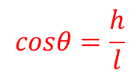









Understanding Area Vectors
Area of abcd
$$Asin θ$$
$$b$$
b
$$\vec{A}$$
----(1) ⊥ to surface abcd
$$\vec{A}$$
$$θ$$
$$\vec{A}=lb$$
a
$$θ$$
$$Acosθ$$
$$cosθ=\frac{h}{l}$$
$$h=lcosθ$$
$$θ$$
$$θ$$
$$l$$
$$l$$
$$θ$$
Area of abef
$$h$$
$$h$$
$$Acosθ$$
$$\vec{A′}=bh$$
$=bl$ $cosθ$
e
$$Asin θ$$
c
$$=Acosθ$$
d
f
Key Concept
The effective area for flux depends on the angle between
the field direction and the area vector (normal to surface).
Notes:
ELECTRIC CHARGE, FIELD LINES & ELECTRIC FLUX
Unified Lesson Plan | Grade 9-12 Physics | ~50 min
SECTION 5 — THE AREA VECTOR CONCEPT [Slide 7 of 11] (5 min)
SAY / DO
Every flat surface has an area vector (normal) pointing perpendicular to it.
Its magnitude equals the surface area.
The angle between the field direction and the area vector determines effective flux.
HANDS-ON DEMO (use cardboard or textbooks)
1. Hold flat, facing you (the field source) — area vector aimed at you — MAXIMUM flux.
2. Tilt 45 degrees — area vector angled away — LESS flux.
3. Turn edge-on — area vector perpendicular to field — ZERO flux.
KEY EMPHASIS
It is not total area that matters — it is effective area, which depends on cos(theta).
QUICK CHECK
If I double the surface area but turn it edge-on, what happens to flux? (Zero — cos 90 = 0.)

Slide 8

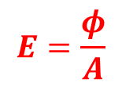
Electric Flux — Case 1: Field Perpendicular to Surface
When E is perpendicular to the surface, all field lines pass through it.
$$E=\frac{φ}{A}$$
Electric Flux: Total number of field lines passing through a surface,normal to it.
$$φ=EA$$
Formula: φ = E × A = EA
where E = electric field strength, A = area of the surface
Notes:
ELECTRIC CHARGE, FIELD LINES & ELECTRIC FLUX
Unified Lesson Plan | Grade 9-12 Physics | ~50 min
SECTION 6A — FLUX: FIELD PERPENDICULAR TO SURFACE [Slide 8 of 11] (5 min)
SAY / DO
When E is perpendicular to the surface, ALL field lines pass through — this is maximum flux.
Formula: phi = E x A (simple multiplication, theta = 0 so cos 0 = 1).
WORKED EXAMPLE (board)
E = 500 N/C, square surface side = 0.2 m.
A = 0.2 x 0.2 = 0.04 m^2
phi = 500 x 0.04 = 20 N.m^2/C
GUIDED PRACTICE (1 min)
E = 300 N/C, rectangle 0.1 m x 0.5 m, field perpendicular.
Answer: phi = 300 x 0.05 = 15 N.m^2/C
SCAFFOLDING TIP
Perpendicular to the surface means E is PARALLEL to the area vector — both point the same way — so theta = 0.

Slide 9

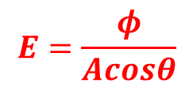


Electric Flux — Case 2: Field at an Angle θ
When the surface is tilted, fewer field lines pass through it.
Only the component of area perpendicular to E contributes.
$$θ$$
Electric Flux: Total number of field lines passing through a surface,normal to it.
$$E=\frac{φ}{Acosθ}$$
$$φ=EAcosθ$$
$$=E.A$$
Formula: φ = EA cosθ = E · A
θ = angle between E and the area vector (outward normal)
Notes:
ELECTRIC CHARGE, FIELD LINES & ELECTRIC FLUX
Unified Lesson Plan | Grade 9-12 Physics | ~50 min
SECTION 6B — FLUX: FIELD AT AN ANGLE [Slide 9 of 11] (5 min)
SAY / DO
When the surface is tilted, only the perpendicular component of area contributes.
Formula: phi = EA cos(theta), where theta = angle between E and the outward normal.
At theta = 0: phi = EA (maximum, matches Case 1). At theta = 90: phi = 0 (edge-on).
WORKED EXAMPLE
E = 400 N/C, A = 0.05 m^2, theta = 60 degrees.
phi = 400 x 0.05 x cos(60) = 400 x 0.05 x 0.5 = 10 N.m^2/C
STUDENT PRACTICE (2 min)
E = 600 N/C, A = 0.03 m^2, theta = 30 degrees.
Answer: phi = 600 x 0.03 x cos(30) = 15.6 N.m^2/C
CONCEPTUAL CHECK
As you tilt from 0 to 90 degrees, does flux increase or decrease? (Decreases — fewer lines pass through.)
CALLBACK
Remember tilting your notebook? Now you have the maths to calculate exactly how much flux changes.

Slide 10
What Is Electric Flux?
Think of Rain Through a Window
Key Formulas
Uniform field, perpendicular:
φ = EA
Uniform field, at angle θ:
φ = EA cosθ
General (non-uniform / curved):
φ = ∫ E⃗ · dA⃗
Hold a window flat in the rain — maximum rain passes through.
Tilt the window — less rain gets through.
Turn it edge-on — no rain passes through at all.
Electric flux works the same way — replace rain with electric field lines, and the window with any surface.
Formal Definition
Electric flux (φ) is a scalar quantity that measures how much electric field passes through a given surface.
SI Unit: N·m²/C (newton-metre squared per coulomb)
Also written as: V·m (volt-metres)
Notes:
ELECTRIC CHARGE, FIELD LINES & ELECTRIC FLUX
Unified Lesson Plan | Grade 9-12 Physics | ~50 min
SECTION 7 — FLUX SUMMARY & RAIN ANALOGY [Slide 10 of 11] (5 min)
SAY / DO
Reinforce the rain-through-a-window analogy:
Window flat = max rain = phi = EA.
Window tilted = less rain = phi = EA cos(theta).
Window edge-on = no rain = phi = 0.
FORMULA RECAP
1. Perpendicular, uniform field: phi = EA
2. At angle theta, uniform field: phi = EA cos(theta)
3. General (non-uniform / curved): phi = integral of E . dA
SI unit: N.m^2/C (or V.m). Flux is a scalar.
WHITEBOARD ACTIVITY (3 min)
Students draw the rain analogy on mini whiteboards — three sketches (flat, tilted, edge-on) with matching formula beneath each. Share and compare.
EXIT TICKET PREVIEW
Write one sentence explaining electric flux to a friend who has never studied physics. Must include the word surface.
DIFFERENTIATION
For advanced students: hint that flux through a closed surface relates to the charge enclosed — a preview of Gauss's Law.

Slide 11
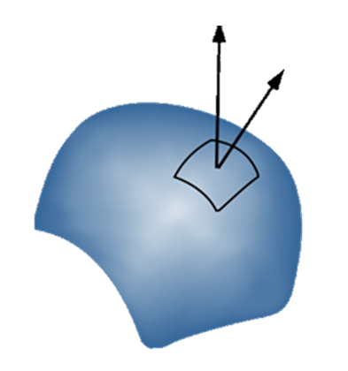




General Case: Non-Uniform Fields & Curved Surfaces
For curved surfaces or varying fields, we integrate
the flux over infinitesimal area elements dA.
$$\vec{E}.$$
$$dφ=\vec{E}.\vec{dA}$$
$$\vec{dA}$$
$$φ=∫\vec{E}.\vec{dA}$$
Summary of All Cases
Perpendicular field: φ = EA
Field at angle θ: φ = EA cosθ
General case: φ = ∫ E⃗ · dA⃗
Notes:
ELECTRIC CHARGE, FIELD LINES & ELECTRIC FLUX
Unified Lesson Plan | Grade 9-12 Physics | ~50 min
SECTION 8 — GENERAL CASE & LESSON WRAP-UP [Slide 11 of 11] (5 min)
SAY / DO
When E varies across the surface or the surface is curved, simple multiplication fails.
We break the surface into thousands of tiny flat tiles (dA), calculate flux through each, and sum — that sum is the integral.
General formula: phi = integral of E . dA (most powerful form).
BOARD RECAP — ALL THREE CASES
Case 1: Perpendicular, uniform -> phi = EA
Case 2: Angled, uniform -> phi = EA cos(theta)
Case 3: General -> phi = integral of E . dA
EXIT TICKET (3 min)
1. Draw field lines for two positive charges near each other.
2. E = 200 N/C through a 0.1 m^2 surface at 45 degrees — calculate the flux.
3. In one sentence, explain why integration is needed for curved surfaces.
HOMEWORK
5 practice problems mixing all three flux cases + 1 conceptual question on field line properties.
LESSON REFLECTION (for the teacher)
Did the balloon hook engage students? Could they connect the rain analogy to the maths?
Did the notebook/cardboard demo help them grasp area vectors? Where did pacing feel rushed?
Adjust timing for next delivery based on where students struggled most.

