Slide 1

Electric Dipole
Notes:
Welcome to this lesson on electric dipoles
An electric dipole is a fundamental concept in electrostatics that appears in many real-world systems
We will cover the definition, properties, and the electric field due to a dipole on the axial line

Slide 2


Electric Dipole
2a
Equal And Opposite charges separated by a small distance
-
+
a
a
$DipoleMoment ,\vec{p}=q 2\vec{a}$
Unit: Cm
An ideal dipole is one with large charges separated by small distance
Notes:
An electric dipole consists of two equal and opposite charges (+q and -q) separated by a small distance 2a
The dipole moment p = q times 2a, with SI unit coulomb-meter (C m)
The direction of the dipole moment vector points from the negative charge toward the positive charge
An ideal dipole has very large charges separated by an infinitesimally small distance, keeping p constant

Slide 3
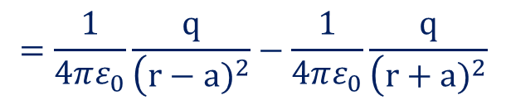
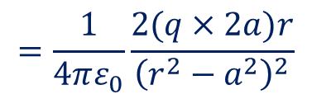

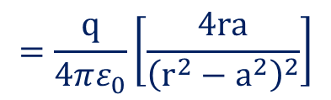

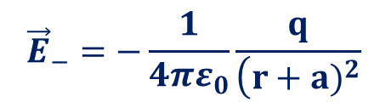
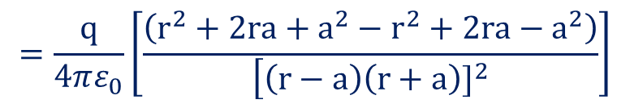
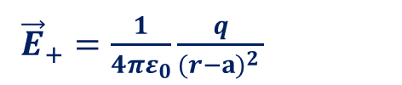

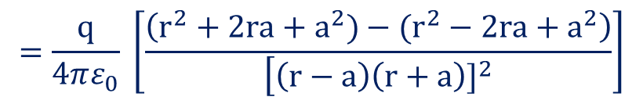
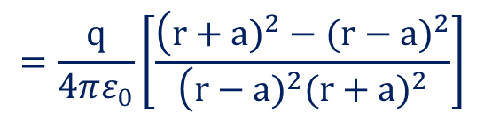
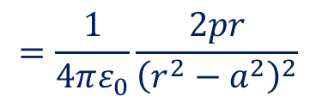
Field Due To Electric Dipole- On axial line
${\vec{E}}_{+}=\frac{1}{4πε_{0}}\frac{q}{(r−a)^{2 }}$
2a
$${\vec{E}}_{−}$$
${\vec{E}}_{+}$
-q
+q
P
$${\vec{E}}_{−}=−\frac{1}{4πε_{0}}\frac{q}{\left(r+a)^{2}\right.}$$
a
a
r
$\vec{E}={\vec{E}}_{+}+{\vec{E}}_{−}$
$$=\frac{1}{4πε_{0}}\frac{q}{\left(r−a)^{2}\right.}−\frac{1}{4πε_{0}}\frac{q}{\left(r+a)^{2}\right.}$$
$$=\frac{q}{4πε_{0}}\left[\frac{\left(r+a)^{2}−(r−a)^{2}\right.}{\left(r−a)^{2}(r+a)^{2}\right.}\right]$$
$$=\frac{q}{4πε_{0}} \left[\frac{\left(r^{2}+2ra+a^{2})−(r^{2}−2ra+a^{2}\right)}{\left[\left(r−a\right)\left(r+a\right)]^{2}\right.}\right]$$
$$=\frac{q}{4πε_{0}}\left[\frac{\left(r^{2}+2ra+a^{2}−r^{2}+2ra−a^{2}\right)}{\left[\left(r−a\right)\left(r+a\right)]^{2}\right.}\right]$$
$$=\frac{q}{4πε_{0}}\left[\frac{4ra}{{\left(r^{2}−a^{2}\right)}^{2}}\right]$$
$$=\frac{1}{4πε_{0}}\frac{2(q×2a)r}{{\left(r^{2}−a^{2}\right)}^{2}}$$
$$=\frac{1}{4πε_{0}}\frac{2pr}{{\left(r^{2}−a^{2}\right)}^{2}}$$
Notes:
Now we derive the electric field at a point P on the axial line of the dipole
Point P is at distance r from the center of the dipole, along the line joining the two charges
We calculate the field contribution from each charge separately and then find the net field by superposition

Slide 4


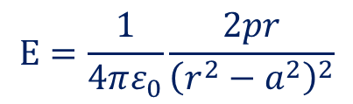
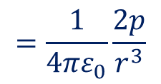

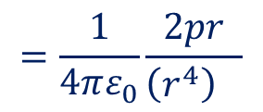
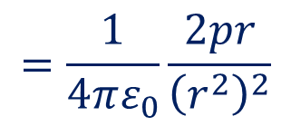
Field Due To Electric Dipole- On axial line
2a
$${\vec{E}}_{−}$$
${\vec{E}}_{+}$
$$E=\frac{1}{4πε_{0}}\frac{2pr}{{\left(r^{2}−a^{2}\right)}^{2}}$$
-q
+q
P
a
a
r
$${If r}^{}≫a^{}$$
$$=\frac{1}{4πε_{0}}\frac{2pr}{{\left(r^{2}\right)}^{2}}$$
$$=\frac{1}{4πε_{0}}\frac{2pr}{{\left(r^{4}\right)}^{}}$$
$$=\frac{1}{4πε_{0}}\frac{2p}{r^{3}}$$
$$E_{axial}$$
$$=\frac{1}{4πε_{0}}\frac{2p}{r^{3}}$$
Notes:
The field due to the positive charge at P is directed away from +q
The field due to the negative charge at P is directed toward -q
Since P is on the axial line, both field contributions are along the same axis but differ in magnitude
The net field is the vector sum: E_axial = E_+q minus E_-q

Slide 5

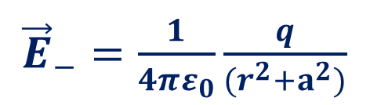


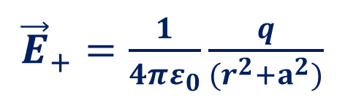



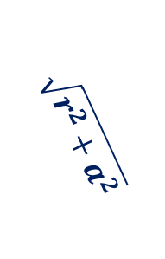


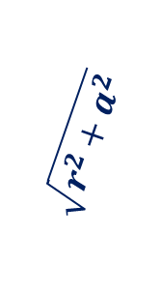



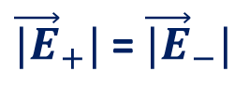
$${\vec{E}}_{+}$$
${\vec{E}}_{+} sinθ$
${\vec{E}}_{+}=\frac{1}{4πε_{0}}\frac{q}{(r^{2}+a^{2})}$
${\vec{E}}_{−}=\frac{1}{4πε_{0}}\frac{q}{(r^{2}+a^{2})}$
${\vec{E}}_{+} cosθ$
$$θ$$
P
${\vec{E}}_{−} cosθ$
$$θ$$
${\vec{|E}}_{+}|$= ${\vec{|E}}_{−}|$
$=2×\frac{1}{4πε_{0}}\frac{q}{(r^{2}+a^{2})}cosθ$
$${\vec{E}}_{−}$$
${\vec{E}}_{Eqitorial}=2× {\vec{E}}_{+}cosθ$
${\vec{E}}_{−} sinθ$
r
$$\sqrt{r^{2}+a^{2}}$$
$$\sqrt{r^{2}+a^{2}}$$
-q
$$θ$$
$$θ$$
+q
a
a
2a
Notes:
We write the electric field from each charge using Coulomb's law
E from +q equals kq over (r minus a) squared, directed away from the dipole
E from -q equals kq over (r plus a) squared, directed toward the dipole
The net field is the difference of these two contributions

Slide 6
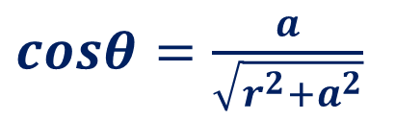

$${\vec{E}}_{+}$$
${\vec{E}}_{+} sinθ$
${\vec{E}}_{+} cosθ$
$$θ$$
P
${\vec{E}}_{−} cosθ$
$$θ$$
$${\vec{E}}_{−}$$
${\vec{E}}_{−} sinθ$
$$\sqrt{r^{2}+a^{2}}$$
r
r
$$\sqrt{r^{2}+a^{2}}$$
$$\sqrt{r^{2}+a^{2}}$$
-q
$$θ$$
$$θ$$
+q
$cosθ=\frac{a}{\sqrt{r^{2}+a^{2}}}$
a
a
a
2a
Notes:
Combining the two expressions over a common denominator
The numerator simplifies using the expansion of (r+a) squared minus (r-a) squared, which gives 4ra
The denominator becomes (r squared minus a squared) squared

Slide 7
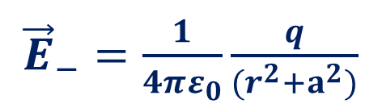
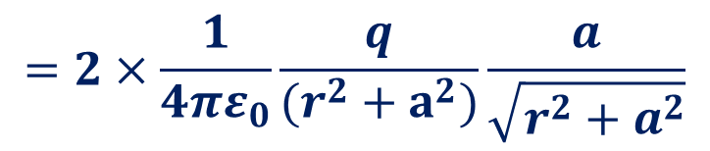
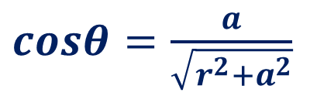

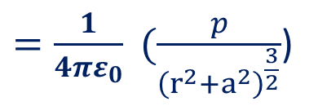
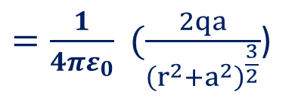


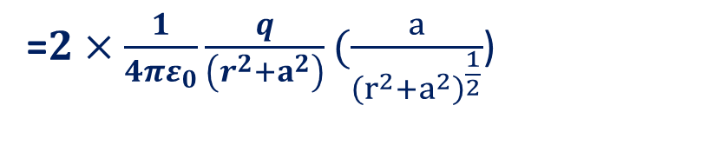
$${\vec{E}}_{+}$$
${\vec{E}}_{+} sinθ$
${\vec{E}}_{+}=\frac{1}{4πε_{0}}\frac{q}{(r^{2}+a^{2})}$
${\vec{E}}_{−}=\frac{1}{4πε_{0}}\frac{q}{(r^{2}+a^{2})}$
${\vec{E}}_{+} cosθ$
$$θ$$
P
$cosθ=\frac{a}{\sqrt{r^{2}+a^{2}}}$
${\vec{|E}}_{+}|$= ${\vec{|E}}_{−}|$
${\vec{E}}_{−} cosθ$
$$θ$$
$${\vec{E}}_{−}$$
${\vec{E}}_{Equitorial}=2× {\vec{E}}_{+}cosθ$
$=2×\frac{1}{4πε_{0}}\frac{q}{(r^{2}+a^{2})}cosθ$
${\vec{E}}_{−} sinθ$
$$=2×\frac{1}{4πε_{0}}\frac{q}{(r^{2}+a^{2})}\frac{a}{\sqrt{r^{2}+a^{2}}}$$
r
$$\sqrt{r^{2}+a^{2}}$$
$$\sqrt{r^{2}+a^{2}}$$
-q
$$θ$$
$$θ$$
+q
=$2×\frac{1}{4πε_{0}}\frac{q}{\left(r^{2}+a^{2}\right)}(\frac{a}{{\left(r^{2}+a^{2}\right)}^{\frac{1}{2}}}$)
a
a
$=\frac{1}{4πε_{0}} (\frac{2qa}{{\left(r^{2}+a^{2}\right)}^{\frac{3}{2}}}$)
$=\frac{1}{4πε_{0}} (\frac{p}{{\left(r^{2}+a^{2}\right)}^{\frac{3}{2}}}$)
2a
Notes:
So E_axial equals k times q times 4ra divided by (r squared minus a squared) squared
Recall that the dipole moment p = q times 2a
Substituting, E_axial = k times 2pr divided by (r squared minus a squared) squared

Slide 8
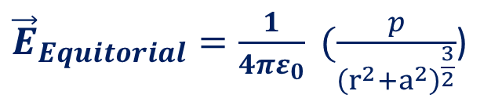

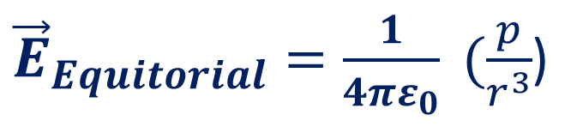
$${\vec{E}}_{+}$$
${\vec{E}}_{+} sinθ$
${\vec{E}}_{Equitorial}=\frac{1}{4πε_{0}} (\frac{p}{{\left(r^{2}+a^{2}\right)}^{\frac{3}{2}}}$)
$$θ$$
${\vec{E}}_{+} cosθ$
P
${\vec{E}}_{−} cosθ$
$$θ$$
$${\vec{E}}_{−}$$
$${If r}^{}≫a^{}$$
${\vec{E}}_{−} sinθ$
${\vec{E}}_{Equitorial}=\frac{1}{4πε_{0}} (\frac{p}{r^{3}}$)
r
$$\sqrt{r^{2}+a^{2}}$$
$$\sqrt{r^{2}+a^{2}}$$
-q
$$θ$$
$$θ$$
+q
a
a
2a
Notes:
For a short dipole or when the observation point is far from the dipole, r is much greater than a
In this approximation, a squared is negligible compared to r squared
The denominator simplifies from (r squared minus a squared) squared to r to the fourth

Slide 9


$$E_{axial}$$
$$=\frac{1}{4πε_{0}}\frac{2p}{r^{3}}$$
r
Notes:
Applying the far-field approximation, the axial field simplifies to E = 2kp over r cubed
This can also be written as E = 2p over 4 pi epsilon-naught r cubed
Key takeaway: the electric field on the axial line falls off as 1 over r cubed, unlike a point charge which falls off as 1 over r squared

Slide 10
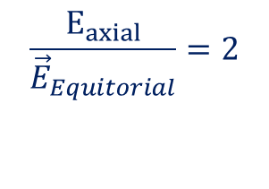
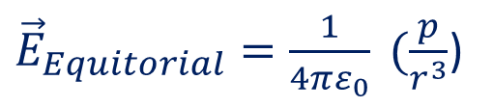


$$E_{axial}$$
$$=\frac{1}{4πε_{0}}\frac{2p}{r^{3}}$$
${\vec{E}}_{Equitorial}=\frac{1}{4πε_{0}} (\frac{p}{r^{3}}$)
r
$$\frac{E_{axial}}{{\vec{E}}_{Equitorial}}=2$$
Notes:
This is the final result for the axial field of a dipole: E_axial = 2kp over r cubed
The field is directed along the dipole axis, from -q toward +q (same direction as p)
Remember this result is valid only in the far-field limit where r is much greater than a
Compare with the equatorial field (to be covered next), which is half the magnitude and opposite in direction

