Slide 1
Electric field
Notes:
LESSON PLAN: Electric Fields (AP/IB Physics) — Total Time: ~45-50 minutes
Learning Objectives:
• Define the electric field and explain its physical meaning as force per unit positive test charge.
• Apply Coulomb's Law to calculate the electric force between point charges.
• Describe and sketch electric field lines for positive and negative charges.
• Apply the superposition principle to find the net electric field from multiple charges.
• Solve problems involving electric fields at specific points due to charge configurations.
Opening (~2 min):
Welcome students and frame the lesson: 'Today we move beyond forces between individual charges to a powerful idea — the electric field. Instead of asking what force one charge exerts on another, we ask: what does a charge do to the space around it?'
Remind students of prior knowledge: Coulomb's Law (F = kQq/r²), the concept of action at a distance, and the sign conventions for charge.

Slide 2
q
Q
Notes:
Introducing the Setup (~3 min):
Present the scenario: a source charge Q and a small test charge q placed nearby.
Key talking points:
• Explain that Q is our 'source' — the charge creating the field — and q is a small positive 'test charge' we use to probe the field.
• By Coulomb's Law, Q exerts a force on q: F = kQq/r², directed along the line joining them.
• If both charges are positive, the force on q is repulsive — directed away from Q.
• Emphasize that the test charge must be small enough not to disturb Q's field (this is a key AP/IB concept).
Ask students: 'What determines the magnitude and direction of this force?' (Answer: the distance r and the signs of the charges.)
Transition: 'Let's see what happens when we move q to different locations around Q.'

Slide 3
q
Q
Notes:
Exploring Different Positions (~2 min):
Now move the test charge q to a different location relative to Q.
Key talking points:
• The force on q changes depending on where we place it — both in magnitude and direction.
• By Coulomb's Law, F = kQq/r², the force depends on the separation distance r.
• The direction of the force is always along the line connecting the two charges.
• Ask students: "If Q is positive, which way does q get pushed?" (Answer: directly away from Q, since like charges repel.)

Slide 4
q
Q
Notes:
Varying Distance — Inverse Square Relationship (~2 min):
Continue placing q at different distances from Q to build intuition for the inverse-square law.
Key talking points:
• When you double the distance r, the force drops to 1/4 of its original value (inverse square).
• When you halve the distance, the force quadruples.
• This 1/r² dependence is critical — it shows up on nearly every AP/IB exam.
Quick check: 'If the force at distance d is F, what is the force at distance 3d?' (Answer: F/9.)
Draw a quick table on the board: r, 2r, 3r → F, F/4, F/9 to make the pattern visual.
Transition: 'We keep talking about the force on q — but what if we want to describe what Q does to space itself, independent of the test charge?'

Slide 5
q
Q
Notes:
Building Toward the Field Concept (~2 min):
This is the pivotal conceptual transition — from force between two charges to the field created by one charge.
Key talking points:
• So far, we've been calculating force, which depends on BOTH charges (Q and q).
• But notice: if we divide the force by q, we get F/q = kQ/r², which depends only on Q and the position.
• This ratio F/q is the same no matter what test charge we use — it's a property of the space around Q.
• This is the electric field: it tells us what WOULD happen to any charge placed at that point.
Analogy: 'Think of the electric field like a weather map showing wind patterns. The wind exists whether or not you put a flag in it — but the flag reveals the wind's direction and strength.'
Ask students: 'Why do we divide by q instead of Q?' (Because we want a quantity that describes Q's influence on space, independent of the probe.)

Slide 6
q
Q
Notes:
Formalizing the Concept (~2 min):
Wrap up the conceptual buildup before moving to the formal definition.
Key talking points:
• We've now seen that placing a test charge at various points around Q reveals a pattern.
• At every point, there's a force waiting to act on any charge placed there.
• The electric field E = F/q gives us a complete map of this influence.
• E is a vector field — it has a value (magnitude and direction) at every point in space.
Important AP/IB distinction: The field EXISTS at a point even if no test charge is present. The test charge is just a thought experiment to define and measure the field.
Transition: 'Let's now write down the formal definition and its units.'

Slide 7
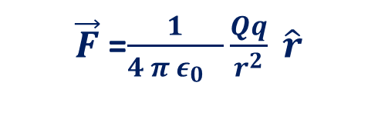




Electric field at a point is defined as the electrostatic force acting per unit positive charge placed at that point.
P
$\vec{F}$=$\frac{1}{4 π ε_{0} }\frac{Qq}{r^{2}} \hat{r}$
q
Q
r
$\vec{E}=\frac{\vec{F}}{q}=\frac{1}{4 π ε_{0} }\frac{Q}{r^{2}}$ $\hat{r}$
$\vec{E}(r)=\underset{δq→0}{Lim}{\frac{\vec{F}}{δq}=}\frac{1}{4 π ε_{0} }\frac{Q}{r^{2}}$ $\hat{r}$
$$E=\frac{F}{q}$$
Unit is $NC^{−1}$
Notes:
Formal Definition — Electric Field (Positive Source) (~4 min):
This is the core definition slide. Slow down and be precise.
State the definition clearly: 'The electric field at a point is defined as the electrostatic force acting per unit positive charge placed at that point: E = F/q.'
Key talking points:
• For a point charge Q: E = kQ/r², where r is the distance from Q to the field point P.
• Units: Newtons per Coulomb (N/C), which is equivalent to Volts per meter (V/m) — both appear on AP/IB exams.
• Direction: For a positive source charge Q, the field points AWAY from Q (radially outward).
• The field is defined using a positive test charge by convention — this sets the direction.
Work through a quick example: 'Find E at a point 0.3 m from a +2 μC charge.' (E = 9×10⁹ × 2×10⁻⁶ / 0.09 = 2×10⁵ N/C, directed away from Q.)
Pause for questions before moving to negative charges.

Slide 8
q
$\vec{F}$=$\frac{1}{4 π ε_{0} }\frac{Qq}{r^{2}} \hat{r}$
P
-Q
r
$\vec{E}=\frac{\vec{F}}{q}=\frac{1}{4 π ε_{0} }\frac{Q}{r^{2}}$ $\hat{r}$
$\vec{E}(r)=\underset{δq→0}{Lim}{\frac{\vec{F}}{δq}=}\frac{1}{4 π ε_{0} }\frac{Q}{r^{2}}$ $\hat{r}$
$$E=\frac{F}{q}$$
Unit is $NC^{−1}$
Notes:
Electric Field Due to a Negative Charge (~3 min):
Now contrast with the field from a negative source charge.
Key talking points:
• For a negative charge −Q, the force on a positive test charge is attractive — directed TOWARD −Q.
• Therefore, E points TOWARD a negative source charge (radially inward).
• The magnitude formula is the same: E = k|Q|/r². Only the direction changes.
• This is a common source of sign errors on exams — emphasize direction carefully.
Comparison: Draw two diagrams side by side on the board — E vectors radiating outward from +Q, and inward toward −Q.
Quick conceptual check: 'A −5 μC charge is at the origin. What is the direction of E at a point to the right of the charge?' (Answer: to the LEFT, toward the negative charge.)
Transition: 'We can visualize these field directions using electric field lines.'

Slide 9
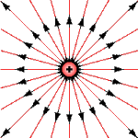
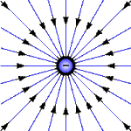
Electric Field Lines
Positive Charge (+)
Field lines radiate outward
Negative Charge (−)
Field lines point inward
Key Rules: Lines originate on + charges and terminate on − charges • Closer lines = stronger field • Field lines never cross • Direction is tangent to the line at any point
Notes:
Electric Field Lines (~5 min):
This is a visual and conceptual slide — take time to let students study the diagrams.
Key rules to emphasize (all are testable on AP/IB):
• Field lines originate on positive charges and terminate on negative charges.
• The density of lines (how close together they are) indicates field strength — closer lines mean stronger field.
• Field lines NEVER cross — if they did, the field would have two directions at one point, which is physically impossible.
• The direction of the field at any point is tangent to the field line at that point.
Walk through the diagrams:
• Positive charge: lines radiate outward symmetrically, like a starburst.
• Negative charge: lines converge inward, like arrows pointing at the center.
Common exam question: 'Where is the field strongest in this diagram?' → Where lines are closest together (near the charge).
Optional: If using PhET, show the simulation now to let students see field lines form dynamically around placed charges.
Transition: 'Now let's think more deeply about what the field does to the space around a charge.'

Slide 10

Discussion on Electric Field
What happens to the space around charge?
Q
r
$\vec{E}=\frac{\vec{F}}{q}=\frac{1}{4 π ε_{0} }\frac{Q}{r^{2}}$ $\hat{r}$
p
+
-
Notes:
Discussion: What Happens to Space Around a Charge? (~5 min):
This is an interactive discussion slide. Pose the question and let students think before guiding them.
Key talking points:
• A charge modifies the space around it — it creates an electric field that extends in all directions.
• Any other charge entering this region will experience a force, even though the charges don't touch.
• This is the field model of interaction: Charge → Field → Force on another charge.
• The field is real — it carries energy and can do work. It's not just a mathematical convenience.
Facilitate discussion:
• Ask: 'How is the electric field different from the gravitational field you studied earlier?' (Both are inverse-square, but electric fields can attract OR repel; gravity only attracts.)
• Ask: 'Does the field exist at a point where no charge is present?' (Yes! The field exists everywhere around Q.)
• Connect to the diagram: the field at point P depends on the source charge Q and the distance r.
This is a good moment to check for understanding before moving to superposition.

Slide 11





Superposition Principle of Fields
Superposition Principle of Fields
-q_{n}
$$E_{2}$$
$$E_{n}$$
q1
$$E_{1}$$
P
$$E_{3}$$
$\vec{E}$= $\vec{E_{1}}$+ $\vec{E_{2}}$+ $\vec{E_{3}}$+…..+ $\vec{E_{n}}$
-q3
q2
Notes:
Superposition Principle (~5 min):
Introduce the key principle for handling multiple charges — essential for AP/IB problem-solving.
State the principle: 'The net electric field at any point is the vector sum of the individual electric fields produced by each source charge.'
Key talking points:
• E_net = E₁ + E₂ + E₃ + … (vector addition, NOT scalar!)
• Each charge contributes independently — the field from q₁ is unaffected by the presence of q₂.
• You must consider both magnitude AND direction when adding fields.
• Opposite charges create fields that may partially cancel; same-sign charges create fields that may reinforce.
Walk through the diagram: Show how E vectors from multiple charges (q₁, q₂, −q₃, … −qₙ) are added at point P.
Problem-solving strategy (write on board):
1. Identify all source charges and the field point P.
2. Calculate E from each charge separately (magnitude and direction).
3. Resolve into x and y components.
4. Add components: Eₓ(net) = ΣEₓ, Eᵧ(net) = ΣEᵧ.
5. Find magnitude and direction of E_net.
Transition: 'Let's apply this to a concrete problem.'

Slide 12

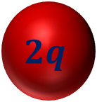



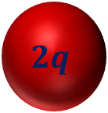
Two equal charges 2q are placed at oppsite corners of a square of side a. A third charge –q is placed at 3rd corner.Find the electric field at 4th corner.
$$E_{B}$$
$$E_{AB}$$
$$2q$$
a
P
$$E_{A}$$
A
$$E_{c}$$
a
a
-q
$$2q$$
C
B
a
Notes:
Problem Setup: Charges on a Square (~3 min):
Read the problem aloud and let students draw their own diagrams before revealing the solution.
Problem: Two equal charges +2q are placed at opposite corners (A and B) of a square of side a. A third charge −q is placed at the third corner (C). Find the electric field at the fourth corner (P).
Guide the setup:
• Label the corners: A (top-left), B (bottom-right) have charge +2q; C (bottom-left) has charge −q; P (top-right) is the field point.
• Identify the distances: A to P = a (horizontal), C to P = a (vertical), B to P = a√2 (diagonal).
• Each charge contributes a field at P — we need to find all three and add them as vectors.
Ask students: 'Which direction does the field from charge A point at P?' (Away from A, so to the right.)
'Which direction does the field from charge C point at P?' (Toward C, so downward — because C is negative.)
'What about charge B?' (Away from B, along the diagonal toward P — at 45° above horizontal.)
Give students 2 minutes to attempt the calculation before proceeding.

Slide 13




$$cp=\sqrt{a^{2}+a^{2}}$$
A
a
P
$$cp=\sqrt{{2a}^{2}}$$
$$cp=\sqrt{2} a$$
$$\sqrt{2} a$$
a
a
C
a
B
Notes:
Solution Part 1 — Individual Field Contributions (~4 min):
Walk through each field contribution step by step.
Field from A (+2q) at P:
• Distance: a
• Magnitude: E_A = k(2q)/a² = 2kq/a²
• Direction: to the right (+x direction), since +2q repels the positive test charge at P.
Field from C (−q) at P:
• Distance: a
• Magnitude: E_C = kq/a²
• Direction: downward (−y direction), toward C, since −q attracts the positive test charge.
Field from B (+2q) at P:
• Distance: a√2 (diagonal of the square)
• Magnitude: E_B = k(2q)/(a√2)² = k(2q)/(2a²) = kq/a²
• Direction: along the diagonal from B toward P. Resolve into components:
E_Bx = E_B cos45° = (kq/a²)(1/√2)
E_By = E_B sin45° = (kq/a²)(1/√2)
Pause and verify: 'Does everyone see why E_B has both x and y components?'

Slide 14

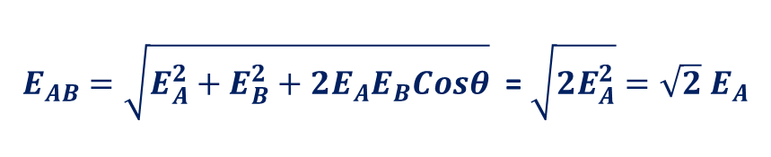



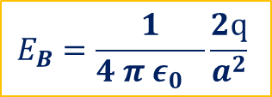

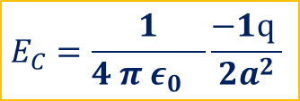

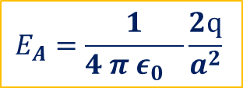


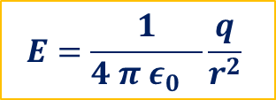


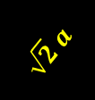
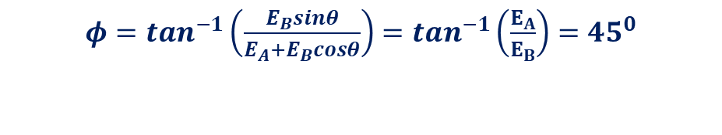
ϕ=tan−1(QsinΘP+QcosΘ)
$$E=\frac{1}{4 π ε_{0} }\frac{q}{r^{2}}$$
$$E_{A}=\frac{1}{4 π ε_{0} }\frac{2q}{a^{2}}$$
$$E_{B}=\frac{1}{4 π ε_{0} }\frac{2q}{a^{2}}$$
$$E_{C}=\frac{1}{4 π ε_{0} }\frac{−1q }{{2a}^{2}}$$
$E_{AB}=\sqrt{E_{A}^{2}+E_{B}^{2}+2E_{A}E_{B}Cosθ}$ = $\sqrt{2E_{A}^{2}}=\sqrt{2} E_{A}$
$$E_{B}$$
$$E_{AB}$$
Or, $E_{AB}=√2 \frac{1}{4 π ε_{0} }\frac{2q}{a^{2}}$
$$2q$$
a
P
$$E_{A}$$
A
$φ=tan^{−1}\left(\frac{E_{B}sinθ}{E_{A}+E_{B}cosθ}\right)=tan^{−1}\left(\frac{E_{A}}{E_{B}}\right)=45^{0}$
$$E_{c}$$
$$E_{ABC}=E_{AB}+E_{C}$$
$$\sqrt{2} a$$
a
a
$E_{ABC}=√2\frac{1}{4 π ε_{0} }\frac{2q}{a^{2}}$ - $\frac{1}{4 π ε_{0} }\frac{1μ}{{2a}^{2}}$
$E_{ABC}=\frac{1}{4 π ε_{0} }\left(\frac{q}{a^{2}}\right)\left(2\sqrt{2}−\left(\frac{1}{2}\right)\right)$
-q
$$2q$$
C
a
B
Notes:
Solution Part 2 — Vector Sum and Final Answer (~4 min):
Now add all the components to find E_net at P.
x-components:
• E_x = E_A + E_Bx = 2kq/a² + (kq/a²)(1/√2) = (kq/a²)(2 + 1/√2)
y-components:
• E_y = −E_C + E_By = −kq/a² + (kq/a²)(1/√2) = (kq/a²)(−1 + 1/√2)
Magnitude: E_net = √(E_x² + E_y²)
Direction: ϕ = tan⁻¹(E_y / E_x), measured from the +x axis.
Key takeaways for students:
• Superposition requires careful vector decomposition — don't just add magnitudes!
• The diagonal distance a√2 is a common geometry in square configurations.
• Signs matter: negative charges reverse the field direction (toward the charge).
Closing (~2 min):
Summarize the lesson: 'Today we defined the electric field as E = F/q, learned to visualize it with field lines, and applied superposition to find the net field from multiple charges.'
Homework: Assign practice problems on electric field calculations and field line sketching from the textbook. Recommend reviewing Coulomb's Law vector problems.
Preview next lesson: 'Next time, we'll explore electric field due to continuous charge distributions and introduce Gauss's Law.'

