Slide 1




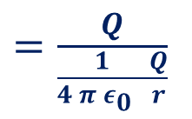

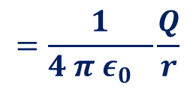



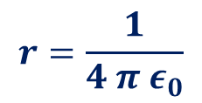
Capacitance
Capacitance $C=\frac{Q}{V}$
$$Unit⟹\frac{Coulomb}{Volt}$$
$$=farad (F)$$
$$micro farad ( μF)$$
Capacitance of a spherical conductor.
$$=\frac{1}{4 π ε_{0} }\frac{Q}{r}$$
If it carries a Q charge, then potential V
+++++++++++++++++++++++++++++++++
r
Capacitance $C=\frac{Q}{V}$
$=\frac{Q}{\frac{1}{4 π ε_{0} }\frac{Q}{r}}$
$$=4 π ε_{0}r$$
$$r=\frac{1}{4 π ε_{0}}$$
$$C=4 π ε_{0}r=1F$$
$$=9×10^{9} m$$

Slide 2

Capacitor
+++++++++++++++++++++++++++++++++
----------------------------------------------------
r
r
Capacitance $C=\frac{Q}{V}$

Slide 3
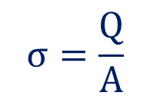
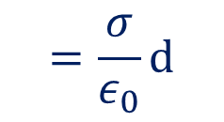
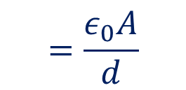
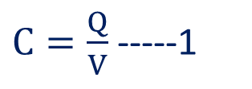

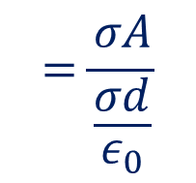
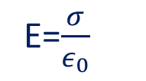
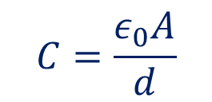

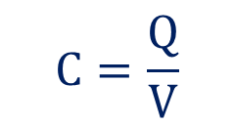
Parallel Plate Capacitor
$C=\frac{Q}{V}$ -----1
+++++++++
---------
+++++++++
$$σ=\frac{Q}{A}$$
$Or,Q=σ$A
$$=\frac{σ}{ε_{0}}d$$
$$V=Ed$$
E=$\frac{σ}{ε_{0}}$
$$C=\frac{Q}{V}$$
$$=\frac{σA}{\frac{σd}{ε_{0}}}$$
$$=\frac{ε_{0}A}{d}$$
$$C=\frac{ε_{0}A}{d}$$

Slide 4
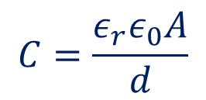
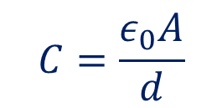
Parallel Plate Capacitor- Effect of Dielectric
$$C=\frac{ε_{0}A}{d}$$
+++++++++
---------
For a vacuum/ air capacitor, We have
When a dielectric slab of dielectric constant k (relative permittivity$ε_{0}$)
$$C=\frac{{ε_{r}ε}_{0}A}{d}$$
(Over Simplified)

Slide 5
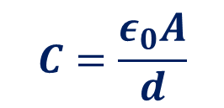
Parallel Plate Capacitor-Factors effecting Capacity
$$C=\frac{ε_{0}A}{d}$$
+++++++++
---------
Increase Area of the plates
Decrease distance of separation
Introduce a dielectric

Slide 6
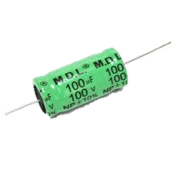
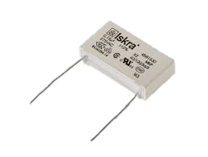
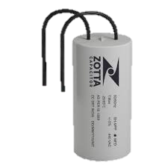
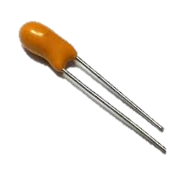
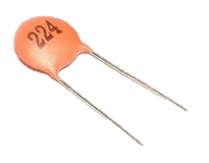
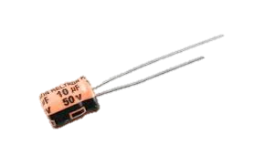
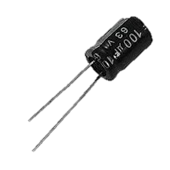
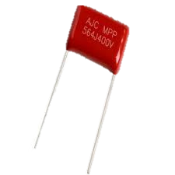
Capacitors

Slide 7
Capacitor-Symbol

Slide 8


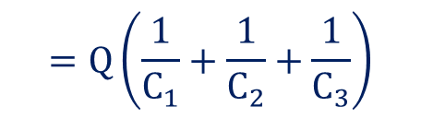


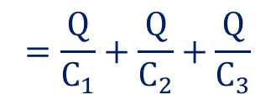

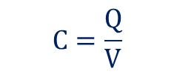



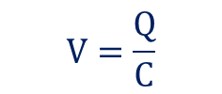
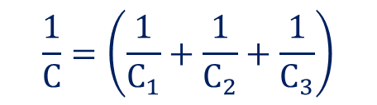

Grouping of Capacitors
$$V_{1}$$
$$V_{2}$$
$V_{3}$
Series
$$V=V_{1}+V_{2}+V_{3}$$
$$C=\frac{Q}{V}$$
$$V=\frac{Q}{C}$$
$$C_{1}$$
$$C_{2}$$
$$C_{3}$$
$$=\frac{Q}{C_{1}}+\frac{Q}{C_{2}}+\frac{Q}{C_{3}}$$
$$V$$
$$\frac{Q}{C}$$
$$=Q\left(\frac{1}{C_{1}}+\frac{1}{C_{2}}+\frac{1}{C_{3}}\right)$$
$$\frac{1}{C}=\left(\frac{1}{C_{1}}+\frac{1}{C_{2}}+\frac{1}{C_{3}}\right)$$

Slide 9







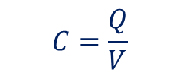






Grouping of Capacitors
Parallel
$$Q=Q_{1}+Q_{2}+Q_{3}$$
$$C=\frac{Q}{V}$$
$$Q=CV$$
$Q_{3}$
$$C_{3}$$
$$=C_{1}V+C_{2}V+C_{3}V$$
$Q_{2}$
$$C_{2}$$
$$CV$$
$$=V\left(C_{1}+C_{2}+C_{3}\right)$$
$$C=\left(C_{1}+C_{2}+C_{3}\right)$$
$$Q_{1}$$
$$C_{1}$$
$$V$$

Slide 10



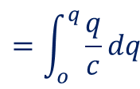
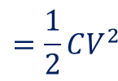
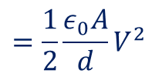

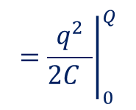
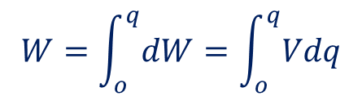
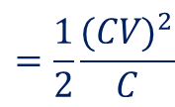
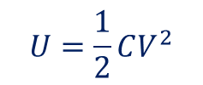
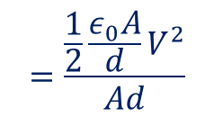

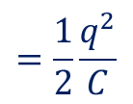
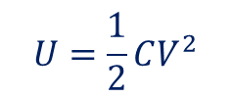
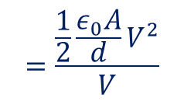
Energy stored in a capacitor.
$$dw=Vdq$$
+++++++++
---------
$$W=\int_{o}^{q}{dW}=\int_{o}^{q}{Vdq}$$
$$=\int_{o}^{q}{\frac{q}{c}dq}$$
$$={\left.\frac{q^{2}}{2C }\right|}_{0}^{Q}$$
$$=\frac{1}{2}\frac{q^{2}}{C}$$
$$=\frac{1}{2}\frac{{(CV)}^{2}}{C}$$
$$=\frac{1}{2}CV^{2}$$
$$U=\frac{1}{2}CV^{2}$$
$$C=\frac{ε_{0}A}{d}$$
For a parallel plate capacitor.
$$U=\frac{1}{2}CV^{2}$$
$$=\frac{1}{2}\frac{ε_{0}A}{d}V^{2}$$
Energy Density= $\frac{Enery Stored}{Volume}$
$$=\frac{\frac{1}{2}\frac{ε_{0}A}{d}V^{2}}{V}$$
$$=\frac{\frac{1}{2}\frac{ε_{0}A}{d}V^{2}}{Ad}$$
$=\frac{1}{2}\frac{ε_{0}A}{A}\frac{{ V}^{2}}{d^{2}}$
$=\frac{1}{2}ε_{0}E^{2}$

Slide 11


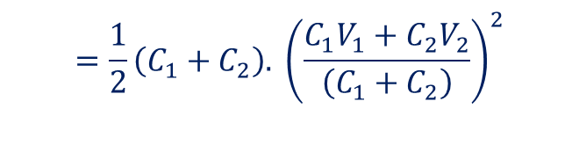


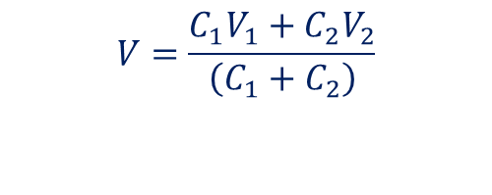



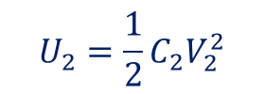


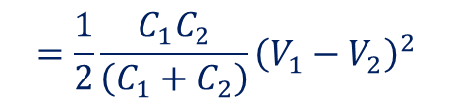
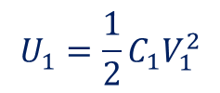
?? To Capacitors $C_{1}$ and $C_{2}$ are charged at $V_{1}$ and $V_{2}$respectively and then they are connected.
What happens to the total energy Stored?
$$U_{1}=\frac{1}{2}C_{1}V_{1}^{2}$$
$$U_{2}=\frac{1}{2}C_{2}V_{2}^{2}$$
$$Q_{1}=C_{1}V_{1}$$
$$Q_{2}=C_{2}V_{2}$$
$Q=C_{1}V_{1}$ +$C_{2}V_{2}$
$$C=C_{1}+C_{2}$$
$$Q=\left(C_{1}+C_{2}\right)V$$
$\left(C_{1}+C_{2}\right)V=C_{1}V_{1}$ +$C_{2}V_{2}$
$$V=\frac{C_{1}V_{1}+C_{2}V_{2}}{\left(C_{1}+C_{2}\right)}$$
$$U_{Final}=\frac{1}{2}CV$$
$$=\frac{1}{2}\left(C_{1}+C_{2}\right). {\left(\frac{C_{1}V_{1}+C_{2}V_{2}}{\left(C_{1}+C_{2}\right)}\right)}^{2}$$
$$ΔU=U_{initial}−U_{Final}$$
$=\frac{1}{2}C_{1}V_{1}^{2}+\frac{1}{2}C_{2}V_{2}^{2}−$ $\frac{1}{2}\left(C_{1}+C_{2}\right). {\left(\frac{C_{1}V_{1}+C_{2}V_{2}}{\left(C_{1}+C_{2}\right)}\right)}^{2}$
$$=\frac{1}{2}\frac{C_{1}C_{2}}{\left(C_{1}+C_{2}\right)}{\left(V_{1}−V_{2}\right)}^{2}$$

