Slide 1

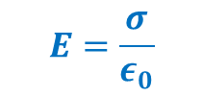
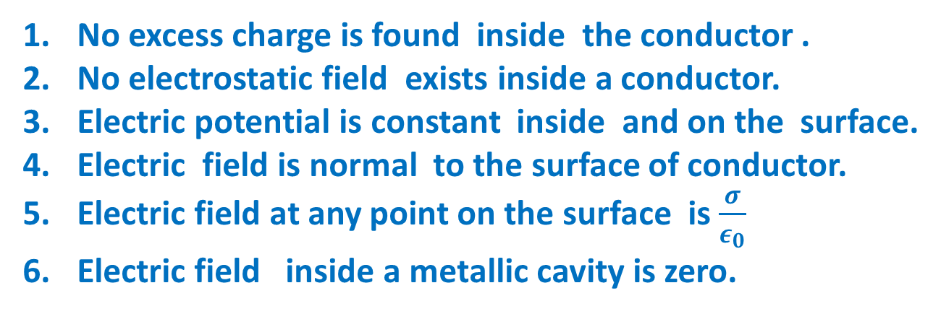
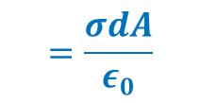


Electrostatics of Conductors
No excess charge is found inside the conductor .
No electrostatic field exists inside a conductor.
Electric potential is constant inside and on the surface.
Electric field is normal to the surface of conductor.
Electric field at any point on the surface is $\frac{σ}{ε_{0}}$
Electric field inside a metallic cavity is zero.
$$E.dA=\frac{q}{ε_{0}}$$
$$=\frac{σdA}{ε_{0}}$$
$$E=\frac{σ}{ε_{0}}$$
$$E$$
$$dA$$

Slide 2
Dielectrics
Non-conducting materials.
Less no of free charge carriers.
Get polarized .
Polar
Non Polar
H Cl
H-H

Slide 3
Polarization
Non Polar
+ -
+ -
+ -
+ -
+ -
+ -
+ -
+ -
+ -
+ -
+ -
+ -
+ -
+ -
+ -
+ -
+ -
+ -
+ -
+ -
+ -
+ -
+ -
+ -
+ -
+ -
+ -
+ -
+ -
+ -
Polar

Slide 4
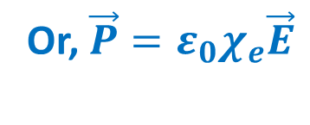

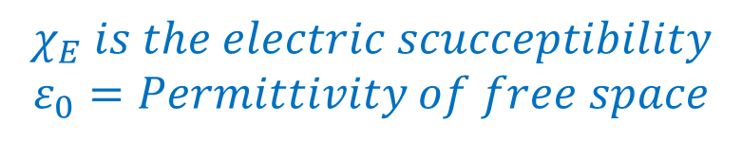
Polarization (P)
The dipole moment developed per unit volume of the material when placed in an external electric field
Polarization $P∝E$
Or, $\vec{P}=ε_{0}χ_{e}\vec{E}$
$$χ_{E} is the electric scucceptibility$$
$$ε_{0}=Permittivity of free space$$

