Slide 1
Potential due to a charged Spherical Shell
R

Slide 2
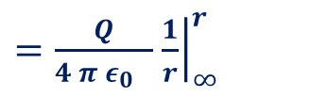

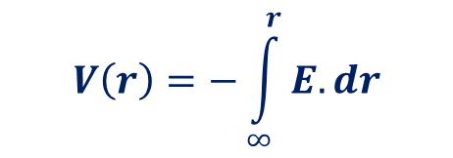

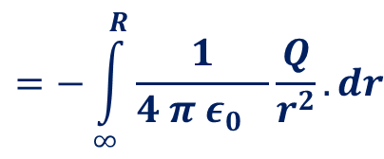
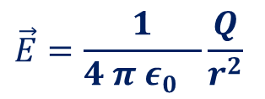

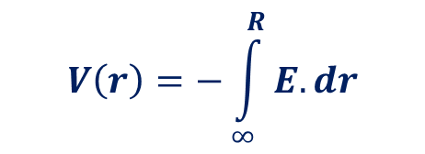
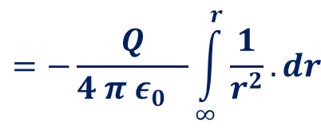

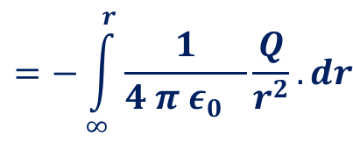

Potential due to a charged Spherical Shell
$$\vec{E}=\frac{1}{4 π ε_{0} }\frac{Q}{r^{2}}$$
P
r
Case 1: Outside the shell.
$$V\left(r\right)=−\int_{∞}^{r}{E.dr}$$
$$=−\int_{∞}^{r}{\frac{1}{4 π ε_{0} }\frac{Q}{r^{2}}.dr}$$
$$=−\frac{Q}{4 π ε_{0} }\int_{∞}^{r}{\frac{1}{r^{2}}.dr}$$
$=\frac{Q}{4 π ε_{0} }$ ${\left.\frac{1}{r}\right|}_{∞}^{r}$
R
$=\frac{Q}{4 π ε_{0} }$ $\frac{1}{r}−\frac{Q}{4 π ε_{0} } \frac{1}{∞}$
$=\frac{Q}{4 π ε_{0} }$ $\frac{1}{r}$
$V(r)=\frac{Q}{4 π ε_{0} }$ $\frac{1}{r}$
Case 2 :on the surface.
$$V\left(r\right)=−\int_{∞}^{R}{E.dr}$$
$$=−\int_{∞}^{R}{\frac{1}{4 π ε_{0} }\frac{Q}{r^{2}}.dr}$$
$=\frac{Q}{4 π ε_{0} }$ $\frac{1}{R}$
$V(R)=\frac{Q}{4 π ε_{0} }$ $\frac{1}{R}$

Slide 3

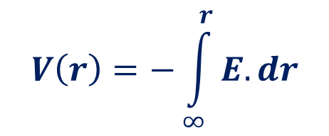
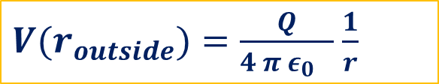

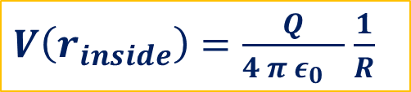
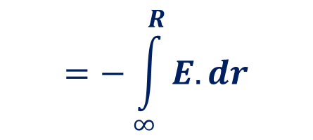
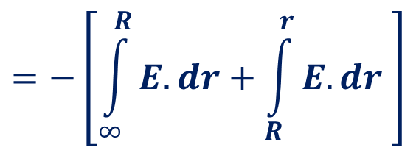
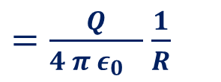
Potential due to a charged Spherical Shell
$$\vec{E}=0$$
Case 3: Inside the shell.
$$V\left(r\right)=−\int_{∞}^{r}{E.dr}$$
$$=−\left[\int_{∞}^{R}{E.dr+\int_{R}^{r}{E.dr} }\right]$$
$$=−\int_{∞}^{R}{E.dr}$$
r
$=\frac{Q}{4 π ε_{0} }$ $\frac{1}{R}$
P
R
$V(r_{outside})=\frac{Q}{4 π ε_{0} }$ $\frac{1}{r}$
$V(R_{on thesurfac})=\frac{Q}{4 π ε_{0} }$ $\frac{1}{R}$
$V\left(r_{inside}\right)=\frac{Q}{4 π ε_{0} }$ $\frac{1}{R}$
Variation of Potential with distance from the centre
r > R
r < R
r < R
r > R

Slide 4
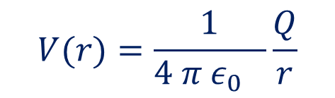
Equipotential surfaces
The surface which is the locus of all points which are at the same potential is known as the equipotential surface.
$$V(r)=\frac{1}{4 π ε_{0} }\frac{Q}{r}$$
r

Slide 5
Equipotential surfaces-Properties
Work Done Equipotential Surface is zero
W = q₀(V_{A} –V_{B})
As V_{A} – V_{B} is equal to zero, the total work done is W = 0

Slide 6




Equipotential surfaces-Properties
The electric field is always perpendicular to an equipotential surface.
$$B$$
$$W=\int_{A}^{B}{F.dr=\int_{A}^{B}{qE.dr=q\int_{A}^{B}{E.dr}}}=0$$
$$dr$$
$$A$$
That is no parallel component of electric field exist in an equipotential surface

Slide 7
Equipotential surfaces-Properties
Two equipotential surfaces can never intersect.
At the intersection line it will be sum of two….

Slide 8
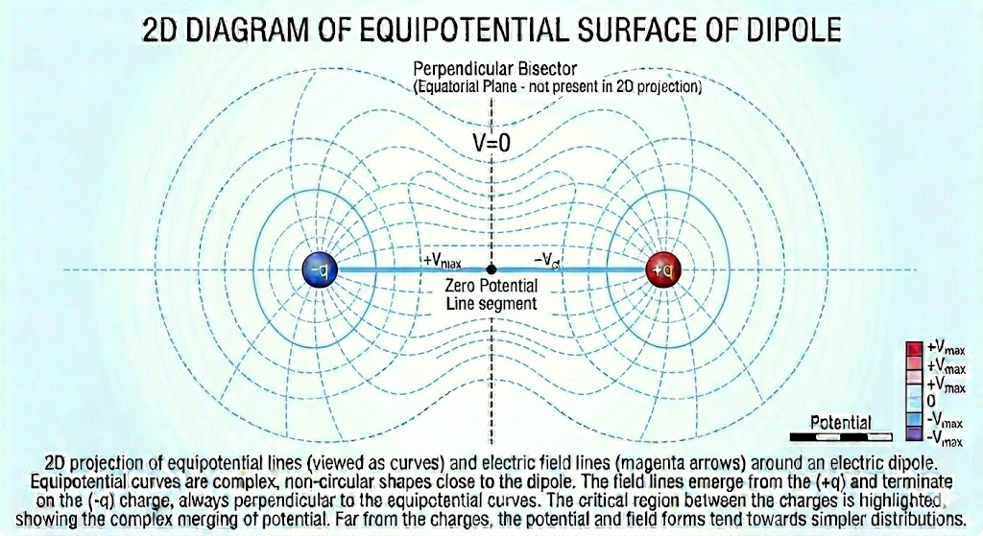
Equipotential surfaces- A Dipole

Slide 9
Equipotential surfaces-Properties
Work Done in moving a charge in an Equipotential Surface is zero
The electric field is always perpendicular to an equipotential surface.
Two equipotential surfaces can never intersect.

Slide 10
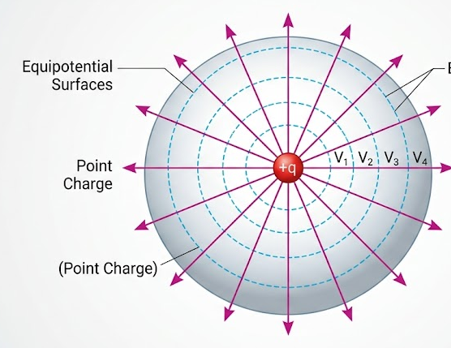
Equipotential surfaces-A point Charge

Slide 11
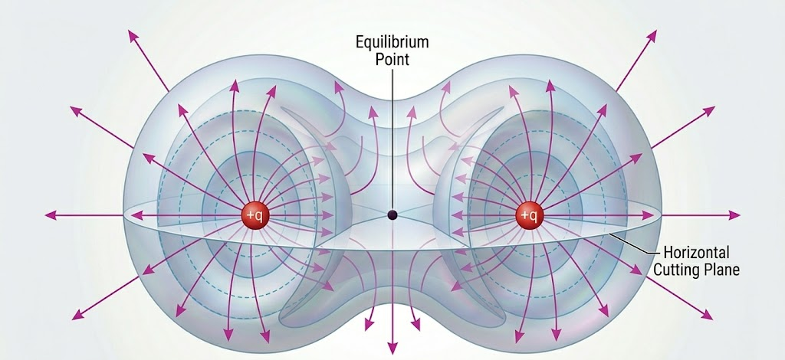
Equipotential surfaces-A pair of Charges

Slide 12
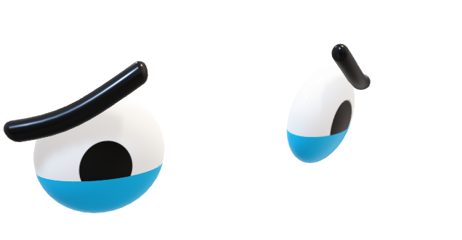
Four equal charges are placed at the corners of square of side a. Find the electrostatic potential energy of the system .

Slide 13

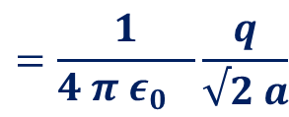
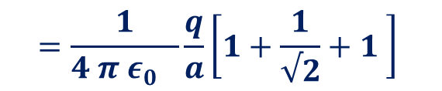





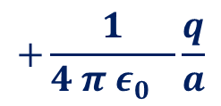

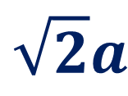
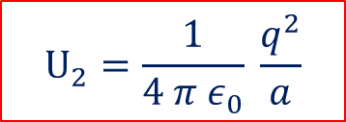
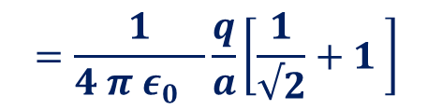
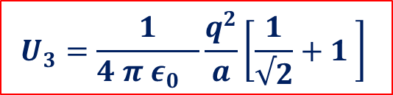


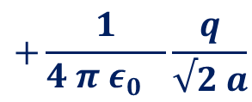


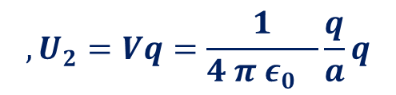
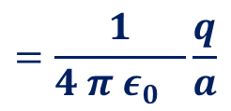


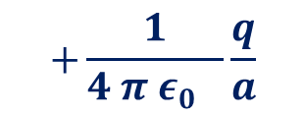



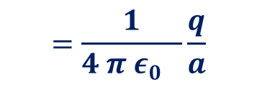

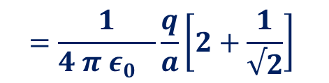
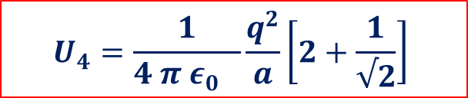

$$V_{1}=0$$
$$U_{1}=V_{1}q=0$$
$$=\frac{1}{4 π ε_{0} }\frac{q}{a}$$
$$,U_{2}=Vq=\frac{1}{4 π ε_{0} }\frac{q}{a}q$$
$$U_{2}=\frac{1}{4 π ε_{0}} \frac{q^{2}}{a}$$
$$V_{2}=V_{21}$$
$$Or,$$
$$=\frac{1}{4 π ε_{0} }\frac{q}{√2 a}$$
$$+\frac{1}{4 π ε_{0} }\frac{q}{a}$$
$$=\frac{1}{4 π ε_{0} }\frac{q}{a}\left[\frac{1}{√2}+1 \right]$$
$$1$$
$$V_{3}=V_{31}+V_{32}$$
$$a$$
$$2$$
$$U_{3}=\frac{1}{4 π ε_{0} }\frac{q^{2}}{a}\left[\frac{1}{√2}+1 \right]$$
$$U_{3}=V_{3}q$$
$$Or,$$
$$\sqrt{2}a$$
$$a$$
$$a$$
$$=\frac{1}{4 π ε_{0} }\frac{q}{a}$$
$$+\frac{1}{4 π ε_{0} }\frac{q}{√2 a}$$
$$+\frac{1}{4 π ε_{0} }\frac{q}{a}$$
$$V_{4}=V_{41}+V_{42}+V_{43}$$
$$=\frac{1}{4 π ε_{0} }\frac{q}{a}\left[2+\frac{1}{√2}\right]$$
$$4$$
$$a$$
$$3$$
$$=\frac{1}{4 π ε_{0} }\frac{q}{a}\left[1+\frac{1}{√2}+1 \right]$$
$$U_{4}=\frac{1}{4 π ε_{0} }\frac{q^{2}}{a}\left[2+\frac{1}{√2}\right]$$
$$U_{4}=V_{4}q$$
$$Or,$$

Slide 14
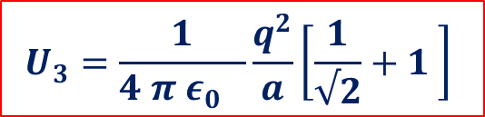


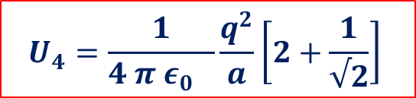
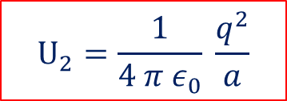
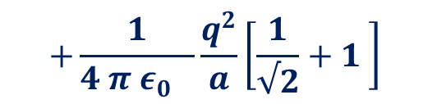
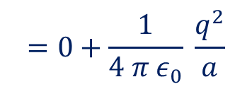







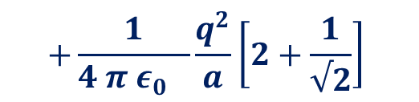
$$U_{2}=\frac{1}{4 π ε_{0}} \frac{q^{2}}{a}$$
$$U_{3}=\frac{1}{4 π ε_{0} }\frac{q^{2}}{a}\left[\frac{1}{√2}+1 \right]$$
$$U_{4}=\frac{1}{4 π ε_{0} }\frac{q^{2}}{a}\left[2+\frac{1}{√2}\right]$$
$$U_{1}=V_{1}q=0$$
$$U=U_{1}+U_{2}+U_{3}+U_{4}$$
$$1$$
$$a$$
$$2$$
$$=0+\frac{1}{4 π ε_{0}} \frac{q^{2}}{a}$$
$$+\frac{1}{4 π ε_{0} }\frac{q^{2}}{a}\left[\frac{1}{√2}+1 \right]$$
$$+\frac{1}{4 π ε_{0} }\frac{q^{2}}{a}\left[2+\frac{1}{√2}\right]$$
$$\sqrt{2}a$$
$$a$$
$$a$$
$$=\frac{1}{4 π ε_{0}} \frac{q^{2}}{a}\left[1+\frac{1}{√2}+1+2+\frac{1}{√2}\right]$$
$$4$$
$$a$$
$$3$$
$$=\frac{1}{4 π ε_{0}} \frac{q^{2}}{a}\left[4+\frac{1}{√2}+\frac{1}{√2}\right]$$
$$=\frac{1}{4 π ε_{0}} \frac{q^{2}}{a}\left[4+√2 \right]$$

