Slide 1
Potential Due to a point charge
Electric Potential $V(r_{p})=\frac{1}{4 π ε_{0} }(\frac{Q}{r_{p}})$
Potential Due to a system of point charges
Electric Potential $V=V_{1}+V_{2}+…$
Electric Potential $V\left(r_{p}\right)=\frac{1}{4 π ε_{0} }\left(\frac{Q_{1}}{r_{1p}}\right)+\frac{1}{4 π ε_{0} }\left(\frac{Q_{2}}{r_{2p}}\right)+$ $\frac{1}{4 π ε_{0} }\left(\frac{Q_{3}}{r_{3p}}\right)+…$

Slide 2
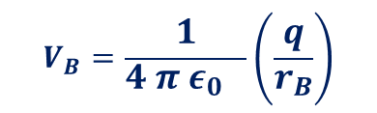


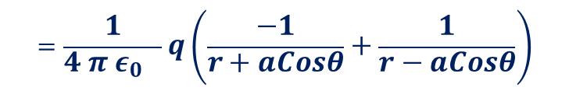


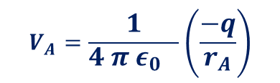


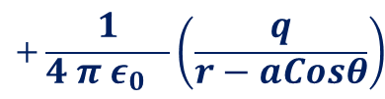



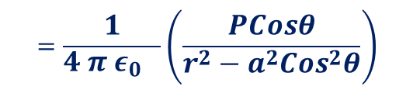


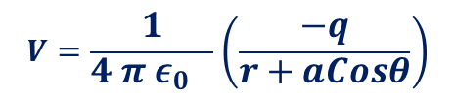



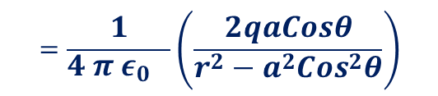






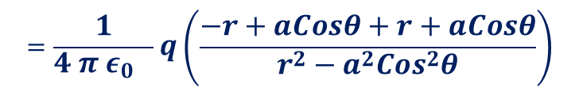
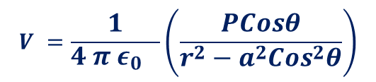
Potential Due to a Dipole
X P
$$V_{A}=\frac{1}{4 π ε_{0} }\left(\frac{−q}{r_{A}}\right)$$
$$V_{B}=\frac{1}{4 π ε_{0} }\left(\frac{q}{r_{B}}\right)$$
$${V=V}_{A}+V_{B}$$
$$r_{A}=PC$$
$$=r+EC$$
$$=r+aCosθ$$
$$r$$
$$r_{B}=PD$$
$$=r−ED$$
$$=r−aCosθ$$
$$r_{A}$$
D
$$r_{B}$$
$$V=\frac{1}{4 π ε_{0} }\left(\frac{−q}{r+aCosθ}\right)$$
$$+\frac{1}{4 π ε_{0} }\left(\frac{q}{r−aCosθ}\right)$$
-
$$A$$
$$a$$
$$θ$$
$$a$$
+
$$B$$
$$θ$$
E
$$Cosθ=\frac{ED}{a}$$
$$=\frac{1}{4 π ε_{0} }q\left(\frac{−1}{r+aCosθ}+\frac{1}{r−aCosθ}\right)$$
$$Cosθ=\frac{EC}{a}$$
ED=$a Cosθ$
$$=\frac{1}{4 π ε_{0} }q\left(\frac{−r+aCosθ+r+aCosθ}{r^{2}−a^{2}Cos^{2}θ}\right)$$
C
EC=$a Cosθ$
$$=\frac{1}{4 π ε_{0} }\left(\frac{2qaCosθ}{r^{2}−a^{2}Cos^{2}θ}\right)$$
$$=\frac{1}{4 π ε_{0} }\left(\frac{PCosθ}{r^{2}−a^{2}Cos^{2}θ}\right)$$
$$V =\frac{1}{4 π ε_{0} }\left(\frac{PCosθ}{r^{2}−a^{2}Cos^{2}θ}\right)$$

Slide 3
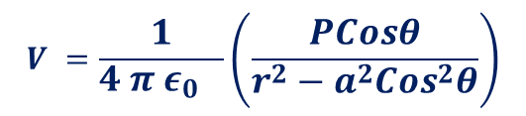


Potential Due to a Dipole
X P
$$V =\frac{1}{4 π ε_{0} }\left(\frac{PCosθ}{r^{2}−a^{2}Cos^{2}θ}\right)$$
$$r$$
For an ideal Dipole a<<r
D
$$r_{A}$$
$$r_{B}$$
$$V =\frac{1}{4 π ε_{0} }\left(\frac{PCosθ}{r^{2}}\right)$$
$$=\frac{1}{4 π ε_{0} }\left(\frac{\vec{P}.\hat{r}}{r^{2}}\right)$$
-
$$A$$
$$a$$
$$θ$$
$$a$$
+
$$B$$
$$θ$$
E
C

Slide 4
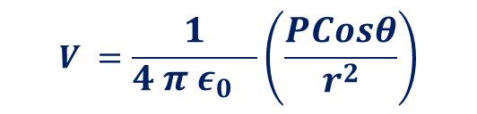


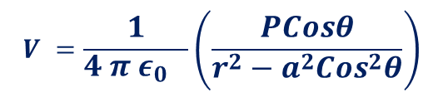

Potential Due to a Dipole
$$V =\frac{1}{4 π ε_{0} }\left(\frac{PCosθ}{r^{2}−a^{2}Cos^{2}θ}\right)$$
For an ideal Dipole a<<r
X P
$$V =\frac{1}{4 π ε_{0} }\left(\frac{PCosθ}{r^{2}}\right)$$
$$=\frac{1}{4 π ε_{0} }\left(\frac{P.\hat{r}}{r^{2}}\right)$$
$$r$$
-
$$A$$
$$a$$
$$θ$$
$$a$$
+
$$B$$
E

Slide 5
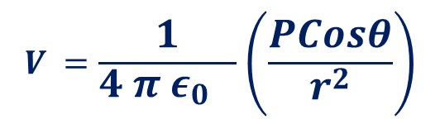

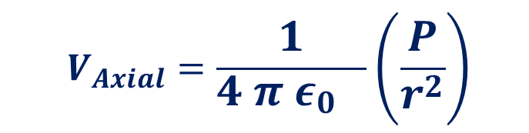
Potential Due to a Dipole
$$V =\frac{1}{4 π ε_{0} }\left(\frac{PCosθ}{r^{2}−a^{2}Cos^{2}θ}\right)$$
For an ideal Dipole a<<r
$$V =\frac{1}{4 π ε_{0} }\left(\frac{PCosθ}{r^{2}}\right)$$
$$V_{Axial}=\frac{1}{4 π ε_{0} }\left(\frac{P}{r^{2}}\right)$$
-
$$A$$
$$a$$
$$θ$$
$$a$$
+
$$B$$
X P
$$r$$

Slide 6



Potential Due to a Dipole
$$V =\frac{1}{4 π ε_{0} }\left(\frac{PCosθ}{r^{2}−a^{2}Cos^{2}θ}\right)$$
X P
For an ideal Dipole a<<r
$$V =\frac{1}{4 π ε_{0} }\left(\frac{PCosθ}{r^{2}}\right)$$
$$V_{Equitorial}=0$$
$$r$$
-
$$A$$
$$a$$
$$θ$$
$$a$$
+
$$B$$

Slide 7


Torque on an Electric Dipole in a uniform Electric field.
++++++++++++++
--------------
+
$$F=+qE$$
$$F=− qE$$
_

Slide 8


Torque on an Electric Dipole in a uniform Electric field.
++++++++++++++
--------------
+
$$F=− qE$$
$$F=+qE$$
_

Slide 9

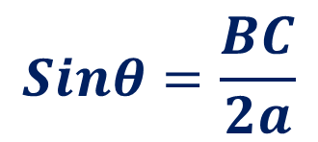














Torque on an Electric Dipole in a uniform Electric field.
Torque
$τ=Either ofthe force×⊥ Distance between them$
++++++++++++++
--------------
$$τ=F×BC$$
+
$$F=+qE$$
$$=qE×BC$$
$$C$$
$$A$$
$$θ$$
$$=qE×2aSinθ$$
$$2a$$
$$=2qaESinθ$$
$$θ$$
$$F=− qE$$
_
$$=PESinθ$$
$$B$$
$$\vec{τ}=\vec{P}× \vec{E}$$
$$Sinθ=\frac{BC}{2a}$$
$$BC=2aSinθ$$

Slide 10



Potential Energy of an Electric Dipole in a uniform Electric field.
$$τ=\vec{P}×\vec{E}=PESinθ$$
++++++++++++++
--------------
+
$$dw=τdθ$$
$$θ$$
_

Slide 11









Potential Energy of an Electric Dipole in a uniform Electric field.
$$τ=\vec{P}×\vec{E}=PESinθ$$
$$dw=τ_{Ext}dθ$$
++++++++++++++
--------------
$$W_{}=\int{dw}=\int{τ_{Ext}dθ}$$
$$dθ$$
$$θ_{}$$
$$=\int{PESinθdθ}$$
$$=PE\int{Sinθdθ}$$
$=$ $−PEcosθ_{}$
$$or U=−\vec{P}.\vec{E}$$

Slide 12






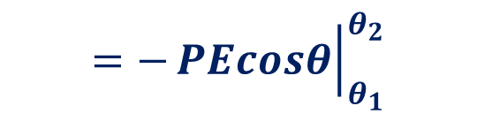
Potential Energy of an Electric Dipole in a uniform Electric field.
$$τ=\vec{P}×\vec{E}=PESinθ$$
$$dw=τ_{Ext}dθ$$
++++++++++++++
--------------
$$W_{θ_{1}→θ_{2}}=\int_{θ_{1}}^{θ_{2}}{dw}=\int_{θ_{1}}^{θ_{2}}{τ_{Ext}dθ}$$
$$dθ$$
$$θ_{1}$$
$$=\int_{θ_{1}}^{θ_{2}}{PESinθdθ}$$
$$=PE\int_{θ_{1}}^{θ_{2}}{Sinθdθ}$$
$$=−{\left.PEcosθ\right|}_{θ_{1}}^{θ_{2}}$$
$=$ $PEcosθ_{1}−PEcosθ_{2}$
$$W_{θ_{1}→θ_{2}}=PEcosθ_{1}−PEcosθ_{2}$$

Slide 13
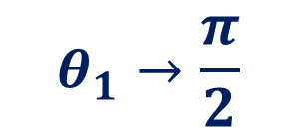

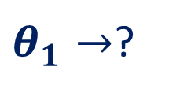








Potential Energy of an Electric Dipole in a uniform Electric field.
q
$$∞$$
$$dr$$
$$W_{θ_{1}→θ_{2}}=PEcosθ_{1}−PEcosθ_{2}$$
Q
$$A$$
$$θ_{2}→θ$$
$θ_{1}→$?
$$θ_{1}→\frac{π}{2}$$
$$W_{\frac{π}{2}→θ}=PEcos\frac{π}{2}−PEcosθ$$
$$W_{\frac{π}{2}→θ}=0−PEcosθ$$
$$θ$$
$$U=−\vec{P}.\vec{E}$$

Slide 14





Potential Energy of an Electric Dipole in a uniform Electric field.
$$U=−\vec{P}.\vec{E}$$
+++++++++
--------
+
+
+
+
_
_
_
_
$$U=−\vec{P}.\vec{E}Cos0=−\vec{P}\vec{E}$$
$$U=−\vec{P}.\vec{E}Cosπ=\vec{P}\vec{E}$$
$$U=−\vec{P}.\vec{E}Cos\frac{π}{2}=0$$
$$U=−\vec{P}.\vec{E}Cos\frac{3π}{2}=0$$

Slide 15

Electric Dipole in a non-uniform Electric field.
$$In a non−uniform field , different forces act on different charges,$$
Thus, along with torque , an unbalanced force is also acted on the dipole.
It Translates along with Rotation
+++++++++
--------
+
_

