Slide 1



Electrostatic Potential Energy
$$∞$$
q
$$P$$
Q
$$r_{p}$$

Slide 2
Electrostatic Potential Energy
$$∞$$
$$P$$
q
Q
$$r_{p}$$
$$To push the positive charge from infinity to{ r}_{p}, a work is to be done$$

Slide 3

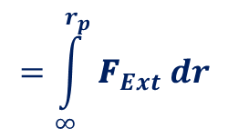
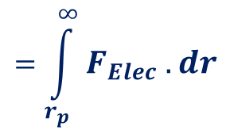


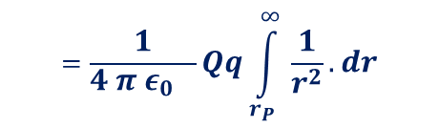

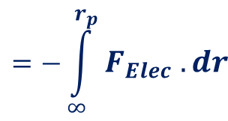
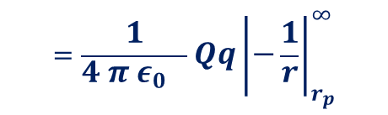




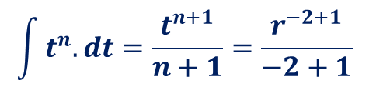
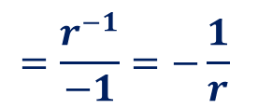
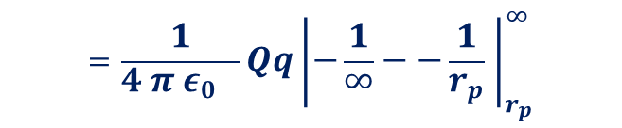

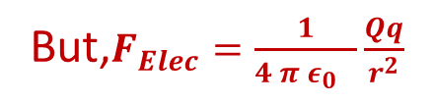

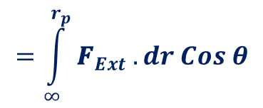


Let’s come back to the point at infinity
$$∞$$
q
$$Elementary workdone ,dW=F_{ext}.dr$$
$$dr$$
$$\int^{ }{\frac{1}{r^{2}}.dr=\int^{ }{r^{−2}.dr}}$$
$$The total workdone in bring to the point p is given by$$
$$W_{Ext}=\int_{∞}^{r_{p}}{F_{Ext}.dr}$$
$$=\int_{∞}^{r_{p}}{{\text{F}}_{Ext} .dr Cos θ}$$
$$=\int_{∞}^{r_{p}}{{\text{F}}_{Ext} dr}$$
$$\int^{ }{t^{n}.dt=\frac{t^{n+1}}{n+1}=\frac{r^{−2+1}}{−2+1}}$$
$$P$$
$$This external force must be against$$
$$the electrostaic repulsion$$
$$=\frac{r^{−1}}{−1}=−\frac{1}{r}$$
$$=\frac{1}{4 π ε_{0} }Qq{\left|−\frac{1}{r}\right|}_{r_{p}}^{∞}$$
Q
$$r_{p}$$
$$∴F_{ext}=−F_{elec}$$
$$W_{Ext}=\int_{∞}^{r_{p}}{{−F}_{Elec} .dr}$$
$$=−\int_{∞}^{r_{p}}{F_{Elec} .dr}$$
$$=\int_{r_{p}}^{∞}{F_{Elec} .dr}$$
$$=\frac{1}{4 π ε_{0} }Qq{\left|−\frac{1}{∞}−−\frac{1}{r_{p}} \right|}_{r_{p}}^{∞}$$
$$=\frac{1}{4 π ε_{0} }(\frac{Qq}{r_{p}})$$
But,$F_{Elec}=\frac{1}{4 π ε_{0} }\frac{Qq}{r^{2}}$
$${∴W}_{Elec}=\int_{r_{P}}^{∞}{\frac{1}{4 π ε_{0} }\frac{Qq}{r^{2}}dr}$$
$$=\frac{1}{4 π ε_{0} }Qq\int_{r_{P}}^{∞ }{\frac{1}{r^{2}}.dr}$$
Electrostatic Potential Energy $U=\frac{1}{4 π ε_{0} }(\frac{Qq}{r_{p}})$

Slide 4
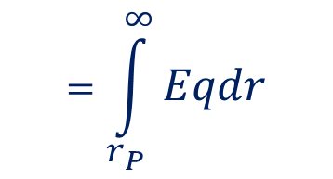
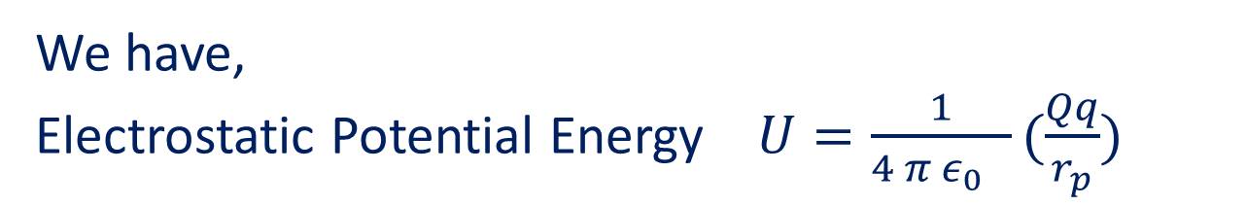




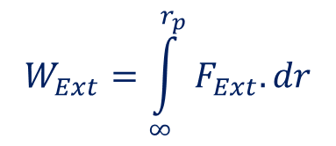


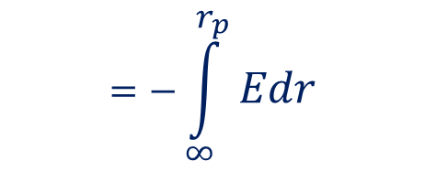


Electric Potential at a point.
We have,
Electrostatic Potential Energy $U=\frac{1}{4 π ε_{0} }(\frac{Qq}{r_{p}})$
Now,Potential Energy $U=\frac{1}{4 π ε_{0} }\frac{Qq}{r_{p}}$
$$∞$$
For q=1,Electric Potential $V(r_{p})=\frac{1}{4 π ε_{0} }(\frac{Q}{r_{p}})$
$$P$$
1
q
Q
$$r_{p}$$
$$W_{Ext}=\int_{∞}^{r_{p}}{F_{Ext}.dr}$$
$${=−W}_{Elec}=\int_{r_{P}}^{∞}{F_{Elec} .dr}$$
$$=\int_{r_{P}}^{∞}{Eqdr}$$
$$Or, when q=1,V(r_{p})=\int_{r_{P}}^{∞}{Edr}$$
$$=−\int_{∞}^{r_{p}}{Edr}$$
Electric Potential at a point is the work done in bringing a unit positive charge from infinity to that point
$$U=V(r_{p})q$$

Slide 5
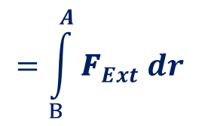
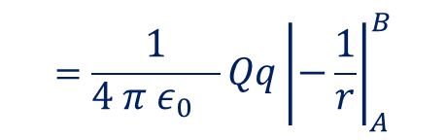



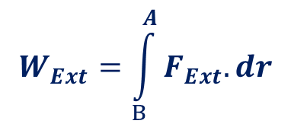
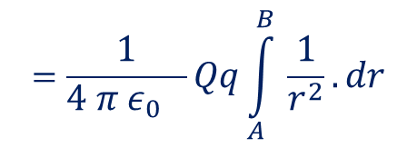
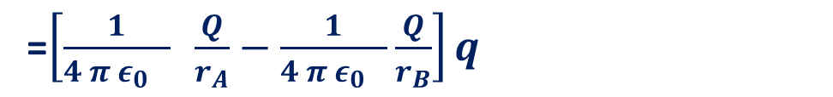

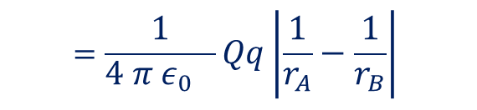
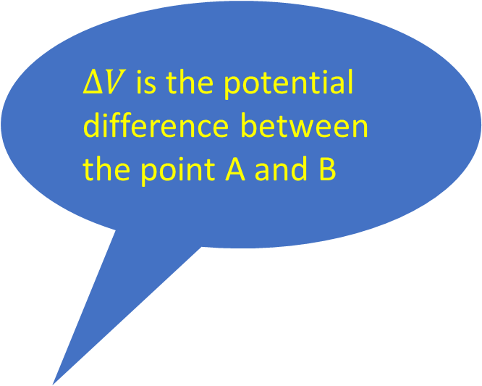

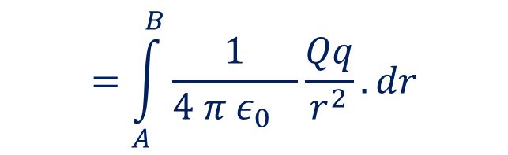
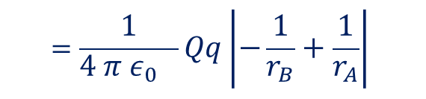
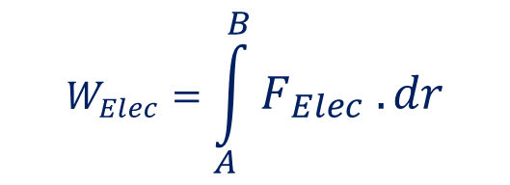





Work done in moving a charge in an Electrostatic Force Field
q
$$In the previous session we have calculated the work done by external force$$
$$in moving a charge from infinity to a point p. Now, we take work done in$$
$$moving a charge from a point at a finite distance to another point. Say B to A$$
$$B$$
$$dr$$
$$W_{Ext}=\int_{B}^{A}{F_{Ext}.dr}$$
$$=\int_{B}^{A}{{\text{F}}_{Ext} dr}Cosθ$$
$$=\int_{B}^{A}{{\text{F}}_{Ext} dr}$$
$$dr$$
Q
$ΔV$is the potential difference between the point A and B
$$A$$
$$Now, the workdone by electrostatic force, in$$
$$moving the charge from A to B is given by$$
$$W_{Elec}=\int_{A}^{B}{F_{Elec} .dr}$$
$$=\int_{A}^{B}{\frac{1}{4 π ε_{0} }\frac{Qq}{r^{2}}.dr}$$
$$Conservative$$
$Force Fiel$d
=$\left[\frac{1}{4 π ε_{0} } \frac{Q}{r_{A}}−\frac{1}{4 π ε_{0} }\frac{Q}{r_{B}}\right]q$
$$=\frac{1}{4 π ε_{0} }Qq\int_{A}^{B }{\frac{1}{r^{2}}.dr}$$
$$=\frac{1}{4 π ε_{0} }Qq{\left|−\frac{1}{r}\right|}_{A}^{B}$$
$${{=(V}_{A}−V}_{B})q$$
$$U=ΔV q$$
$$=\frac{1}{4 π ε_{0} }Qq{\left|−\frac{1}{r_{B}}+\frac{1}{r_{A}}\right|}_{ }^{ }$$
$$=\frac{1}{4 π ε_{0} }Qq{\left|\frac{1}{r_{A}}−\frac{1}{r_{B}}\right|}_{ }^{ }$$

Slide 6
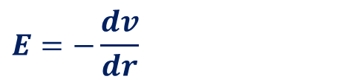





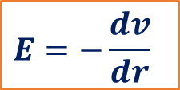


Electric Field and Potential Contd.
$$∞$$
$$dW=dU=F_{ext}.dr$$
$$dU=−F_{ele}.dr$$
$$P$$
q
1
$$dV=−E.dr$$
Q
$$r_{p}$$
$$E=−\frac{dv}{dr}$$
$$V\left(r_{p}\right)=−\int_{∞}^{r_{p}}{E.dr}$$
$$E=−\frac{dv}{dr}$$

Slide 7








Electron Volt
$$U=ΔV q$$
𝑰𝒕 𝒊𝒔 𝒕𝒉𝒆 𝒆𝒏𝒆𝒓g𝒚 𝐞𝐪𝐮𝐢𝐯𝐚𝐥𝐞𝐧𝐭 𝐭𝐨 𝐭𝐡𝐞 𝐞𝐧𝐞𝐫𝐠𝐲 𝐚𝐭𝐭𝐚𝐢𝐧𝐞𝐝 𝐛𝐲 𝐚𝐧 𝐞𝐥𝐞𝐜𝐭𝐫𝐨𝐧
𝐰𝐡𝐞𝐧 𝐚𝐜𝐜𝐞𝐥𝐚𝐫𝐚𝐭𝐞𝐝 𝐛𝐲 𝐨𝐧𝐞 𝐯𝐨𝐥𝐭
$$ΔV$$
+++++
-----
+
$$Kinetic energy is given byK=\frac{1}{2}mv^{2}$$
$$This energy is obtained from the P.E$$
$$ie,K=\frac{1}{2}mv^{2}$$
$$=ΔV q$$
$$Joules$$
$$ΔV=1 Volt , q=e=1.6×{10}^{−19}C$$
$$or K=1.6×{10}^{−19}Joules$$
=One $Electron Volt(eV)$

Slide 8






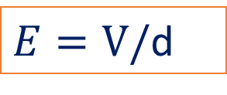




Potential Difference and Uniform Electric Field
$$A$$
$$B$$
$$ΔV=\int_{A}^{B}{E.dl}$$
$$=E\int_{A}^{B}{dl}$$
$$ΔV$$
+++++
-----
$$E$$
+
$ΔV=E$d
$$dl$$
$$d$$
$E=ΔV/$d
$E=V/$d

