Slide 1

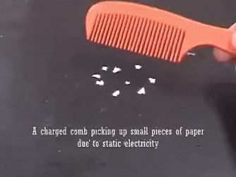
Electrostatics
Some common examples
Why?
The Answer: Frictional Electricity

Slide 2
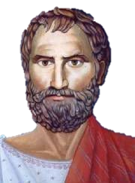
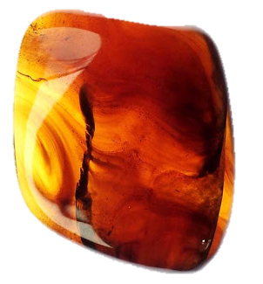
A little history
Thales of Miletus
Amber: A Wood Resin
Notes:
3-D hexagon with 3-D text
(Advanced)
To reproduce the shape effects on this slide, do the following:
On the Home tab, in the Slides group, click Layout, and then click Blank.
On the Home tab, in the Drawing group, click Shapes, and then under Basic Shapes click Hexagon (first row, ninth option from the left).
Press and hold SHIFT, and then on the slide, drag to draw a hexagon.
Select the hexagon. On the Home tab, in the bottom right corner of the Drawing group, click the Format Shape dialog box launcher. In the Format Shape dialog box, click Fill in the left pane. In the Fill pane, select Gradient fill, and then do the following:
Click the button next to Preset Colors, and then click Fog (second row, fifth option from the left).
In the Type list, select Linear.
Click the button next to Direction, and then click Linear Down (first row, second option from the left).
Also in the Format Shape dialog box, click Line Color in the left pane. In the Line Color pane, select No line.
Also in the Format Shape dialog box, click 3-D Format in the left pane. In the 3-D Format pane, do the following:
Under Bevel, click the button next to Top, and then under Bevel click Angle (second row, first option from the left). Next to Top, in the Width box, enter 6 pt, and in the Height box, enter 6 pt. Click the button next to Bottom, and then under Bevel click Angle (second row, first option from the left). Next to Bottom, in the Width box, enter 6 pt, and in the Height box, enter 6 pt.
Under Depth, in the Depth box, enter 23.5 pt.
Under Surface, click the button next to Material, and then under Translucent click Clear (third option from the left). Click the button next to Lighting, and then under Neutral click Balance (first row, second option from the left). In the Angle box, enter 340°.
Also in the Format Shape dialog box, click 3-D Rotation in the left pane. In the 3-D Rotation pane, do the following:
Click the button next to Presets, and then under Perspective, click Perspective Relaxed (second row, third option from the left).
In the X box, enter 333°.
In the Y box, enter 300°.
In the Z box, enter 25.5°.
In the Perspective box, enter 70°.
Also in the Format Shape dialog box, click Glow and Soft Edges in the left pane. In the Glow and Soft Edges pane, under Glow, do the following:
Click the button next to Color, and then under Theme Colors click White, Background 1, Darker 35% (fifth row, first option from the left).
In the Size box, enter 11 pt.
In the Transparency box, enter 60%.
To reproduce the text effects on this slide, do the following:
On the Insert tab, in the Text group, click Text Box, and then on the slide, drag to draw the text box.
Enter text in the text box, select the text, and then on the Home tab, in the Font group, select Arial from the Font list, select 60 from the Font Size list, click the arrow next to Font Color, and then under Theme Colors click Black, Text 1, Lighter 50% (second row, second option from the left).
On the Home tab, in the Paragraph group, click Center to center the text in the text box.
Select the text box. Under Drawing Tools, on the Format tab, in the bottom right corner of the WordArt Styles group, click the Format Text Effects dialog box launcher.
In the Format Text Effects dialog box, click Text Fill in the left pane. In the Text Fill pane, do the following:
Click Solid fill.
Click the button next to Color, and then under Theme Colors click Blue, Accent 1, Darker 25% (fifth row, fifth option from the left).
Also in the Format Text Effects dialog box, click 3-D Format in the left pane. In the right pane, do the following:
Under Depth, in the Depth box, enter 7 pt.
Under Surface, click the button next to Material, and then under Standard click Warm Matte (second option from the left). Click the button next to Lighting, and then under Special click Glow (third option from the left).
Also in the Format Text Effects dialog box, click 3-D Rotation, and then do the following:
Click the button next to Presets, and then under Perspective click Perspective Heroic Extreme Right (third row, third option from the left).
In the X box, enter 340°.
In the Y box, enter 10°.
In the Z box, enter 0°.
In the Perspective box, enter 90°.
On the slide, drag the text box on top of the hexagon.
Press and hold CTRL and select the hexagon and the text box. On the Home tab, in the Drawing group, click the arrow under Arrange, point to Align, and then do the following:
Click Align Selected Objects.
Click Align Center.
Click Align Middle.
To reproduce the background on this slide, do the following:
Right-click the slide background area, and then click Format Background. In the Format Background dialog box, click Fill in the left pane, select Gradient fill in the Fill pane, and then do the following:
In the Type list, select Linear.
Click the button next to Direction, and then click Linear Down (second option from the left).
Under Gradient stops, click Add or Remove until two stops appear in the slider.
Also under Gradient stops, customize the gradient stops that you added as follows:
Select the first stop in the slider, and then do the following:
In the Position box, enter 46%.
Click the button next to Color, and then click White, Background 1 (first row, first option from the left).
Select the second stop in the slider, and then do the following:
In the Position box, enter 100%.
Click the button next to Color, and then click Blue, Accent 1, Lighter 60% (third row, fifth option from the left).

Slide 3
Elementary Particles
Electrons, Protons , Neutrons …
Electron
Mass=9.1 X 10 ⁻³¹ Kg
Charge = -1.6 X 10 ⁻¹⁹ C
etc
Proton
Mass=1.632 X 10 ⁻²⁷ Kg
Charge = 1.6 X 10 ⁻¹⁹ C
etc

Slide 4
Charges
Charge : A fundamental property, just as mass, of an elementary particle which governs the basic characteristics of that elementary particle

Slide 5
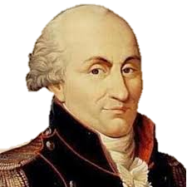
Charges
Unit Coulomb (C)
10⁻⁶ C= 1 μC
Dimensional Formula [M⁰L⁰T¹I¹]

Slide 6
Charges

Slide 7
Charges
+1 C
-1 C
+2 C
+3 C
+2 C
+1 C
Q= q1+q2+q3+…

Slide 8
Charges
Electron
Proton
|e|= 1.6 X10⁻¹⁹C

Slide 9
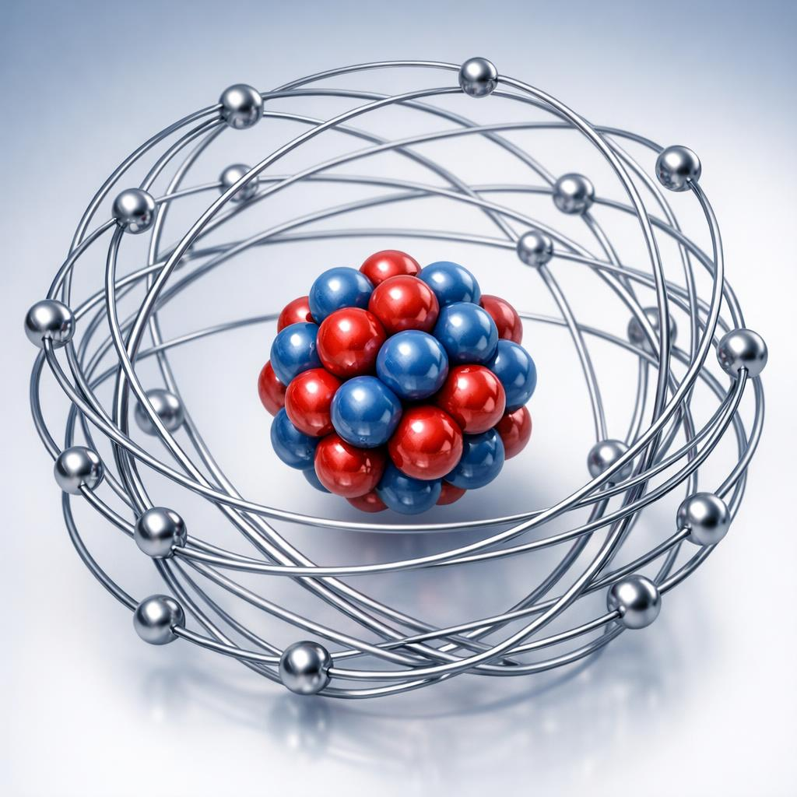
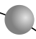
Charges
Proton
Electron
Neutron
Notes:
What you see on the Screen is a Bohr Atom model.In bohr atom model, entire mass and totalpositivechargeis concentrated at the centre , called nucleous . The nucleousconsist of Protons and neutrons.
Electrons are revolving around nucleusin certain definite paths called orbits
The protons are positive,electrons are negative and neutrons are neutral.
the toal number

Slide 10
Charge
Fundamental Property
Interact
Additive
Quantised
Conserved
Like Repel
Unlike Attract
Algebraic sum of charges
Integral multiple of fundamental packet
Total charge of an isolated sysm remains constan
Notes:
Now lets conclude what so far discussed about charges

Slide 11
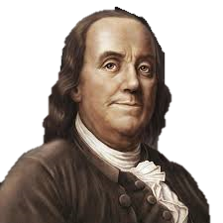
Tribo Electric Series (Not in Syllabus)
Human Hands, Skin
Asbestos
Rabbit Fur
Glass
Human Hair
Nylon
Wool
Silk
Aluminum
Paper
Cotton
Steel
Wood
Amber
Rubber Balloon
Nickel
Copper
Silver
Polyester
Celluloid
Orlon, Acrylic
Cellophane Tape
Polyurethane
Polypropylene
Polyvinylchloride (Vinyl)
Benjamin Franklin

Slide 12
Classification of Materials
Conductors
Insulators

Slide 13
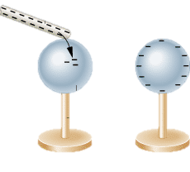
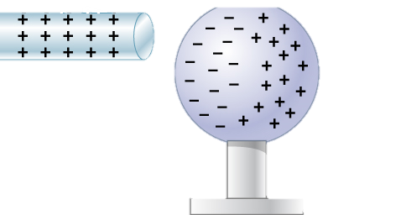
Methods of Charging
Charging By Friction
Charging By Conduction
Charging By Induction

