Slide 1
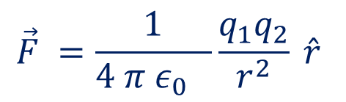
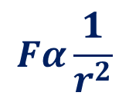
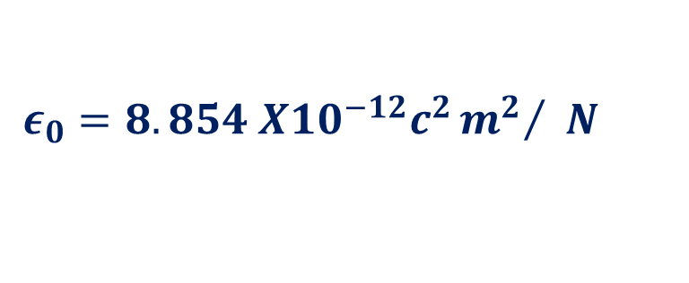
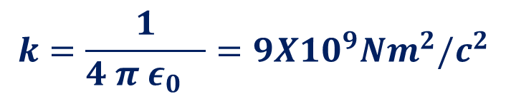

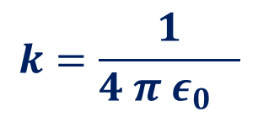
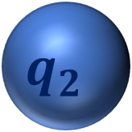
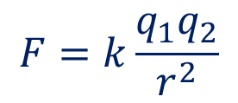
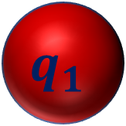
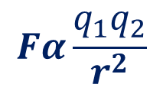
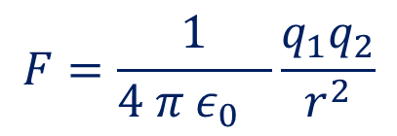
Coulomb’s law
r
Coulomb's law states that, the force of interaction between any two charges is directly proportional to the product of their charges and inversely proportional to the square of the distance between them
$$q_{1}$$
$$q_{2}$$
$$Fα\frac{1}{r^{2}}$$
$$Fα q_{1}q_{2}$$
$$k=\frac{1}{4 π ε_{0} }$$
$$Fα\frac{q_{1}q_{2}}{r^{2}}$$
$$ε_{0}=8.854 X10^{−12}c^{2}{m^{2}}/ N$$
$$F=k\frac{q_{1}q_{2}}{r^{2}}$$
Permittivity of free space
$$k=\frac{1}{4 π ε_{0} }=9X10^{9}Nm^{2}/c^{2}$$
$$F=\frac{1}{4 π ε_{0} }\frac{q_{1}q_{2}}{r^{2}}$$
$$\vec{F} =\frac{1}{4 π ε_{0} }\frac{q_{1}q_{2}}{r^{2}} \hat{r}$$

Slide 2
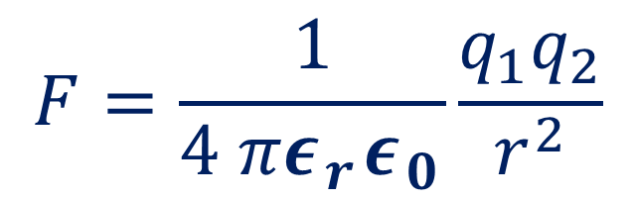

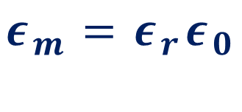
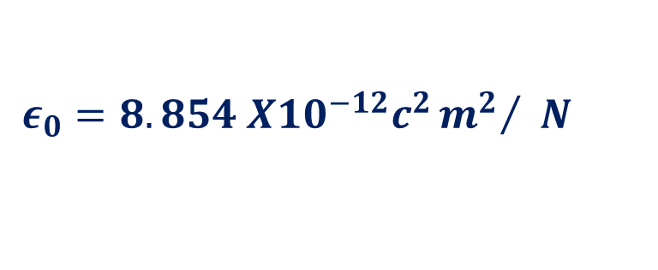
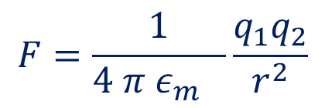

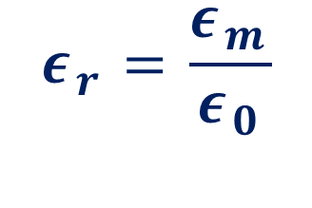
Permittivity of free space
$$ε_{0}=8.854 X10^{−12}c^{2}{m^{2}}/ N$$
$$ε_{m}=Permitivity of Medium$$
$$F=\frac{1}{4 π ε_{m} }\frac{q_{1}q_{2}}{r^{2}}$$
$$Relative Permittivity$$
$$ε_{r}=\frac{ε_{m}}{ε_{0}}$$
$$ε_{m}=ε_{r}ε_{0}$$
$$F=\frac{1}{4 πε_{r}ε_{0}}\frac{q_{1}q_{2}}{r^{2}}$$

Slide 3
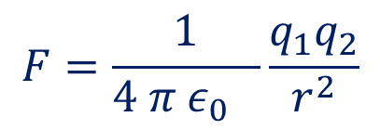
r
q1
q2
$$F=\frac{1}{4 π ε_{0} }\frac{q_{1}q_{2}}{r^{2}}$$
Same kind repel while opposite kind attract
Central Force
Long Range Force
Inverse square law
Conservative Force
Superposition Principle

Slide 4

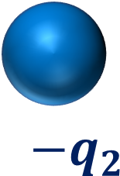

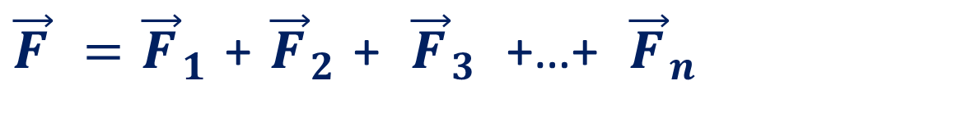

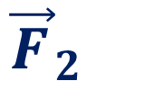
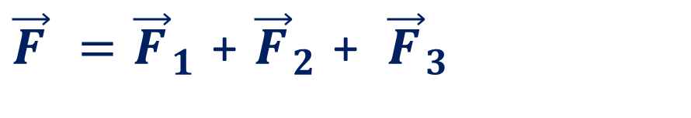

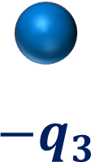


${−q}_{3}$
$${{\vec{F}}_{123}}_{}$$
$${{\vec{F}}_{3}}_{}$$
$${{\vec{F}}_{1}}_{}$$
$${{\vec{F}}_{2}}_{}$$
$${−q}_{2}$$
$$q_{1}$$
Q
$${{\vec{F}}_{12}}_{}$$
${\vec{F}}_{12 }=$ ${\vec{F}}_{1 }$+ ${\vec{F}}_{2 }$
${\vec{F}}_{ }=$ ${\vec{F}}_{1 }$+ ${\vec{F}}_{2 }$+ ${\vec{F}}_{3 }$ +…+ ${\vec{F}}_{n }$
${\vec{F}}_{ }=$ ${\vec{F}}_{1 }$+ ${\vec{F}}_{2 }$+ ${\vec{F}}_{3 }$

Slide 5
r
q1
q2
Same kind repel while opposite kind attract
Central Force
Long Range Force
Inverse square law
Conservative Force
Obeys Superposition Principle

